Slide 1
Protected Information / GT-D pre and post the REC
December 2021

Slide 2
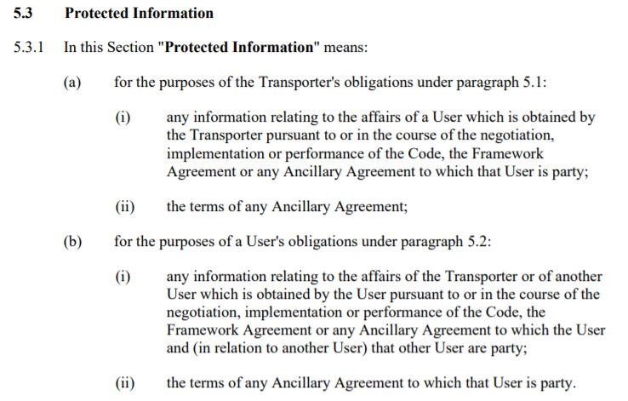
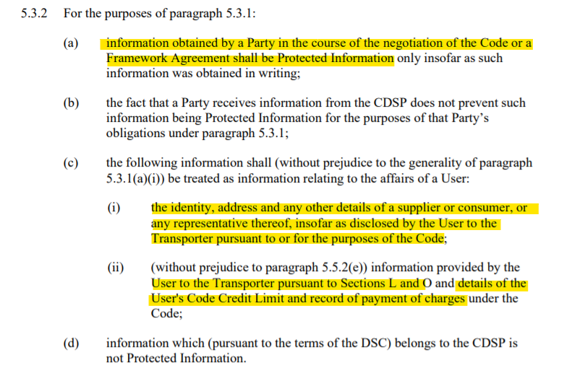
Background
Protected Information is defined in UNC TPD V
Mod 0649S created the Data Permissions Matrix – which sets out the data that the CDSP is entitled to release to parties (currently in TPD V)
Amended by 0697S to remove reference to specific services and also rationalise instances where the Code described release of data to third parties
Lots of information (see highlighted text for example data) is classed as Protected Information – not just the data in the DPM
Where a Code / Licence obligation exists to provide the information to a party this has not needed to be added to the DPM

Slide 3
Data post REC v3 - Parties
Ofgem position:
Following implementation of REC v3, then access to data for DSC Core Customers (Shippers and Transporters) when in their portfolio (including for periods of ownership historically) will continue under UNC / DSC post REC v3.
If obligations exist in UNC / Licence that requires a UNC party to access data linked to Supply Meter Points not within their portfolio, then this data may also continue to be released under DSC.
Otherwise, access to data will transfer to REC governance
REC have created the Data Access Matrix (DAM) which follows the principles of the DPM

Slide 4
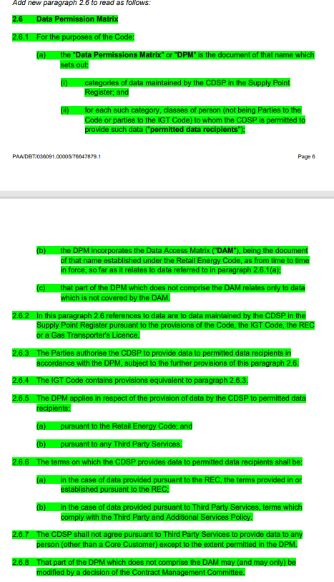
Post REC v3
As part of the SCR it is proposed to move the DPM references from V to GT-D
March 2021 SCR UNC drafting proposes that the DPM will refer to the DAM to assess whether data can be released
This MAY be true in some instances – e.g. parties who are common to both the DPM and the DAM… so it may be a practical way of achieving this but to what extent do we want to include this in the UNC itself
Following consideration, the Code should be silent on the interaction between the DAM and DPM

Slide 5
DPM post REC v3 - Parties
Construction of DPM post REC v3
Majority of data requests are for retail (at a MP level) data, rather than wholesale data, therefore expect that the majority of parties can be removed from the DPM
Some parties do / could have a wholesale use case (Research Bodies / Local Authorities) so we would propose to retain these parties in the DPM
Where a wholesale use case is not envisaged currently should we remove the parties from the DPM, or should they be retained in the DPM / DPM Conditionality Document structure in any way?
The need to have a Code Mod to add a party to the DPM is removed from REC v3, so they can be re-instated relatively easily if required but we would need to agree the process for doing so
View of the DPM excluding DSC Core Customers – blue shading proposed DAM & DPM parties; yellow: DPM only?

Slide 6
DPM post REC v3 - Parties
Some other points to consider:
Performance Assurance Framework Administrator – should this also be retained in the DPM? So access to data for the PAFA to perform tasks under the UNC is retained in the UNC / DSC as currently?
Community View DSC Core Customers – does this move to the DAM?
Assume any obligations would not be documented in the DPM – so this would be fine.

Slide 7
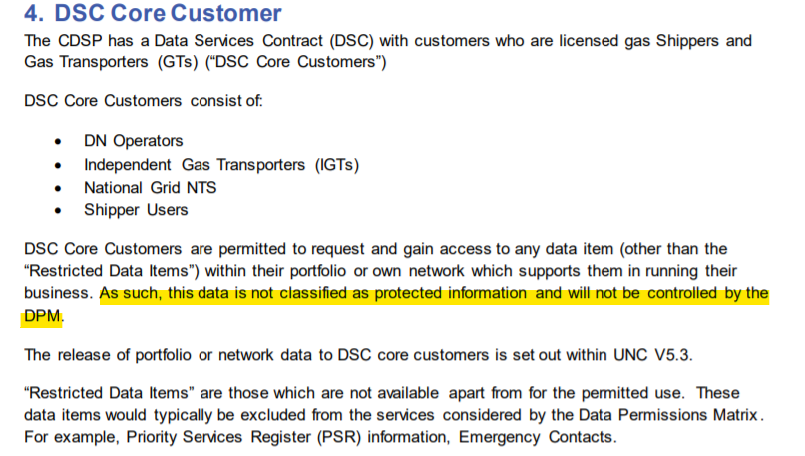
Some Observations to consider now
The DPM has historically included portfolio Shipper and Transporters, which is not necessary
DPM Conditionality highlights that DPM does not determine whether data can be released to Shippers or Transporters
Should we now remove such parties from the DPM when they are the Portfolio User / Transporter?
If so, suggest that the statement from DPM Conditionality Document is retained.

Slide 8
Questions arising during Development
Views?
Other follow on actions?

