Slide 1
Change Management Committee
11th May 2022

Slide 2
Section 2: DSC Change Budget & Horizon Planning

Slide 3
DSC Change Budget 21/22 Financial Year End

Slide 4
FYE Budget v Committed Spend BP21/22
21/22 Committed Spend
Total 75%
Shippers 67
DNs 100%
IGTs 17%
NTS 28%
Full view of budget here

Slide 5
Change Pipeline

Slide 6
Change Development & Delivery Pipeline (DSC Change / Minor Release Budget)
* Pre-capture may contain changes that won’t require delivery / funding

Slide 7
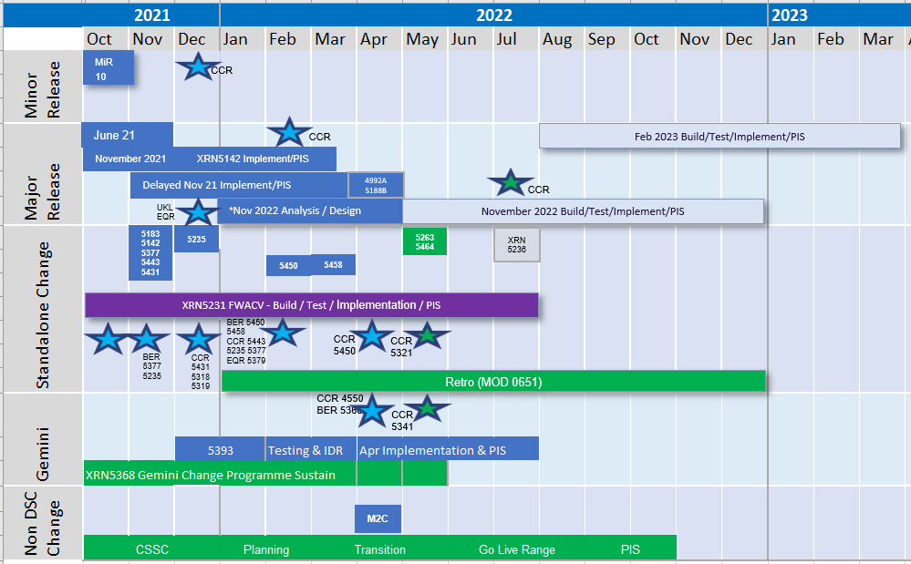
2021-2022 DSC Change / MiR Pipeline
Key:
Approval on track
Approved
Approval at risk
Key:
On Track
Potential Activity
Complete
Potential risk to plan
Plan At Risk
Planning

Slide 8
Section 3: Capture

Slide 9
New Change Proposals
For Approval
XRN5469 - Increasing Frequency of FSG Payments
For Information
XRN5505 – Amendments to v24 of the Service Description Table

Slide 10
XRN5469 - Increasing Frequency of FSG Payments
Customer Class | Voting Party?
Shipper | X
Distribution Network Operators (DNOs) | X
National Grid Transmission
IGT’s
Change Description
We wish to explore potential changes to increasing the frequency of FSG payments and would request that Xoserve assess options to facilitate this requirement; for Cadent only and, for all DNs. This is to ensure the DNs will meet their FSG Licence obligations during gas supply interruption events (including extended outage periods) and, increased customer satisfaction.
DSC Service Area: | Service Area 10 - Invoicing Customers
Link to Change Proposal | Link to CP
Change Type | Regulatory
Priority Score | N/A
Sponsor Representative | Xoserve

Slide 11
XRN5505 – Amendments to v24 of the Service Description Table
Customer Class | Voting Party?
Shipper | N/A
Distribution Network Operators (DNOs) | N/A
National Grid Transmission | N/A
IGT’s | N/A
This will be presented for approval at CoMC on 18th May.
Change Description
This change is to seek approval for the inclusion of a number of new service lines to the DSC Service Description Table. Wording to be updated once all REC related service lines that are to be amended have been identified.
DSC Service Area: | N/A
Link to Change Proposal | Link to CP
Change Type | Documentation
Priority Score | N/A
Sponsor Representative | Xoserve

Slide 12
section 4. Design & Delivery

Slide 13
Design Change Pack
XRN4978 - Notification of Rolling AQ value
XRN4990 - Transfer of Sites with Low Read Submission Performance -MOD0664
XRN5298 H100 Fife Project Phase 1
CSSC - GES Online Portal REL Address Display Order
CSSC - Transition and Cutover BRD

Slide 14
XRN4978 - Notification of Rolling AQ value
Detailed Design Consultation Summary
Change Pack Ref | Funding | Voting | Release | Link to CP | Representation Summary
 |  |  |  |  | Approve | Defer | Reject
3015.1 - RT - PO | Service Area 2 100% Shipper | Shipper | Proposed Nov 22 | CP
Organisation | Status | Comments
Centrica |  | Currently we receive the NRL files around the 23/24th of the month. Not sure if SAP is setup to process NRLs daily or only once a month. If they are going to send us Delta NRLs there could be a need to change SAP Schedules to work daily. Plus it looks like they are not including the full sent of Groups in the delta file. Might also require changes to the NRL code?

Slide 15
XRN4990 - Transfer of Sites with Low Read Submission Performance - MOD0664
Detailed Design Consultation Summary
Change Pack Ref | Funding | Voting | Release | Link to CP | Representation Summary
 |  |  |  |  | Approve | Defer | Reject
3015.2 - RT - PO | Service Area 3 90% Shipper, 10% DNO | Shipper | Proposed Nov 22 | CP | 1
Organisation | Status | Comments
EDF | Approve | In the supply point read benchmarks - if one is not hit for example aggregate is not met but individual is met, would all of the MPRNs in the aggregate be moved class irrespective of individual MPRNs hitting their target measures? Could we have some further clarification on the benchmarks please?
Centrica |  | Please clarify, does a site need to be Class 2 or 3 for a full calendar month before being considered for performance? For example, Supply Point is class changed to Class 3 mid January, the first 3 months of performance to be considered will be February, March, April? It also states that the CDSP will halt Class change activity to Class 2 or 3 after the 20th business day. Please confirm, if a Supply Point has to be effective for a full month to be considered in performance (as with other DDP reporting, has to be a full month to be considered for performance) Class 2 sites have D+5 days to submit actuals read. However, in this modification Class 2 sites have a failure after D+1, This is not acceptable as it will impact sites with intermittent comms that submit actual reads within the UNC specified D+5. The lack of transparency for service cost for the CDSP to move sites is not acceptable. There is no indication on price; Please confirm the difference in approach. Please confirm why we should not move them using DDP reports for other admin charges, like changing monthly read frequency as per MOD 0692

Slide 16
XRN5298 H100 Fife Project Phase 1
Detailed Design Consultation Summary
Change Pack Ref | Funding | Voting | Release | Link to CP | Representation Summary
 |  |  |  |  | Approve | Defer | Reject
3015.3 - RT - PO | Decarb investment budget | Shipper, DNO | Proposed Nov 22 | CP | 1
Organisation | Status | Comments
Wales & West | Approve | We support this change as it advances the use of Hydrogen in networks and works towards net zero targets.

Slide 17
GES Online Portal REL Address Display Order
Detailed Design Consultation Summary
Change Pack Ref | Funding | Voting | Release | Representation Summary
 |  |  |  | Approve | Defer | Reject
3016.1 – RT - PO | CSSC | Shipper | CSSC Implementation Date - 18th July 2022
Org | Status | Comments
 |  | No Reps Received

Slide 18
Transition and Cutover BRD
Detailed Design Consultation Summary
Change Pack Ref | Funding | Voting | Release | Representation Summary
 |  |  |  | Approve | Defer | Reject
3016.2 – RT - PO | CSSC | Shipper, DNO | CSS Implementation Date -18th July 2022
Org | Status | Comments
 |  | No Reps Received

Slide 19
Standalone Change Documents for Approval (BER, CCR, EQR)
CCR for XRN5341 - UNC745 - Mandatory Setting of Auction Bid Parameters
Voting NTS
CCR for XRN5321 - PAC Ring-Fenced DSC Change Budget 21/22
Voting Shippers, IGTs and DNOs

Slide 20
Move to Cloud Programme Update
Verbal Update to be presented by Dave Jones

Slide 21
December 21 - April 22 Changes in Design Update

Slide 22
Dec 21 - April 22 Changes in Design – Shipper Status Update
XRN Title | Target Detailed Design Date | Risk & Issues / RAG | Cost RAG | Key Messaging
XRN4978 - Notification of Rolling AQ Value (following Transfer of Ownership between M-5 and M) | April 2022 – Consultation​ May 2022 - Approval |  |  | Change Pack issued to ChMC for consultation on 19/04/22
XRN4990 - Transfer of Sites with Low Read Submission Performance from Class 2 and 3 into Class 4 (MOD0664) | April 2022 – Consultation​ ​ May 2022 - Approval |  |  | Change Pack issued to ChMC for consultation on 19/04/22
XRN4992B - Modification 0687 Clarification of Supplier of Last Resort (SoLR) Cost Recovery Process | May 2022 – Consultation​ ​June 2022 - Approval | Risk ID 67431: There is a risk that a MOD may be raised to include IGT sites into SoLR charging. This will cause a scope change and as different charge rates will be required for IGT sites; unknown impact to design. Mitigation: Accept risk. Design will be completed as per the current scope and issued for consultation in May 2022 and will not form part of any Nov22 Release. |  | Change Pack to be issued to ChMC for consultation on 16/05/22
XRN5091 - Deferral of creation of Class change reads at transfer of ownership | May 2022 – Consultation​ ​June 2022 - Approval |  |  | Change Pack to be issued to ChMC for consultation on 16/05/22
XRN5186 - MOD0701 - Aligning Capacity booking under the UNC and arrangements set out in relevant NEXAs | May 2022 – Consultation​ ​June 2022 - Approval |  |  | Change Pack to be issued to ChMC for consultation on 16/05/22
Slide updated on 27th April 2022
Notes:
u

Slide 23
Dec 21 - April 22 Changes in Design – DN Status Update
XRN Title | Target Detailed Design Date | Risk & Issues / RAG | Cost RAG | Key Messaging
XRN4900 - Biomethane/Propane Reduction | May 2022 – Consultation ​June 2022 - Approval | Risk ID 67731: There is a risk that the physical works required on Customer site will not be completed in line with a Nov 22 Release Date. Mitigation: Align to a future release post Nov22 release |  | Change Pack to be issued to ChMC for consultation on 16/05/22
XRN5186 - MOD0701 - Aligning Capacity booking under the UNC and arrangements set out in relevant NEXAs | May 2022 – Consultation​ ​June 2022 - Approval |  |  | Change Pack to be issued to ChMC for consultation on 16/05/22
XRN5298 - H100 Fife Project – Hydrogen Network Trial | April 2022 – Consultation​ ​May 2022 - Approval | Risk ID 67645: There is a risk that the detailed design change pack will not be approved if MOD0799 is still outstanding​ Mitigation: Accept risk. Complete Design. Decision will be taken at ChMC in May whether this will be taken into delivery for Nov22. Risk ID 67482: There is a risk that the CV range will not be updated for hydrogen because a change is required to Gemini leading to the CV for hydrogen being rejected Mitigation: Monitor change request to be raised by SGN and align to implementation release for this change. |  | Change Pack issued to ChMC for consultation on 19/04/22
Slide updated on 27th April 2022

Slide 24
UK Link Major Release Scoping

Slide 25
UK Link Major Release Scoping
May ChMC: Decision required on Scope
November 22 Major Release | Changes: XRN4978 - Notification of Rolling AQ Value (following Transfer of Ownership between M-5 and M) XRN4990 - Transfer of Sites with Low Read Submission Performance from Class 2 and 3 into Class 4 (MOD0664) XRN5298 - H100 Fife Project – Hydrogen Network Trial
NB: The above takes into account feedback received directly from Constituents to include as many changes in November 22 release as possible rather than include the above in February 23 Release
BER for the above will be submitted to June ChMC for approval
This is currently under review as to whether Minor Release budget can be used to part fund delivery
Also to be presented at June ChMC - Further options on delivery of XRN5186 - MOD0701 - Aligning Capacity booking under the UNC and arrangements set out in relevant NEXAs
Possible delivery of a manual workaround to support June-23 Release or an earlier delivery of the full change
Slide produced 3rd May 2022

Slide 26
November 2021 Major Release

Slide 27
XRN5289 – November 21 Major Release - Status Update
 | Overall Project RAG Status
 | Schedule | Risks and Issues |  | Cost
RAG Status
Status Justification
Schedule | Deferred Changes: Post Implementation Support completed for XRN’s 4941, 5007, 5072 & 5180 to plan Post Implementation Support for XRN4780C on track to complete Data cleanses for XRN’s 4941 & 5007 complete, adjustments for XRN5072 applied and in final verification XRN4992a: Implemented as planned on 23/04 In Post Implementation Support, progressing to plan XRN5188b: Implemented as planned on 23/04 In Post Implementation Support, progressing to plan MAP ID data interim load to be completed during Post Implementation Support period CCR to be presented in July ChMC Decision in May ChMC: None |  | XRN5289
Risks and Issues | None
Cost | Forecast to complete delivery against approved BER
Scope | In Scope - XRN4941 - MOD0692 - Auto updates to meter read frequency In scope - XRN5007 - Enhancement to reconciliation process where prevailing volume is zero​ In Scope - XRN5072 - Application and derivation of TTZ indicator and calculation of volume and energy – all classes​ In Scope - XRN5142 - New allowable values for DCC Service Flag in DXI File from DCC​ In Scope - XRN5180 - Inner tolerance validation for replacement reads and read insertions​ In Scope - XRN4780C – Inclusion of Meter Asset Provider Identity (MAP Id) in the UK Link system (CSS Consequential Change) In Scope - XRN4992a - Modification 0687 Clarification of Supplier of Last Resort (SoLR) Cost Recovery Process In Scope - XRN5188b - Interim Data Loads of MAP Id into UK Link Descoped - XRN5091 - Deferral of creation of Class change reads at transfer of ownership​ Descoped - XRN5186 MOD0701 – Aligning capacity booking under the UNC and arrangements set out in relevant NExAs​ Descoped - XRN5187 MOD0696 – Addressing inequalities between capacity booking under the UNC and arrangements set out in the relevant NExAs
Complete
On Track
At Risk
Overdue
Not Baselined
Slide updated on 25th April 2022

Slide 28
XRN5231 Flow Weighted Average CV

Slide 29
XRN5231 Flow Weighted Average CV
May 22 ChMC Dashboard |  | Overall Project RAG Status
 |  | Schedule | Risks and Issues |  | Cost
RAG Status
Status Justification
Schedule | Overall RAG status is tracking at purple. Project is in re-plan due to the issue that 1st April 22 implementation date was not met. The project has continued with its planned activities alongside the replan for the FWACV service & Gemini consequential changes. Several clarifications are still being discussed in conjunction with Xoserve & Customers alongside the Change Pack. Change Pack consultation closed on 28/03; review of reps completed, and this will be submitted for approval at the April ChMC to rebaseline the scope, plan and BER of the project. UAT continues to make progress with the assurance of test cases not impacted by scope change. Blocked test cases will be completed as part of the replan Dual Run Phase 2 commenced but lack of full DN connectivity to provide daily files is now causing an issue for having the files/data to validate to the existing NG service. Only NG & NGN are fully connected with NGN providing the required daily files. Issue raised at the Focus Group on 29/03. This is now an issue as the phase 2 plan is not giving the confidence planned, though testing will commence with 2 connected shippers and progress monitored Re-plan in progress to include full impact assessment. Revised supplier costs received and in review. MTB cost assessment of the additional requirements to support manual processes are drafted and are being assessed to confirm MTB uplift required. Gemini consequential changes assessment defined and is part of the re-plan and revised BER Business Readiness and Service Transition work continues as per the plan Risk of FWACV Imp to CSSC assessment completed and confirmed that no risk to CSSC Transition & Cutover plans if implemented in June 2022 Next Steps: Finalise full re-plan from the changes to scope and requirements to define the revised plan and BER Continue Cutover & Transition scenarios with NG and DNs to define scope, plan and acceptance criteria Outstanding DNs to complete End To End connectivity to provide daily files to remove issue with DR/MT plan Continue with UAT assurance, DR/MT and Business Change planned activities Revised BER from re-plan to be approved at an extraordinary ChMC (to be agreed) | Overall RAG status is tracking at Purple as project is now in re-planning phase due to the position that we will not be able to implement by 1st April 22. The project has continued with its planned activities alongside the replan. To support the re-plan activity the project is conducting a Gap Analysis exercise on the defined requirements to ensure we have a baselined position for Day 1 Implementation. An Impact Assessment will then be conducted against the change variations to support the re-plan activity UAT execution and assurance is in progress, revised completion date to be confirmed as part of re-plan Dual Run Preparation continues with Connectivity Testing and Master Data Readiness. Resolution of the Master Data Issue is a significant step forward to support Dual Run Testing and Data Migration approach for cutover Re-planning to be completed post completion of Gap Analysis activity with the intention to agree revised plan in March and present updated BER for approval at April ChMC Next Steps: Finalise Gap Analysis exercise with DNs and National Grid to agree Day 1 Must Have requirements & any decisions in order to meet a proposed Go Live date (Mid June 22) Define full re-plan based on Gap Analysis Impact Assessment and Business Readiness requirements Target to issue revised BER from replan for approval at the April 22 ChMC Risk of FWACV Imp to CSSC is in assessment, this is deemed low risk as there is no code conflict |  | Replan in progress to finalise the revised dates of the project. The project continues to progress key phases/activities (eg UAT assurance, DR/MT, Business Change (inc External Training) and Cutover & Transition planning)
Risks and Issues | There is an issue that NG and DNs do not understand the consequential changes with the removal of the FWACV service from NG and the impact to existing business processes – Update – Action for NG & DNs to review the consequences of the FWACV service moving from NG to Xoserve. This is key to understand any impacts to business/system processes as part of individual organisation Business Readiness plans There is a risk that changes to the approved scope and requirements and subsequent replan may put at risk a Mid June 2022 Go Live of the new Xoserve service – Update – Replan in progress There is an issue with Dual Run/Market Trials phase that only 1 DN is fully connected to provide daily files, this is now causing an issue with transactional date being out of synch due to only 1 DNs providing daily files to compare to NGs service running in production – Update – Continued engagement to work through connectivity is being progressed with impacted DNs and NG to provide support. Phase 2 to progress with 2 connected shippers There is a risk that changes to the baselined scope and requirements will increase the costs of the new FWACV service in extending the project and manual process being identified – Update – The impact assessment to define the re-plan and revised business case is in progress to conclude the revised BER for review & approval with customers | The dependencies for NG to provide Master data and DNs connectivity details for Dual Run/MT have not been provided as per the plan defined in the approach leading to a delay to this phase of testing Update: A plan was defined to mitigate this issue through validating and cross-checking data with National Grid and Distribution Networks (DNs). Plan is nearing completion with final checks now being completed by DNs. Issue to be closed once Data loaded to testing environment The Project is not able to meet its planned Implementation Date of 1st April due to delays to the start of Dual Run, volume of parallel activity required prior to the planned implementation and identification of gaps in the As Is and To Be processes that could lead to further changes to approved solution Update: The project is carrying out a re-plan activity with the priority being to complete Analysis on approved scope/processes to confirm Day 1 must have requirements. The plan and activities has been agreed with Xoserve, NG and DNs on 22/02 and the activities are tracking to plan
Cost | Forecast costs tracking to approved BER costs at present. Revised plan options will lead to updated costs which will be agreed in a revised BER for review & approval | Forecast costs tracking to approved BER costs at present. Revised plan options will require a full cost assessment to be completed on the replan position for Day 1
Scope | XRN5231 Flow Weighted Average (CV) – Change to scope and requirements in impact assessment Gemini consequential change parts A & B - A - PRCMS validation/processing & Part B - LDZ Stock Change and Embedded LDZ Unique Sites | XRN5231 Flow Weighted Average (CV) Gemini consequential change part A - PRCMS validation/processing Gemini consequential change part B - LDZ Stock Change and Embedded LDZ Unique Sites

Slide 30
NG TRANSMISSION CHANGE HORIZON PLAN 0 - 2 YEARS MAR 2022 – MAR 2024
May 2022

Slide 31
NG TRANSMISSION CHANGE HORIZON PLAN 0-2 YEARS APR 2022 – MAR 2024
Programmes & Projects 2022-2024 |  |  |  | 2022 |  |  |  |  |  |  |  |  | 2023 | 2023
 |  |  |  | Apr | May | Jun | July | Aug | Sept | Oct | Nov | Dec | Jan | Feb | Mar
MAJOR RELEASES | Regulatory / Customer Requested Change | PM Matthew Rider | XRN5393 Gemini Spring 22 Release
 | UK Link Consequential Changes | PM Hannah Reddy | XRN5231 Flow Weighted Average CV FWACV
 | Gemini Change Programme Sustain | PM Emma Catton | XRN5368.2 Single Sign on Experience
 |  |  | XRN5368.3 API Enhancements
 |  |  | XRN5368.5 Site Minder Upgrade
PIS – From Apr 22 to Jun 22
Go Live
30th Jun
Design to PIS - Nov 21 to Jul 22
KEY RISK & % = Certainty of Scope
 | Approved on Track
 | Approved
 | Approval at Risk
 | Change Completion Report
 | External User Activity
Go Live
29th May
Contingency
12th Jun
Design to PIS – Sept 21 to June 22
Go Live
6th May
API - Design to PIS – Jan 22 to May 22
Go Live
8th May
Prod ChG 1
Go Live
18th May
Prod ChG 2
KEY – Project Status
On Track
Complete
Potential Risk to Plan
Plan at Risk
Design to PIS -Dec 21 to June 22
Notes:
XRN5393 – Gemini Spring 22 Release - RFC
CHG0033706 - Go Live 25/02 - UNC785 - Aggregate Bacton Exit Points - Part A (Operational)
CHG0033667 - Contingency 27/02 - UNC785 - Aggregate Bacton Exit Points - Part A (Operational)
CHG0033668 - Go Live 03/04 - UNC785 - Aggregate Bacton Exit Points - Part B (Charging Theory)
CHG0033767 - Contingency 10/04 - UNC785 - Aggregate Bacton Exit Points - Part B (Charging Theory
XRN5231 - Flow Weighted Average - RFC
CHG0033749 – Go Live 30/06 - Flow weighted Average CV Calculation
XRN5368.2 - Single Sign on Experience - RFC
CHG0033809 – Go Live 29/05 - SSO/MFA /SSPR
CHG0033828 – Contingency 12/06 - SSO/MFA /SSPR - Placeholder
XRN5368.3 - API Enhancements - RFC
CHG0033766 Go Live 10/04 - Azure APIM API’s over the internet - TBC
XRN5368.1 - Control M and Batch Processing - RFC
CHG0033808 Go Live 01/03 - Deletion & Housekeeping
CHG0033810 Go Live 15/03 - Deletion & Housekeeping
XRN5368.5 - Site Minder Upgrade - RFC
CHG0033777 - Siteminder upgrade - Prod change 1
CHG0033778 - Siteminder upgrade - Prod change 2 - Log4j re-fix.

Slide 32
Section 5: Non-DSC Change Budget Impacting Programmes

Slide 33
CSSC Programme Dashboard
May 2022

Slide 34
Programme Health – RAG
Overall Programme Status | Previous | Current | The programme is reflective of a Green Status Programme activities continue to track to plan. Predominant activities include Transition Stage 2 implementation, Business Change and Post Implementation Support activities. Test activities continue for PT and OAT.
Programme Plan | Previous | Current
Risk Profile | Previous | Current
Resources | Previous | Current
Executive Summary |  |  |  | Upcoming Activities & Milestones (Next Month)
Potential Mismatch Between CSS & UK Link & Gemini We continue discussions with the central Programme around Cr-D129. This CR has been presented to the Ofgem Design Workgroup and will be progressed as a Post Programme CR to be implemented as part of a REC release following monitoring of systems during PIS. We are raising a new CR to obtain the ability to request the re-send of a secured active message. It has been confirmed by the Central Programme that this CR will be a REC Change CR. Transition Stage 2 Transition Stage 2 implements this bank holiday weekend (30th April – 2nd May). This implementation will see four API’s productionised between ourselves and the CSSP (Landmark). The four API’s are: RMP Data Meter Asset Provider Alliance Data REL Data Transition Stage 2 also includes the catch up of data since the bulk load to the CSSP six weeks ago. The flow of data between the two Organisations commences on Monday 2nd May at which point the API’s will have been implemented and productionised and the delta data will be issued. Our delta updates amount to 800,000 data changes which will be updated in the CSSP during this delta catch up. |  |  |  | Transition Stage 2 implementation, including Go/No Activities Refinement of Transition Stage 3 Activities Continue OAT and PT Testing Continued Business change activities which includes new operating model Continued Post Implementation Support Activities
e

Slide 35
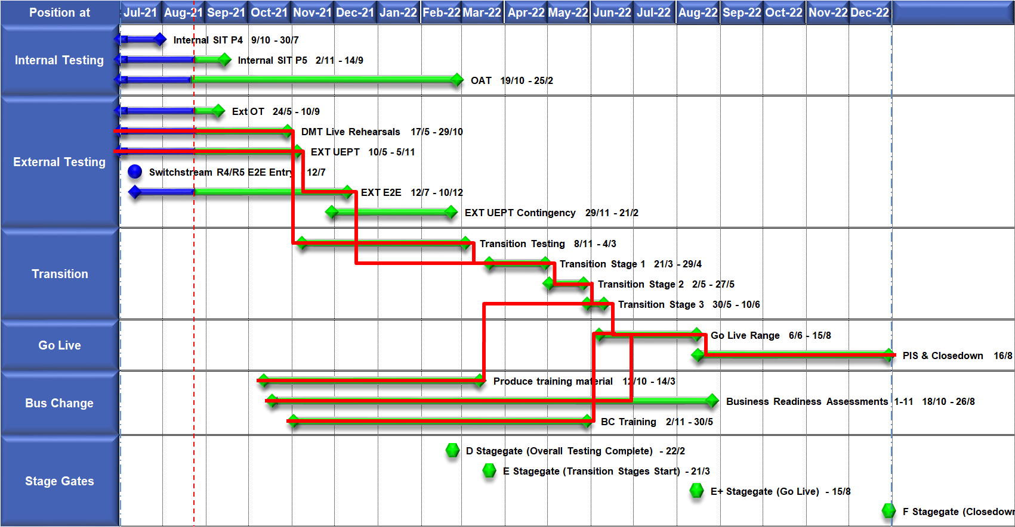
High Level Plan

Slide 36
CMS Rebuild May Update
Update

Slide 37
Progress to Date
The CMS Rebuild Team continue to build out the foundations of the new CMS and the Shipper raised MNC (Meter Number Creation) Process.
Work also continues defining the requirements for the Supplier Theft of Gas process.
The first Customer Focus Group took place on 06/04/22 which yielded some great conversations and suggestions on the proposed User Interface which have been taken on board and the minutes can be found: https://www.xoserve.com/products-services/data-products/contact-management-service-cms/cms-rebuild-product/.
The CMS Rebuild website is now live with the ability to book onto future CMS Customer Focus Groups, of which the remaining dates are:
The Address amendment (ADD) and Unconfirmed Address Amendment (UNC) have been identified of potential candidates for Release 1 delivery based on the number of similarities with the MNC process.
As a reminder the delivery will follow an Agile Framework, there is an option to deliver a Minimum Viable Product (MVP) initially with future releases improving the end-to-end functionality of that process.
Further updates will be provided in June ChMC.
Date | Time Start | Time end
10/06/2022 | 10:00 | 11:00
06/07/2022 | 10:00 | 12:00
09/08/2022 | 10:00 | 12:00
09/09/2022 | 10:00 | 12:00
14/10/2022 | 10:00 | 12:00
08/11/2022 | 10:00 | 12:00
09/12/2022 | 10:00 | 12:00
10/01/2023 | 10:00 | 12:00
07/02/2023 | 10:00 | 12:00
07/03/2023 | 10:00 | 12:00

Slide 38
Section 6: AnY Other Business

Slide 39
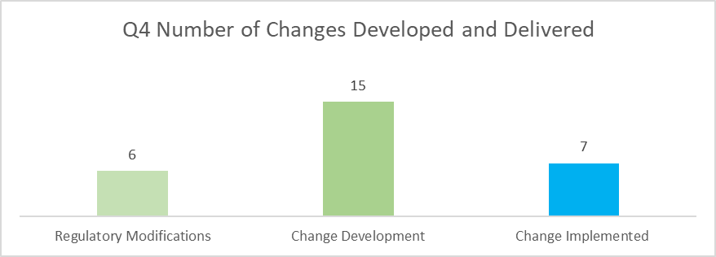
KVI Customer Change Survey
We would like to request your feedback on our Change Management performance
The scope of your feedback should include changes that we have developed and delivered for DSC customers within the last quarter. As a reminder, please see below a summary of the changes we have supported our customers in developing and delivering during this period;
Full Details
You can give your feedback through this Survey

Slide 40
APPENDIX

Slide 41
Portfolio POAP

Slide 42
Outages
Change Request Number | Impacted System | Outage Duration |  |  |  |  | Committee Notified Date
 |  | Start Date | Start Time | End Date | End Time | Brief Description
XRN 5339 | EFT | 21/05/2022 | TBC | 22/05/2022 | TBC | As part the Enhanced File Transfer (EFT) project we will conduct Disaster Recovery (DR) testing. The EFT DR test will prove and confirm the procedures, resilience and capability of the newly upgrade EFT. As EFT is a multiple site application we will have failed over, then failed back one site on the previous week, to complete the DR testing this weekend we will DR test the remaining site. Please be aware that the EFT DR Contingency Dates will be carried out on the following weekend. Any files that would be processed by EFT during this window will remain safely in their respective Folders, once EFT is back online, all file transfers will be synced and issued. | 24/03/2022
XRN 5301 | UKLink Portal | 18/06/2022 | 09:00 | 20/06/2022 | 07:00 | As part of the UK Link move to Cloud Programme, an extended outage will be required to complete implementation and cutover activities for the new DES & Portal screens. These systems will be unavailable for use from 7th May 09:00 to 9th May 2022 7:00. | 09/02/2022
CHG0033559 | Gemini | 04/06/2022 | 03:15 | 04/06/2022 | 07:30 | Gemini Disaster Recovery Test 2022 This is an annual activity to confirm Gemini services can be migrated to a secondary data centre location should there be a catastrophic failure within the primary data centre. During this phase of the test Gemini services will failover from the primary site to the secondary site. The activity starts within the scheduled maintenance window and the system will operate normally during times where there is no outage. | 13/04/2022
CHG0033559 | Gemini | 05/06/2022 | 03:00 | 05/06/2022 | 07:30 | Gemini Disaster Recovery Test 2022 During this phase of the test Gemini services will failback from the secondary site to the primary site. Again the activity starts within the scheduled maintenance window and the system will operate normally during times where there is no outage. NOTE: Contingency dates for these activities are 18th/19th June | 13/04/2022

