Slide 1
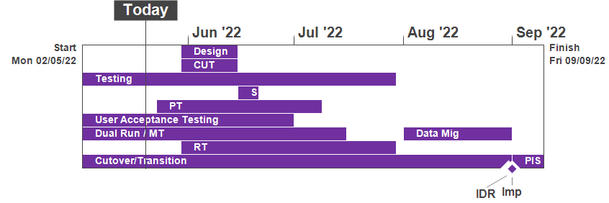
XRN5231 Flow Weighted Average CV
June 22 ChMC Dashboard |  | Overall Project RAG Status
 |  | Schedule | Risks and Issues |  | Cost
RAG Status
Status Justification
Schedule | Overall RAG status is tracking at Red. The 2nd Project replan is in progress to baseline the Lowest CV requirement change. The project has continued with its planned activities alongside the replan for the FWACV service & Gemini consequential changes. DNs have approved the option to automate the Lowest CV requirements; DNs need to confirm their own internal dependencies will support a proposed End of August 22 Go Live Date. UAT for the revised Change Pack is planned for completion 24th May. Performance Testing started 24th May with Regression Testing planning in-flight in readiness to commence as part of the 2nd project replan Dual Run Phase 2 is in progress. SGN has completed full connectivity with engagement continuing for Cadent to complete its connectivity. Daily files are being received from WWU & NGN and the new FWACV service CV calculation largely matches NG’s existing service (MIPI); differences are down to DN data flows Re-plan to be reviewed/baselined: Once DNs confirm support of the dependencies of DR/MT to achieve the acceptance criteria/outcomes to the proposed plan timescales. An assessment of the proposed implementation date will be conducted across the wider CDSP change delivery portfolio The revised Business Case & BER remains draft and requires DN confirmation on the proposed implementation date of the end of August 22; DNs should consider their internal dependencies to support this date Business Readiness/Service Transition planned activities continue to progress (training, End to End Process definition, Service Management readiness etc) Next Steps: Finalise full re-plan once DN readiness is confirmed and define the revised BER for the costs of the project Plan out the revised design, build and test activities (ST, UAT & RT) to support the Lowest CV change Finalise the draft of the Data Migration, Cutover & Transition Scope & Approach (inc the Go No Go Criteria) to review with DN & NG Stakeholders at the Focus Group All DNs to complete End To End connectivity to provide daily files to remove issue with DR/MT plan Continue with UAT assurance, DR/MT and Business Change planned activities Revised BER from re-plan to be approved at an extraordinary ChMC (to be agreed) | Overall RAG status is tracking at Purple as project is now in re-planning phase due to the position that we will not be able to implement by 1st April 22. The project has continued with its planned activities alongside the replan. To support the re-plan activity the project is conducting a Gap Analysis exercise on the defined requirements to ensure we have a baselined position for Day 1 Implementation. An Impact Assessment will then be conducted against the change variations to support the re-plan activity UAT execution and assurance is in progress, revised completion date to be confirmed as part of re-plan Dual Run Preparation continues with Connectivity Testing and Master Data Readiness. Resolution of the Master Data Issue is a significant step forward to support Dual Run Testing and Data Migration approach for cutover Re-planning to be completed post completion of Gap Analysis activity with the intention to agree revised plan in March and present updated BER for approval at April ChMC Next Steps: Finalise Gap Analysis exercise with DNs and National Grid to agree Day 1 Must Have requirements & any decisions in order to meet a proposed Go Live date (Mid June 22) Define full re-plan based on Gap Analysis Impact Assessment and Business Readiness requirements Target to issue revised BER from replan for approval at the April 22 ChMC Risk of FWACV Imp to CSSC is in assessment, this is deemed low risk as there is no code conflict |  | Replan baseline requires DNs’ assurance that key phase milestones for DR/MT and Migration/Transition can be met by all parties. The project continues to progress key phases/activities (eg UAT assurance, DR/MT, Business Change (inc External Training) and Cutover & Transition planning). Plan rebaseline is a dependency to confirm the overall plan, governance (e.g. BER) and confirm the Service Go Live date
Risks and Issues | There is an issue that NG and DNs do not understand the consequential changes arising with transfer of the FWACV service from NG and the impact to existing business processes – Update: Action for NG & DNs to review the consequences of the FWACV service moving from NG to Xoserve, this will be left open to monitor through the Business & Transition phase Business Readiness phase There is a risk that changes to the approved scope and requirements will be identified through the deliver plan – Update: 2nd replan in progress following the Lowest CV requirement change for revised plan to be baselined There is an issue with Dual Run/Market Trials phase that not all DNs are fully connected to provide daily files to progress the approved scope and plan to compare the new FWACV calculation to NGs service running in production – Update: Continued engagement for full connectivity is being progressed with impacted DNs and NG to provide support. Phase 2 to progress with 2 connected shippers There is a risk that changes to the baselined scope and requirements will increase the costs of the new FWACV service in extending the project and manual process being identified – Update: Finalise the impact assessment following the decision on Lowest CV automation to be progressed. The revised plan and business case will be defined for the BER to be review & approved | The dependencies for NG to provide Master data and DNs connectivity details for Dual Run/MT have not been provided as per the plan defined in the approach leading to a delay to this phase of testing Update: A plan was defined to mitigate this issue through validating and cross-checking data with National Grid and Distribution Networks (DNs). Plan is nearing completion with final checks now being completed by DNs. Issue to be closed once Data loaded to testing environment The Project is not able to meet its planned Implementation Date of 1st April due to delays to the start of Dual Run, volume of parallel activity required prior to the planned implementation and identification of gaps in the As Is and To Be processes that could lead to further changes to approved solution Update: The project is carrying out a re-plan activity with the priority being to complete Analysis on approved scope/processes to confirm Day 1 must have requirements. The plan and activities has been agreed with Xoserve, NG and DNs on 22/02 and the activities are tracking to plan
Cost | Revised costs to be presented in an updated BER for review & approval by DNs and National Grid | Forecast costs tracking to approved BER costs at present. Revised plan options will require a full cost assessment to be completed on the replan position for Day 1
Scope | XRN5231 Flow Weighted Average (CV) Gemini consequential change parts A & B - A - PRCMS validation/processing & Part B - LDZ Stock Change and Embedded LDZ Unique Sites | XRN5231 Flow Weighted Average (CV) Gemini consequential change part A - PRCMS validation/processing Gemini consequential change part B - LDZ Stock Change and Embedded LDZ Unique Sites

