Slide 1
CSSC Programme Dashboard
May 2022

Slide 2
Programme Health – RAG
Overall Programme Status | Previous | Current | The programme is reflective of a Green Status Programme activities continue to track to plan. Predominant activities include Transition Stage 2 implementation, Business Change and Post Implementation Support activities. Test activities continue for PT and OAT.
Programme Plan | Previous | Current
Risk Profile | Previous | Current
Resources | Previous | Current
Executive Summary |  |  |  | Upcoming Activities & Milestones (Next Month)
Potential Mismatch Between CSS & UK Link & Gemini We continue discussions with the central Programme around Cr-D129. This CR has been presented to the Ofgem Design Workgroup and will be progressed as a Post Programme CR to be implemented as part of a REC release following monitoring of systems during PIS. We are raising a new CR to obtain the ability to request the re-send of a secured active message. It has been confirmed by the Central Programme that this CR will be a REC Change CR. Transition Stage 2 Transition Stage 2 implements this bank holiday weekend (30th April – 2nd May). This implementation will see four API’s productionised between ourselves and the CSSP (Landmark). The four API’s are: RMP Data Meter Asset Provider Alliance Data REL Data Transition Stage 2 also includes the catch up of data since the bulk load to the CSSP six weeks ago. The flow of data between the two Organisations commences on Monday 2nd May at which point the API’s will have been implemented and productionised and the delta data will be issued. Our delta updates amount to 800,000 data changes which will be updated in the CSSP during this delta catch up. |  |  |  | Transition Stage 2 implementation, including Go/No Activities Refinement of Transition Stage 3 Activities Continue OAT and PT Testing Continued Business change activities which includes new operating model Continued Post Implementation Support Activities
e

Slide 3
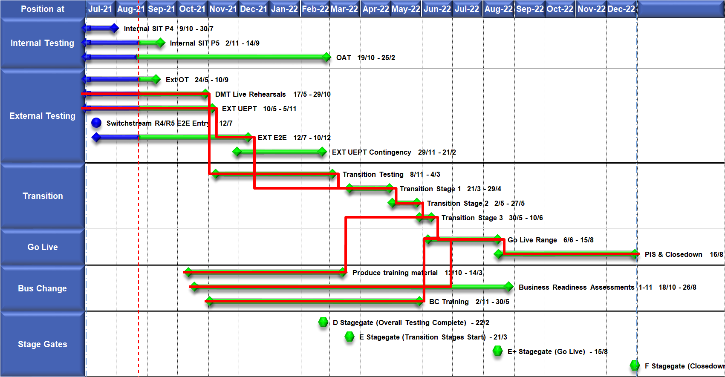
High Level Plan

