Slide 1
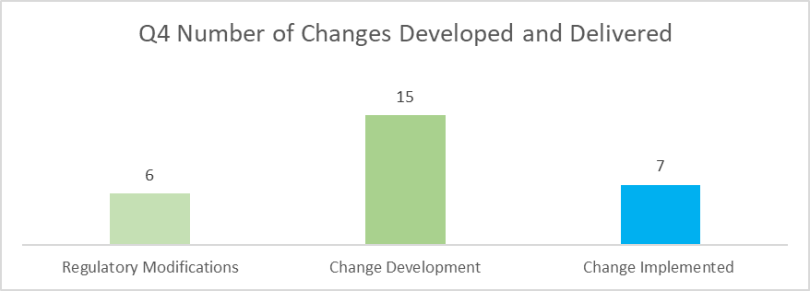
KVI Customer Change Survey
We would like to request your feedback on our Change Management performance
The scope of your feedback should include changes that we have developed and delivered for DSC customers within the last quarter. As a reminder, please see below a summary of the changes we have supported our customers in developing and delivering during this period;
Full Details
You can give your feedback through this Survey

