Slide 1
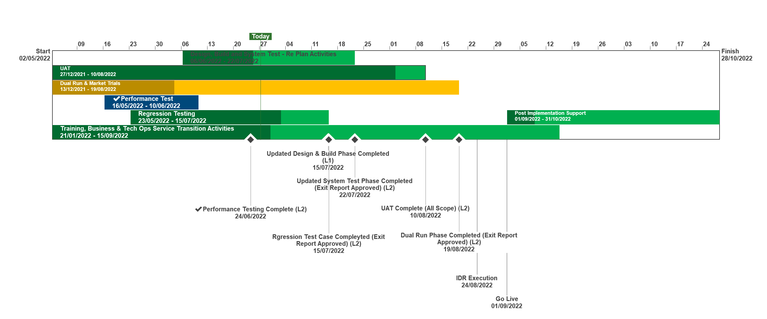
XRN5231 Flow Weighted Average CV
July 22 ChMC Dashboard |  | Overall Project RAG Status
 |  | Schedule | Risks and Issues |  | Cost
RAG Status
Status Justification
Schedule | Overall RAG status is tracking at Amber on basis a revised Go Live date of 1st September 2022 has been agreed, though Dual Run and Market Trials is currently behind plan due to a delay in full connectivity for all DNs. Progress to be closely monitored and decision made in early July, via project checkpoint on whether to progress into full E2E testing for all external parties. Cost set to Red, pending approval of revised BER A revised Go Live date of 1st September has been agreed with a contingency date of 14th September Dual Run/ Market Trials testing continues with all DNs connected. Due to a delay in full connectivity for all parties this phase is currently behind plan. Checkpoint arranged for 4th July on whether to commence full E2E testing to planned timescales A revised Change Pack, with Lowest CV requirement included was presented to project Focus Group on 21st June. To be formally approved in July following Focus Group Sign Off Revised BER to be approved in July following definition of revised plan and agreement on new Go Live date Internal testing phases are progressing to plan. Additional UAT scenarios (for Lowest CV requirement) to be executed and assured in 2nd week of July. Performance Testing and Regression Testing completed to plan. Data Migration (for Cutover), Transition and Cutover approach drafted and under internal review. To be reviewed with Focus Group in the first half of July Go No Go (GONG) criteria has been drafted and will be shared and agreed with Focus Group members in July Internal Business Readiness activities continue to progress to plan Next Steps: Gain approval of revised BER Finalise Data Migration, Cutover and Transition Approach Finalise GONG criteria Progress Dual Run/ Market Trails testing phase, working to completion by end of July Draft and agree detailed Implementation Plan | Overall RAG status is tracking at Purple as project is now in re-planning phase due to the position that we will not be able to implement by 1st April 22. The project has continued with its planned activities alongside the replan. To support the re-plan activity the project is conducting a Gap Analysis exercise on the defined requirements to ensure we have a baselined position for Day 1 Implementation. An Impact Assessment will then be conducted against the change variations to support the re-plan activity UAT execution and assurance is in progress, revised completion date to be confirmed as part of re-plan Dual Run Preparation continues with Connectivity Testing and Master Data Readiness. Resolution of the Master Data Issue is a significant step forward to support Dual Run Testing and Data Migration approach for cutover Re-planning to be completed post completion of Gap Analysis activity with the intention to agree revised plan in March and present updated BER for approval at April ChMC Next Steps: Finalise Gap Analysis exercise with DNs and National Grid to agree Day 1 Must Have requirements & any decisions in order to meet a proposed Go Live date (Mid June 22) Define full re-plan based on Gap Analysis Impact Assessment and Business Readiness requirements Target to issue revised BER from replan for approval at the April 22 ChMC Risk of FWACV Imp to CSSC is in assessment, this is deemed low risk as there is no code conflict
Risks and Issues | The DR/MT phase of testing will need to be signed off by all DNs but Cadent have not completed their connectivity testing activities, so they are unable to participate. The original connectivity date was January 22. There is a planned checkpoint on 04/07/22 where all DNS and Xoserve will decide whether final month of fully automated testing can start and therefore whether revised timelines can be met. Update 27/06:Cadent are now connected but need to catch up DR activities before MT start on 04/07. Issue to be monitored There is a risk that changes to the approved scope and requirements will be identified through the deliver plan – Update 27/06: 2nd replan in progress following the Lowest CV requirement change for revised plan to be baselined. Risk to be monitored through Dual Run and Market Trial There is a risk that changes to the baselined scope and requirements will increase the costs of the new FWACV service in extending the project and manual process being identified – Update: Revised costs finalized and approval to be sought in revised BER | The dependencies for NG to provide Master data and DNs connectivity details for Dual Run/MT have not been provided as per the plan defined in the approach leading to a delay to this phase of testing Update: A plan was defined to mitigate this issue through validating and cross-checking data with National Grid and Distribution Networks (DNs). Plan is nearing completion with final checks now being completed by DNs. Issue to be closed once Data loaded to testing environment The Project is not able to meet its planned Implementation Date of 1st April due to delays to the start of Dual Run, volume of parallel activity required prior to the planned implementation and identification of gaps in the As Is and To Be processes that could lead to further changes to approved solution Update: The project is carrying out a re-plan activity with the priority being to complete Analysis on approved scope/processes to confirm Day 1 must have requirements. The plan and activities has been agreed with Xoserve, NG and DNs on 22/02 and the activities are tracking to plan
Cost | Revised costs to be presented in an updated BER for review & approval by DNs and National Grid | Forecast costs tracking to approved BER costs at present. Revised plan options will require a full cost assessment to be completed on the replan position for Day 1
Scope | XRN5231 Flow Weighted Average (CV) Gemini consequential change parts A & B - A - PRCMS validation/processing & Part B - LDZ Stock Change and Embedded LDZ Unique Sites | XRN5231 Flow Weighted Average (CV) Gemini consequential change part A - PRCMS validation/processing Gemini consequential change part B - LDZ Stock Change and Embedded LDZ Unique Sites

