Slide 1
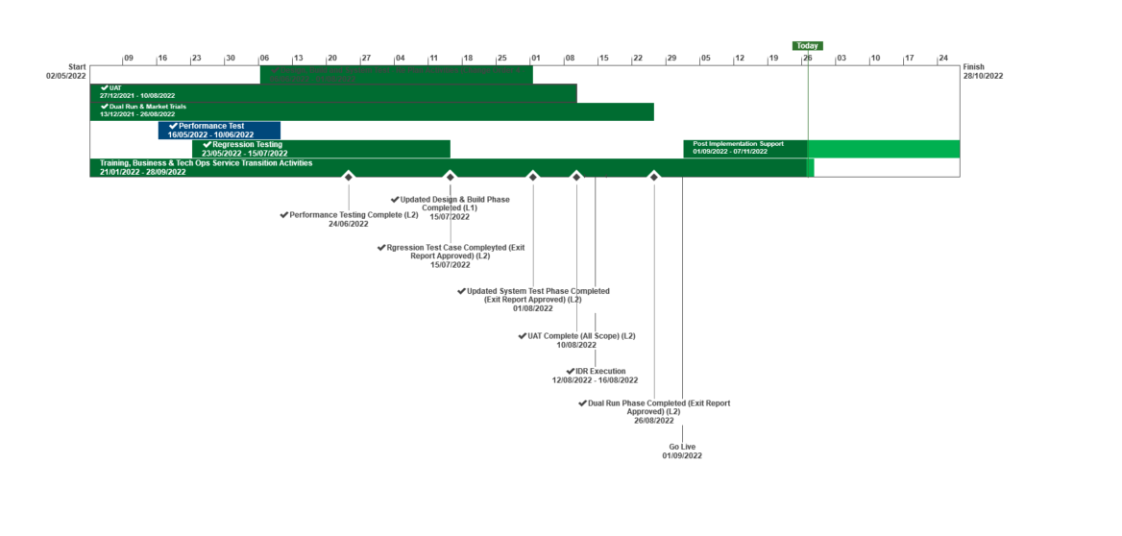
XRN5231 Flow Weighted Average CV
October 2022 ChMC Dashboard |  | Overall Project RAG Status
 |  | Schedule | Risks and Issues |  | Cost
RAG Status
Status Justification
Schedule | Overall RAG status is now tracking as GREEN. All implementation activities are complete. PIS activity is progressing to plan. 1st Usage monitoring and assurance taking place. Requirements traceability activities have completed. No major issues have been reported and the service is largely working as expected since 1st Sept. A number of PIS tickets have been raised; 10 key PIS activities are now closed and work is in progress for the remaining 5 issues. The resolution activities for these issues will conclude within the PIS phase. Regular calls are taking place with the DNs as appropriate, NG and key stakeholders. These will continue for the remainder of PIS. Next Steps: Conclude PIS phase. Commence Closedown activity | Overall RAG status is tracking at Purple as project is now in re-planning phase due to the position that we will not be able to implement by 1st April 22. The project has continued with its planned activities alongside the replan. To support the re-plan activity the project is conducting a Gap Analysis exercise on the defined requirements to ensure we have a baselined position for Day 1 Implementation. An Impact Assessment will then be conducted against the change variations to support the re-plan activity UAT execution and assurance is in progress, revised completion date to be confirmed as part of re-plan Dual Run Preparation continues with Connectivity Testing and Master Data Readiness. Resolution of the Master Data Issue is a significant step forward to support Dual Run Testing and Data Migration approach for cutover Re-planning to be completed post completion of Gap Analysis activity with the intention to agree revised plan in March and present updated BER for approval at April ChMC Next Steps: Finalise Gap Analysis exercise with DNs and National Grid to agree Day 1 Must Have requirements & any decisions in order to meet a proposed Go Live date (Mid June 22) Define full re-plan based on Gap Analysis Impact Assessment and Business Readiness requirements Target to issue revised BER from replan for approval at the April 22 ChMC Risk of FWACV Imp to CSSC is in assessment, this is deemed low risk as there is no code conflict
Risks and Issues | There are currently no key issues or risks. | The dependencies for NG to provide Master data and DNs connectivity details for Dual Run/MT have not been provided as per the plan defined in the approach leading to a delay to this phase of testing Update: A plan was defined to mitigate this issue through validating and cross-checking data with National Grid and Distribution Networks (DNs). Plan is nearing completion with final checks now being completed by DNs. Issue to be closed once Data loaded to testing environment The Project is not able to meet its planned Implementation Date of 1st April due to delays to the start of Dual Run, volume of parallel activity required prior to the planned implementation and identification of gaps in the As Is and To Be processes that could lead to further changes to approved solution Update: The project is carrying out a re-plan activity with the priority being to complete Analysis on approved scope/processes to confirm Day 1 must have requirements. The plan and activities has been agreed with Xoserve, NG and DNs on 22/02 and the activities are tracking to plan
Cost | Forecasting costs are within approved spend | Forecast costs tracking to approved BER costs at present. Revised plan options will require a full cost assessment to be completed on the replan position for Day 1
Scope | XRN5231 Flow Weighted Average (CV) Gemini consequential change parts A & B - A - PRCMS validation/processing & Part B - LDZ Stock Change and Embedded LDZ Unique Sites | XRN5231 Flow Weighted Average (CV) Gemini consequential change part A - PRCMS validation/processing Gemini consequential change part B - LDZ Stock Change and Embedded LDZ Unique Sites

