Slide 1
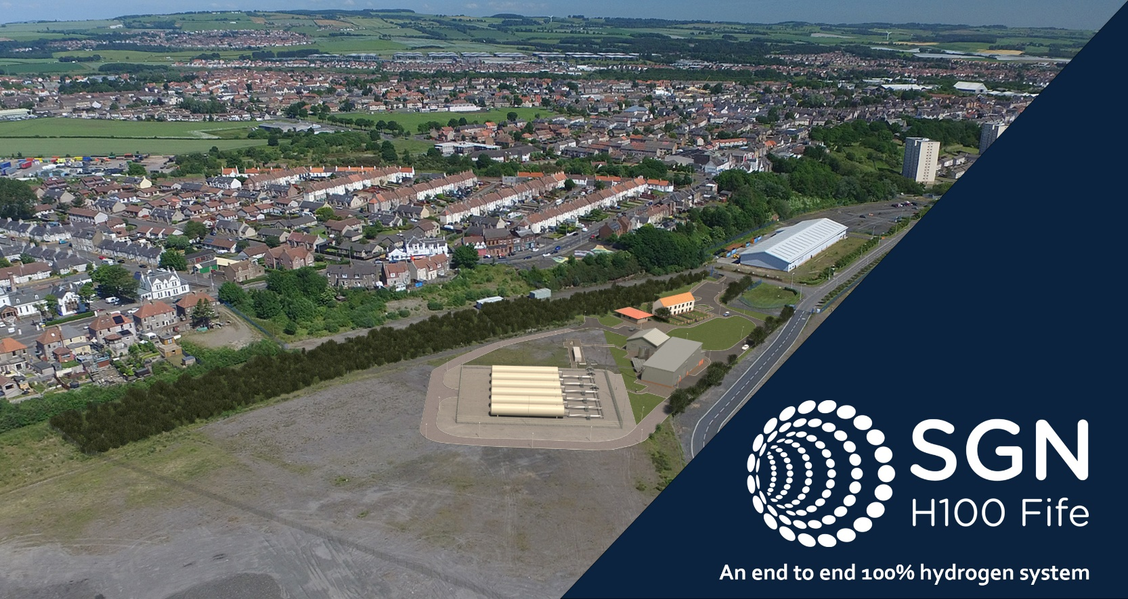
H100 Fife- Project Staging
At a high level, the project stages of Phase 1 can be split out into the following:
Stage 1: Project Development April 2020-March 2021
Stage 2: Pre-Construction April 2021- Dec 2022
Stage 3: Construction January 2023- August 2024
Stage 4: Operation From September 2024-March 2025
Stage 5: Project Exit/Enduring Strategy

