Slide 1
XRN5562 June 23 Release Implementation Approach

Slide 2
Principles
Project plan for both Implementation Dress Rehearsal (IDR) and Implementation will be defined and agreed by all parties involved
All external customers and internal business training and awareness sessions will have been completed prior to implementation.
All critical activities will be completed prior to implementation date (24th June), Communication will be provided (see slide 6 for further details on communications)
Standard maintenance window will be utilised for code deployments (from 5am -7am)

Slide 3
XRNs in Scope of June 23 Release
Change Reference | Change Title
XRN5091 | Deferral of creation of Class change reads at transfer of ownership

Slide 4
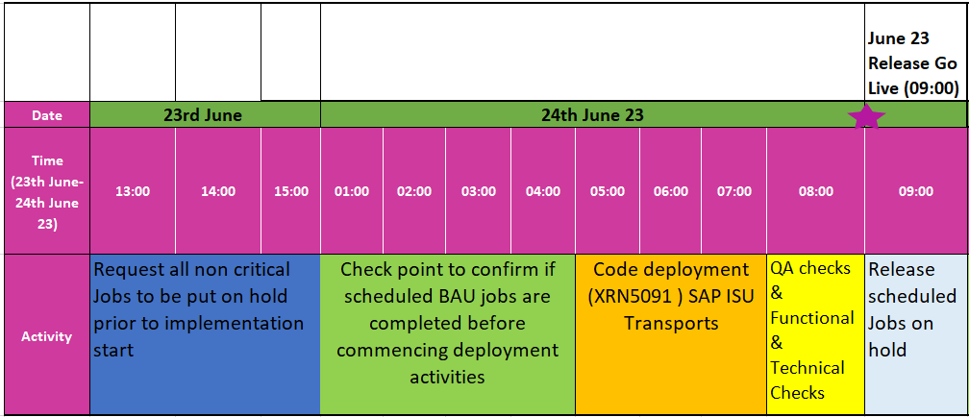
June 23 Release High Level Implementation Plan

Slide 5
File Format Transition plan
Inbound files
As part of June23 there are no changes to any inbound File format hence no file transition required
Outbound files
As part of June23 there are no changes to any outbound File format hence no file transition required

Slide 6
Further Communications
Implementation Go Live is planned for 24th June 2023
Key implementation communications:
Confirmation of planned implementation – 23rd June 2023
Confirmation if implementation date is to be moved – 23rd June 2023
Confirmation of Successful / Unsuccessful Implementation – 24th June 2023
Should we need to use a contingency date the following weekend of 1st July 2023 will be utilised and the above key communications dates will be used to provide the necessary updates
Further information and training awareness material will be available here

Slide 7
If you have any queries on the changes being delivered as part of the June23 Release please contact
UKLinkDelivery@xoserve.com

