Slide 1


Unlocking a low carbon gas future

Slide 2
Agenda
Welcome
About Future Billing Methodology
Why Future Billing Methodology?
Our approach
Consultation
Q&A
03

Slide 3
Project overview
David Chalmers
Project Manager, National Grid Gas Distribution
05

Slide 4
Project overview
A Gas Network Innovation Competition project
Total value £5.4M of which £4.7M comes from gas customers
It’s a ‘proof of concept’ project
The project is subject to Ofgem ‘stage gate’ approval in late Summer 2017
A consultation - we need your help
06

Slide 5
Decarbonising heat: GB energy demand
• Heat demand
• Electricity demand
Heat
(natural gas)
Electric
(natural gas)
Thanks to University of Sheffield – EPSRC’s Energy Storage for Low Carbon Grids Consortium
07

Slide 6
The future network
08

Slide 7
Why Future Billing Methodology?
09

Slide 8
All gas must be safe to transport
All gas must be safe and meet regulations to be transported
10

Slide 9
The current
billing framework:
Local Distribution Zones (LDZs)
SCOTLAND
NORTH
NORTH WEST
NORTH EAST
NORTH WALES
EAST MIDLANDS
WEST MIDLANDS
EAST ANGLIA
SOUTH WALES
NORTH THAMES
SOUTH EAST
SOUTH WEST
SOUTH
11

Slide 10
Flow-weighted
average calorific
value
12

Slide 11
Flow-weighted
average calorific
value
12

Slide 12
Flow-weighted
average calorific
value
12

Slide 13
A barrier to diverse gas sources
13

Slide 14
The current
billing framework:
Local Distribution Zones (LDZs)
SCOTLAND
NORTH
NORTH WEST
NORTH EAST
NORTH WALES
EAST MIDLANDS
WEST MIDLANDS
EAST ANGLIA
SOUTH WALES
NORTH THAMES
SOUTH EAST
SOUTH WEST
SOUTH
14

Slide 15
Our approach
Sarah Kimpton,
Senior Consultant, Energy Measurement and Compliance, DNV GL
15

Slide 16
Exploring three options
No change
to regulations
16

Slide 17
CV zones of influence
Now
17

Slide 18
Exploring CV zones of influence
Pragmatic
18

Slide 19
Exploring CV zones of influence
Composite
19

Slide 20
Exploring CV zones of influence
Ideal
20

Slide 21
Field trials
21

Slide 22
Exploring three options
22

Slide 23
Project timeline
23

Slide 24
Benefits of the project
24

Slide 25
Our vision for the future
25

Slide 26
Consulting with you
26

Slide 27
Consultation
We want to hear your views on:
Whether a change to the existing billing framework is warranted
Our proposed approach
The potential commercial
benefits and costs
27

Slide 28
How to respond
Following this event you will be sent a copy of the consultation, or printed copies are available today
Please read the FBM consultation document
Complete the questionnaire
Return to us by 14 April 2017
Please indicate where your responses
should remain confidential.
28

Slide 29
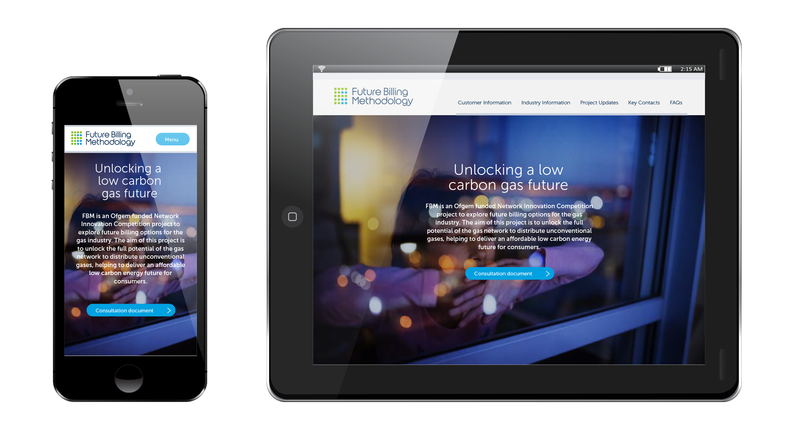
Project website
29

Slide 30

Future Billing Methodology explained
30

Slide 31
Q&A
31

Slide 32
Consultation
Ways to get in touch:
Come and talk to us today, or get in touch with us afterwards
Further workshops will be made
available for interested groups
32

Slide 33
Thank you

