Slide 1
European Update
1 June 2017

Slide 2
1. General Update

Slide 3
Code Status Update
Code | Current Status | Implementation date
Tariffs (TAR) | Entered into Force 6 April 2017, Mods now being raised | Applicable from 6 April 2017, 1 October 2017, 31 May 2019.
Transparency (TRA) | Entered into Force 6 April 2017 | Applicable from 01 October 2017, First publication end 2017
CAM amendments | Entered into Force 6 April 2017 | Applicable from 6 April 2017 Capacity Conversion effective from 1st Jan 2018.

Slide 4
Draft Indicative Timeline – National Grid Gas
2016
2017
2018
2019
Q3
Q4
Q1
Q2
Q3
Q4
Q1
Q2
Q3
Q4
Q1
Q2
Q3
Q4
Comitology
Annual Yearly Auction
(6th Mar)
NG Process /
System
Entry into Force 6 April 2017
Consultation
Mod Panel Decision
First Quarterly Auction (Aug)
Annual Yearly Auction (July)
Annual Yearly Auction (July)
CAM Amendments
(Mod 598s)
Modification Devt.
Implemented 6 April
Business Rule
Devt.
Comitology
Demand Assessment
Starts
NG Process /
System
PARCA
Demand Assessment Report
(June)
Consultation
(Nov)
Project Proposal
(Feb)
Reservation of Capacity
Entry into Force 6 April 2017
Joint Notice
Modification Devt.
Consultation
Implemented 6 April
Incremental
Capacity
(Mod 597)
Licence
Changes
Consultation
13 Apr
to 16 May
Business Rule
Devt.
Consultation
13 Apr – 16 May
Ofgem
Decision
Methodology
Statements
Draft
Changes
Internal
Review
Report Issued
30th May
Statements
Effective July
EU Consultation processes
(Ofgem/NG?)
Entry into Force 6 April 2017
Comitology
NG Process /
System – early consideration of potential impacts
Mod 0611 Devt
including consultations
Licence Changes
Ofgem
Decisions
TAR Network Code
Pre Mod(s) Modification Devt.
Ofgem Decision
Business Rule
Devt.
Modification(s) Devt including consultation(s), etc.
Possible Ofgem Revised Decision?
May Implementation
Impact
Assessment to cover TAR/ Charging?
NTS CMF / Sub Group Workgroups – to develop and scrutinise options + Devt
Charging Review
NTS CMF Workgroups – monthly – ongoing throughout
Pre Mod(s) / Mod Devt.
Licence Changes ?
Oct Implementation
Modification(s) Devt including consultation(s), etc.
Ofgem Decisions

Slide 5
Draft Indicative Timeline – National Grid Gas
2016
2017
2018
2019
Q3
Q4
Q1
Q2
Q3
Q4
Q1
Q2
Q3
Q4
Q1
Q2
Q3
Q4
Comitology
Consultation 20Jul to 10Aug 17
Mod Panel Decision 11 Aug 17
ENTSOG Conversion Model finalised
Business Rule
Devt.
Entry into Force
(1 January 2018)
CAM Amendment
Capacity Conversion
(Mod 616s)
Mod Devt.
NG Process /
System
Transitional arrangement
Transparency
Pre Mod(s) Modification Devt.
May Implementation
Mod for Transparency for 2018
Ofgem Decisions
Aug Implementation
Last updated: 18/05/17

Slide 6
2. EU Code Updates

Slide 7
Tariff Code Update

Slide 8
ENTSOG Activities for remainder of 2017
Preparation for 2nd Implementation Workshop and updated Implementation Document
Internal Workshops between TSOs to
knowledge share and develop a shared understanding
support implementation
Topics include
Cost allocation assessment
CWD model
NGG presented CWD model at ENTSOG on 24 May

Slide 9
ENTSOG Activities for remainder of 2017
Coordination between TSOs/ENTSOG to meet new publication requirements
Agreement on standardised section for TSO/NRA website, standardised table for ENTSOG’s Transparency Platform
Preparation for Implementation Monitoring & Effect Monitoring of TAR NC.

Slide 10
Chapter VIII Compliance (data publication)
EC/ACER push for early publication
i.e. by 1 October 2017
Agreed compromise with ENTSOG
Allows existing IT project to remain as planned
Publication on ENTSOG Platform by year end
the reserve prices at IPs and, if applied, the flow-based charges; information refers to the current tariff period which is running at the date of publication in December 2017

Slide 11
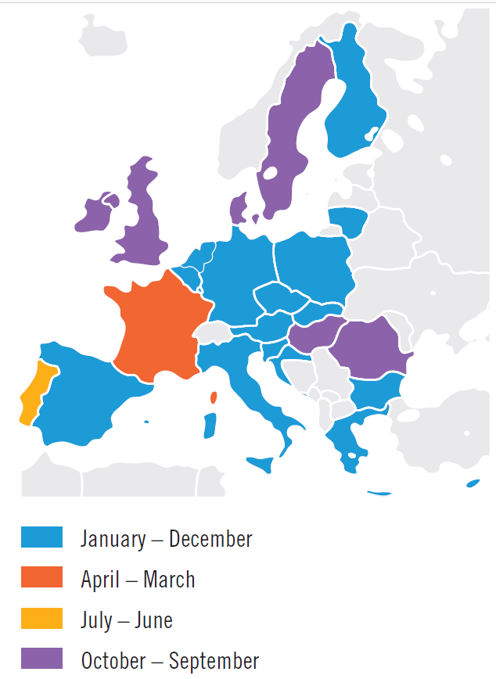
Chapter VIII Compliance (data publication)
Publication on ENTSOG TP
Different TSOs have different Tariff Years
Compromise agreement means all TSOs must publish by end 2017
NGG will publish current tariffs by year end

Slide 12
Chapter VIII Compliance (data publication)
Publication on TSO website (Art 30)
Information (where relevant) to be published
Accessible through link on ENTSOG TP
Information shall reflect current tariff period at date of publication
Publication to be shortly after October 2017 but no later than end of 2017

Slide 13
Publication on TSO website
(i) the allowed or target revenue, or both, of the TSO;
(ii) the information related to changes in the revenue referred to in point (i) from one year to the next year;
(iii) the following parameters:
(1) types of assets included in the regulated asset base and their aggregated value;
(2) cost of capital and its calculation methodology;
(3) capital expenditures, including:
(a) methodologies to determine the initial value of the assets;
(b) methodologies to re-evaluate the assets;
(c) explanations of the evolution of the value of the assets;
(d) depreciation periods and amounts per asset type.
(4) operational expenditures;
(5) incentive mechanisms and efficiency targets;
(6) inflation indices

Slide 14
Publication on TSO website
(iv) the transmission services revenue;
(v) the following ratios for the revenue referred to in point (iv):
(1) capacity-commodity split […];
(2) entry-exit split […];
(3) intra-system/cross-system split […].
(vi) where and to the extent that the TSO functions under a non-price cap regime, the following information related to the previous tariff period on regarding the reconciliation of the regulatory account:
(1) the actually obtained revenue, the under- or over-recovery of the allowed revenue and the part thereof attributed to the regulatory account and, if applicable, sub-accounts within such regulatory account;
(2) the reconciliation period and the incentive mechanisms implemented.
(vii) the intended use of the auction premium

Slide 15
Implementation and Effect Monitoring Planning Timescale for Implementation and Effect Monitoring reports – Tariff NC (2017-18)
- Identify scope of IM report
- Refine EM indicators
Provisional IM/EM questionnaires - WG approval
- ACER input
Refine questionnaires
Launch IM and EM questionnaires
Collect and verify data
Analyse data and draft reports
Approval of reports
Publication
March
January - February
October
November- December
August - September
June -July
April - May
31st Dec deadline* for
info to ENTSOG from TSO’s
31st March deadline for
info to ACER from ENTSOG

Slide 16
EU Gas Regulatory Change Programme
EU Change 2017 – CAM, Incremental & Transparency

Slide 17
EU Phase 4a CAM Amendments, Transparency and Incremental Changes - Shipper Information
Minimal impact to shippers
Highlights
Four auctions for IP Quarterly Capacity replaces 1 auction
IP Annual Yearly Auction is moving from March to July
2 new Gemini reports will be available to view
Additional Transparency Data
Some operational systems improvements
CAM Incremental – Market Demand Assessment window is now open
Negative Implied Flow Rates (Bacton only)

Slide 18
High Level Timeline
Gemini / MIPI System
System Testing (ST): 16th January – 13 March 2017 Complete
System Integration Testing (SIT): 13th March – 13th April 17 Complete
User Acceptance Testing (UAT): 18th April – 10th July 2017 On track
Go Live (Gemini outage scheduled): 13th August 2017 On track
CAM Incremental (IP PARCA Process)
Activity | Date
Expression of interest for Market Demand Indications document published | 6th April 2017
Market Demand Indication Window Open | Duration 8 weeks
Market Demand Indication Window Closes | 1st June 2017
Market Demand Assessment Report published to Industry | no later than 27th July 2017
Please direct any queries to: box.gasops.businessc@nationalgrid.com

Slide 19
CAM Code Update

Slide 20
Capacity Methodologies Update
Statement Review:
The consultations for the ECR, ExCR & ECTT are all due to be completed by July 2017
A review of the ECR, ExCR, ECS & ExCS is required for EU CAM Amendments (UNC Mods 0597 & 0598)
Consultation
All capacity methodologies were issued for consultation 13th April 2017
Consultation closed on Tuesday 16th May 2017

Slide 21
Capacity Methodologies Update
Two responses received and are available to view on the website from:
Centrica
Wales and West Utilities
Conclusions report which will also be available to view on the website will be issued by 30th May 2017
Subject to Authority approval the effective date will be 31st July 2017

Slide 22
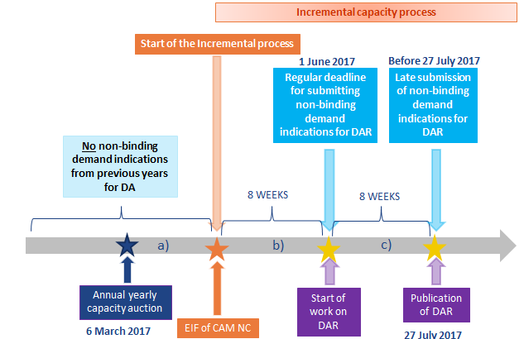
Demand Assessment Phase
6th April 2017
1 June 2017

Slide 23
Future Topics

Slide 24
Future Topics
Topic Area | Provisional Date
Tariffs Code | Monthly updates
Transparency requirements | Monthly updates
CAM Amendment – Capacity Conversion | Monthly updates

Slide 25
Future Topics

Slide 26
Future Topics
Topic Area | Provisional Date
Tariffs Code | Monthly updates
Transparency requirements | Monthly updates
CAM Amendment | Monthly updates
Incremental | Monthly updates

Slide 27
Modification 0605S
Amendments to TPD Section K: Additional Methods to Procure and Dispose of Operating Margins Gas

Slide 28
Modification 0611
Amendments to the Firm Capacity Payable Price at Interconnection Points

Slide 29
Modification 0616
Capacity Conversion Mechanism for Interconnection Points

Slide 30
Any Other Business

Slide 31
Negative Implied Flow Rate

Slide 32
Gas Quality Information Provision

Slide 33
Background
Last year NG ran a “Information Provision Consultation” on both the balancing and the gas quality data we provide
Gas Balancing: Obligation in the EU Balancing Code for the TSO to consult stakeholders on, and assess the benefit of,
Article 38 (1) (a) increasing the frequency of information provision to network users
(b) reducing the related timeline of information provision;
(c) improving the accuracy of the information provided
Gas Quality: Obligation in the EU Interoperability Code for the TSO to assess;
Article 17.3 (b) (i) the relevant information on gas quality parameters to be provided
(ii) the frequency of the information to be provided
(iii) the lead time
(iv) the method of communication”
Received 3 responses to the consultation from RWE, EDF Energy and Energy UK

Slide 34
Data Issues

Slide 35
Data inconsistencies
Allocations and nominations data in MIPI are not the same as measured End of Day data in Gemini meaning that there was a mismatch between physical flows measured in the “Actual Offtake Flows Report” and the “Aggregate Allocation Report” and the “Nominations Report” (the later 2 having the issue).
Gemini sending information across to MIPI light; or
MIPI is not processing
Fix to this data was deployed since 13th February which aligned the three reports
Historical data was also corrected at the beginning of April 2017
Any future data issues should be directed to box.OperationalLiaison@nationalgrid.com

Slide 36
Incentives

Slide 37
Executive Summary
National Grid Gas (NGG) undertakes the role of System Operator (SO) for the high pressure gas National Transmission System (NTS) in Great Britain.
NGG is currently operating within the first price control to be set up through the new RIIO regulatory framework model (Revenue = Incentives + Innovation + Outputs).
Under the first RIIO framework two new incentives were introduced, focusing on delivering the outputs that stakeholders highlighted were of core value. These incentives known as shallow incentives were set out for a trial period. This led to the introduction of a Maintenance incentive and the extension of the Demand forecasting incentive to cover the D-2 to D-5 time period.
As well as these two incentives, the Greenhouse Gas incentive framework was set for a period of three years. This was to allow National Grid to undertake further work to review operational venting sources and to further investigate current internationally accepted best practice.
The incentive three year period is up for review in 2017/18 the outputs from the review are set to be implemented in 2018/19. NGG initially proposed its recommendations to OFGEM in April 2017. This engagement builds upon stakeholder and customer comments received into NGG and from additional events that we are attending prior to a formal proposal. It sets out the shape of potential incentive frameworks that are designed to encourage us to innovate in the delivery of key outputs valued by customers, whilst ensuring continued focus on delivering real value for consumers.
Our high level proposals for the incentives that fall within the scope of the review are summarised in this presentation

Slide 38
Overview
High level summary
GHG – We are proposing to make some changes to this scheme to ensure maximum effectiveness in driving the right behaviours. To ensure the incentive mechanism is fit for purpose, the mechanism will only include performance measures that are under National Grid’s direct control.
We propose a change from the down side only incentive to a symmetrical incentive with an upside.
Demand forecasting – We are not proposing any changes to this incentive scheme, we intend to continue to forecast D- 2-5 as is, using the current mechanism and cap and collar targets. The targets remain challenging due to increased volatility.
The introduction of new data ranges and or publication times can be progressed outside the remit of the shallow incentive review.
Maintenance – We are proposing to have changes made to this incentive scheme to mitigate the risk of continuing with the incentive as is. This incentive has driven massive financial rewards for our customers, NGG are proposing to increase maintenance activity alignment meaning less disturbance to the customer and ensuring more availability.
Operating Margins- Although not part of the Gas SO Shallow Incentive review, we are also reviewing whether the Operating Margins incentive should remain reputational or return to a risk sharing financial incentive. We would welcome customer views on this.

Slide 39
Greenhouse Gas Emissions
Position
Currently the GHG incentive mechanism includes performance measures that are outside the control of National Grid and its processes. The current mechanism does not allow National Grid to drive performance improvements effectively.
Proposed Amendments
Scheme extended for a further three years
Scheme structure to be based on a symmetrical basis (pain/gain)
Performance to be calculated on an annual basis
Incentive to remain focused on compressor emissions
Scheme should not include any types of seal leakage

Slide 40
Why Compressors Vent
Within NGG Control
Outside NGG Control
Exhaust Gases
Discharge
Gas Generator
Planned Vents
Static Seal
Leakage Vets
Air
Gas
Compressor
Unit
Suction
Fuel Gas
Power Turbine
Fuel Gas Vents
Start up Purge Vents
Starter Vents
April 16 – March 17
3,555,438 KG of Gas
Dynamic Seal Leakage Vents
ESD Vents

Slide 41
GHG Emissions
We propose the following amendments to the incentive mechanism;
We will be incentivised on the following five mechanisms of venting which are in our control;
Planned Vents
ESD Vents
Fuel Gas Vents
Starter Vents
Start up Purge Vents
If the above mechanism is implemented then we propose a reduction to our targets in line with a baseline set by OFGEM.
We propose a symmetrical incentive capped at £1m at the RPI adjusted value per tonne.

Slide 42
Demand Forecasting D-2 to D-5
Position
Continue to forecast D-2 to D-5 as is, using current mechanism cap and collar targets, the targets remain challenging due to increased volatility.
The introduction of new data ranges and times will be discussed outside the remit of the shallow incentive review
Proposed Amendments
No changes to this incentive.
Additional Demand Forecasts
Separately, we’re also keen to hear whether customers would also value demand forecasts for a longer time frame (e.g. Up to D-10). We would welcome your views on this.

Slide 43
Maintenance
Position
Currently we are only being incentivised to align £1.54m worth of revenue to the customer, this is the value realised by the alignment of Remote Valve Operations RVOs, allowing the customers to continue operate.
Proposed Amendments
Financial incentive scheme extended for a further three years.
Scheme performance to be calculated on an annual basis.
Change of days scheme
Continued in current format.
Use of days scheme
Alignment of (RVO) to be continued in current format.
Alignment of additional maintenance activities to be included.
Break even target of 10%.

Slide 44
Customer Benefit
£m
National Grid’s incentive target is based on £1.54m worth of revenue to the customer.
Amount that National Grid facilitated the customer generating 2016/2017 was £3.65m.
In 2017/18 National Grid are expected to facilitate the customer generating £11m, however a modified incentive would allow National Grid to generate even more value for the customer.

Slide 45
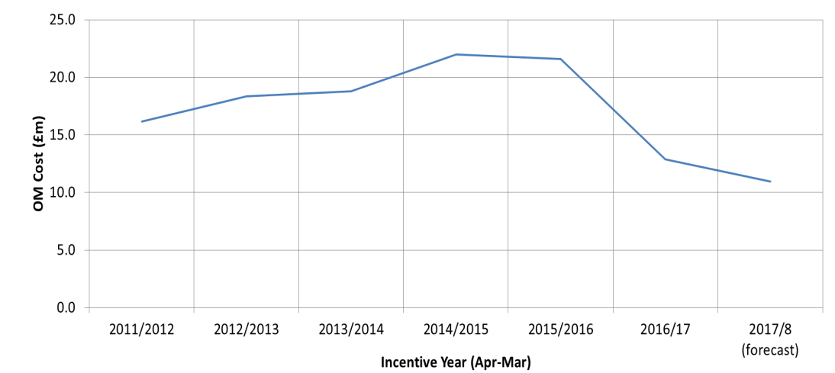
Operating Margins
Background
In order to maintain system pressures in the gas network, National Grid may need to utilise Operating Margins gas. This is gas procured for use under specific circumstances that can include:
periods immediately after a major supply loss (before other measures become effective);
plant failure, such as pipe breaks and compressor trips; or
run-down of the system during an emergency.
The cost of procuring Operating Margins is passed on to customers. Therefore, Ofgem incentivise National Grid to minimise the costs incurred by customers. Over the past 15 years the incentive has either been financial or reputational.
Current Position
Currently the incentive is reputational, because, when it was reviewed in 2012, both National Grid and Ofgem felt that there was too much uncertainty over costs to develop a fair incentive. National Grid and Ofgem intended to later review whether it should return to a financial incentive .
As can be seen from the graph, operating costs increased from 2012/13, but since 2015/16, they have been reduced by around 40%.

Slide 46
Operating Margins
Proposed amendments
We are reviewing whether reintroducing a financial incentive would help deliver further customer value.
Rational for the amendment
The cost savings since 2015/16 have been achieved as a result of a number of factors, most importantly the stimulation of a more competitive market through industry engagement to attract new service providers. Any ‘quick wins’ to reduce costs have already been taken.
Maintaining those savings - and driving yet more savings - will require significant focus on this area. We therefore believe that returning to a financial incentive - whereby National Grid has a stake in both the risks and the rewards of any cost changes - will help ensure that costs to customers continues to be minimised.
We would welcome feedback on whether customers feel a financial incentive on National Grid could help ensure that the cost of Operating Margins continues to be procured in the most efficient and economic manner?
At this point we are consulting on the general principal of National Grid sharing the risk and reward. The exact details of the scheme would be consulted on soon.

Slide 47
Contact Details
Matthew Kleanthous
Principal Commercial Developer
Matthew.Kleanthous@nationalgrid.com
07866 786 514
Joshua Bates
Commercial Developer
Joshua.Bates@nationalgrid.com
07790 941 158

