Slide 1
IUK draft alternative 621 mod proposal thoughts
UNC Mod Working Group Meeting
23 Jan 2018

Slide 2
Key changes being considered compared to UNC mod 621
Equal capacity discounts to GB storage applied to capacity bookings at bi-directional interconnection points
Discount applied to proportion of bookings in = out
For period beyond 2021 based on anticipated bookings to determine Transmission Entry/Exit capacity charges and revenue recovery charges
Transitional period
Same rules as applied to GB storage

Slide 3
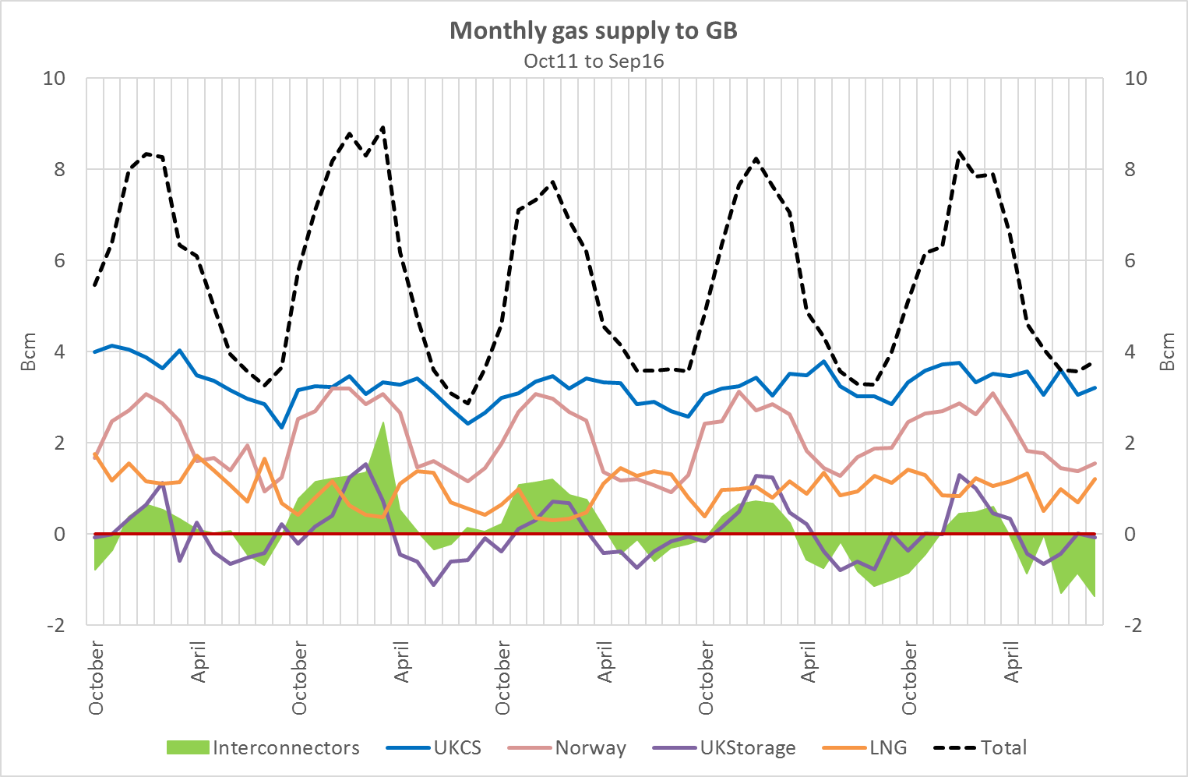
Interconnectors provide seasonal flexibility just like Storage

Slide 4
Rationale for a level playing field
Addresses distortion to competition and barrier to cross border flows:
Interconnectors complement continental storage enabling cross border storage competition
Reflects interconnectors contribution to SofS and system flexibility
Helps safeguard interconnection: current distortion to competition mitigated mainly by interconnector capacity being treated as a sunk cost but this is ending soon
Wider benefits for GB consumers
Cross border flows improve liquidity
Facilitating access to continental storage avoids the need for additional GB storage investment
Permitted by European Law

