Slide 1
UIG Resolution
Weekly Progress Update 09 Feb 2018

Slide 2
DM read rejection update
Pot 1 Key messages
Outstanding last week = 5
Closed this week = 0
0 meter points still impacting UIG (estimated consumption not accurate)
Row Labels | DMSP | N/A | SHIPPER | MAM | XOS | Grand Total
Assigned | 0 | 0 | 0 | 0 | 0 | 0
Closed | 0 | 168 | 0 | 0 | 0 | 168
Fix in Progress | 0 | 0 | 6 | 1 | 1 | 8
New | 0 | 0 | 0 | 0 | 0 | 0
Monitor | 0 | 0 | 0 | 1 | 0 | 1
Failed | 0 | 0 | 0 | 0 | 0 | 0
Total | 0 | 168 | 6 | 2 | 1 | 177
Total number of meter point queries open |  |  |  |  |  | 5
Pot 2 Key messages
Outstanding last week = 31
New Rejections identified = 11
Closed this week = 1
20 meter points still impacting UIG (estimated consumption not accurate)
Row Labels | DMSP | N/A | SHIPPER | MAM | XOS | Grand Total
Assigned | 2 | 0 | 2 | 3 | 3 | 10
Closed | 0 | 122 | 0 | 0 | 0 | 122
Fix in Progress | 6 | 0 | 4 | 1 | 2 | 13
Fixed | 0 | 0 | 0 | 0 | 0 | 0
New | 0 | 0 | 0 | 0 | 11 | 11
Monitor | 0 | 0 | 0 | 0 | 0 | 0
Total | 8 | 122 | 6 | 4 | 16 | 156
Total number of meter point queries open |  |  |  |  |  | 31

Slide 3
DM Financial Adjustments Progress
Pot 1 - 177
CA Decision Pending – 68
Root Cause Pending Fix – 9
CA Submitted - 19
Not invoiced – 10
Invoiced - 4
Held Pending Rec - 4
Being Processed – 6
No CA Required/ Closed – 54
Root Cause Fixed – 168
CA Needed – 46
DMQ Submitted - 4
Shipper Notification Received - 23
No Adjustment Required - 5

Slide 4
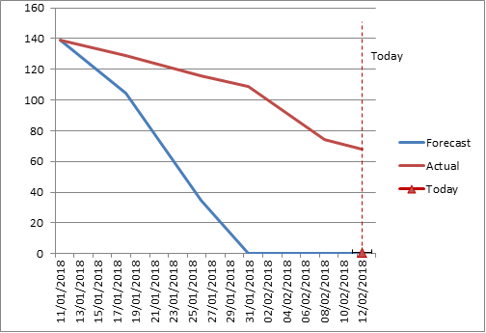
DM Financial Adjustments Burndown
DM Financial Adjustments Burndown

Slide 5
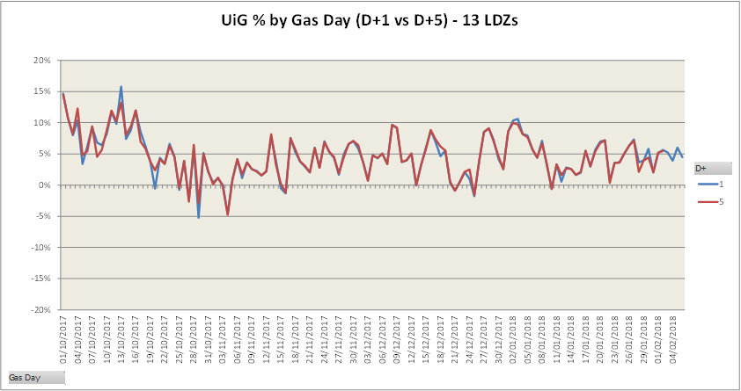
Latest UIG volatility

