Slide 1
Mod 644 UIG Analysis
Rebecca Knight

Slide 2
Introduction
Modification 644: Improvements to nomination and reconciliation through the introduction of new EUC bands and improvements in the CWV
Purpose of Modification:
This modification seeks to split the End User Categories (EUC) EUC01B and EUC02B into three and grouping by prepayment, market sector code of industrial and commercial and finally all remaining meter point reference numbers. It also seeks to amend the Composite Weather Variable (CWV) to include more than just wind speeds and temperature plus the creation of parameters to flex the Weather Correction Factor (WCF) and/or Daily Adjustment Factors (DAF) where they reach defined tolerances. These amendments would provide a more accurate profile to that which is in place today and would work towards improved nominations which in turn would reduce reconciliation and UIG.

Slide 3
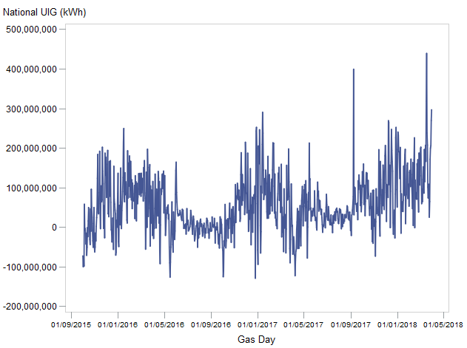
Introduction: UIG History
At a national level, UIG can be generated back to October 2015 using industry agreed data (because Nexus-ready DAFs were produced for this month onwards).
Over this period, the volatility of UIG volume is very high, especially during the winter months, and UIG has also had a strong positive bias.

Slide 4
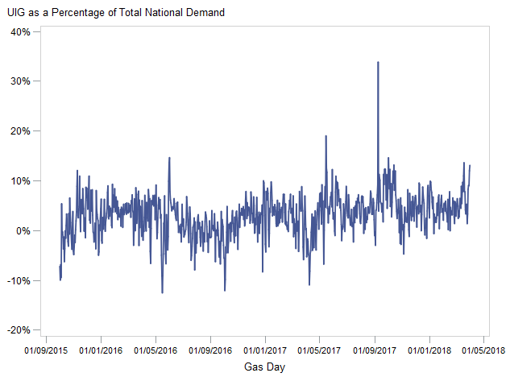
Introduction: UIG History
Looking at the same range of data as a % of total national demand shows the volatility remains, and is similar across each year.

Slide 5
Methodology: DAF Adjustment
In order to produce a recommendation that could be implemented without large scale system change, analysis was focussed on changing the DAF values, rather than a different part of the NDM demand algorithm. (Mathematically, adjusting the DAF values themselves is the same as adjusting the weather component of the DAF.)
To identify how UIG volatility and bias could be impacted by changes in DAF values, a range of multipliers were applied to the DAF values, and new values of NDM demand and UIG were calculated, to model the dependencies.

Slide 6
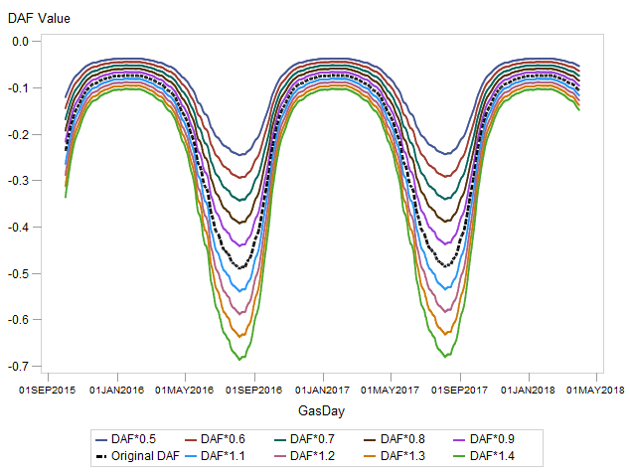
Methodology: DAF Adjustment Example
For illustration:
This graph shows for EA:E01B the range of DAF values used to model UIG from, where the dotted black line shows the original DAF values.
For the actual analysis, rather than changing the DAF multiplier by 0.1 each time, this was iterated by 0.01, producing 100 different sets of DAFs.

Slide 7
Methodology: Data Used
No shipper specific data was used in this analysis to ensure the results are relevant for the gas industry as a whole.
National Grid:
LDZ Demand Actuals D+6
DM Demand Actuals D+6
CVs (Calorific Values)
Joint Office Website:
Shrinkage Factors
CDSP:
ALPs (post-Nexus)
DAFs (post-Nexus)
CWVs
SNCWVs
Profile Sample Data for Mar16-Mar17
Xoserve:
National AQ split by LDZ and EUC
Analysis data covered Oct15-Mar18, because over this time period, industry agreed DAFs were available relevant for the post-Nexus algorithm.

Slide 8
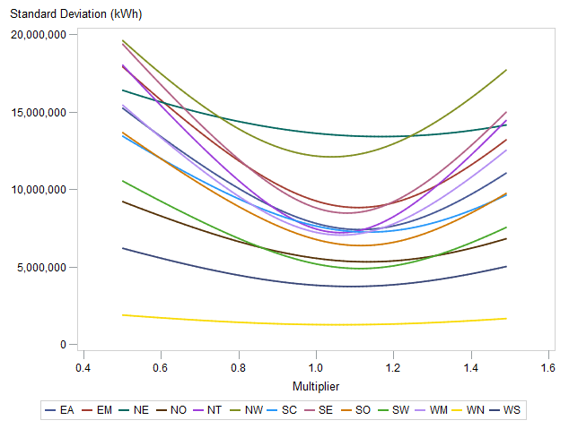
Results: DAF Adjustment
This graph shows how the volatility of UIG varies depending on the size of the factor applied to the DAFs.
At 1, the volatility (or standard deviation of UIG over the full time period) is quite low, but most LDZs do show that the optimum DAF level actually requires a slight positive multiplier to be applied.
This suggests the DAFs are not accounting for enough weather sensitivity across all LDZs.

Slide 9
Results: DAF Adjustment
The actual minimum volatility points depended on LDZ, but ranged between improvements of 0.7% and 5.7% upon the standard deviation calculated based on using the original DAFs.
LDZ | Best DAF Multiplier | Change in Standard Deviation
EA | 11% | -5.0%
EM | 11% | -4.6%
NE | 17% | -1.5%
NO | 13% | -4.1%
NT | 6% | -3.1%
NW | 4% | -0.4%
SC | 13% | -5.0%
SE | 8% | -3.7%
SO | 12% | -5.7%
SW | 11% | -5.6%
WM | 6% | -2.4%
WN | 6% | -0.7%
WS | 9% | -2.0%

Slide 10
Methodology: Including ALP Adjustments
DAFs do not provide a noticeable improvement to UIG bias and only a small volatility improvement. To investigate if there is another part of the algorithm that could be adjusted to improve UIG without significant system change, the analysis next considered changing the ALPs.
Applying multipliers to the ALPs is the same mathematically as applying a multiplier to NDM demand overall, but is hopefully more straightforward for system changes.
To generate the final recommendation, ALPs and DAFs are considered together due to possible interdependencies.

Slide 11
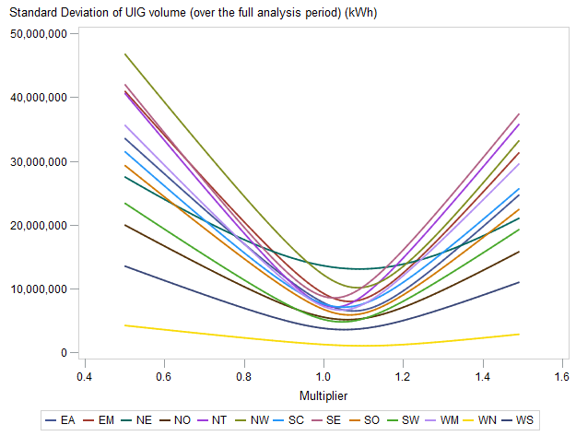
Results: ALP Adjustment
This graph shows how the volatility of UIG varies depending on the size of the factor applied to the ALPs.
The sensitivity of UIG volatility is much higher than for DAFs when the same range of factors are applied and the minimum for each LDZ is quite clear.
The true minima are found after increasing the ALPs by a small factor.

Slide 12
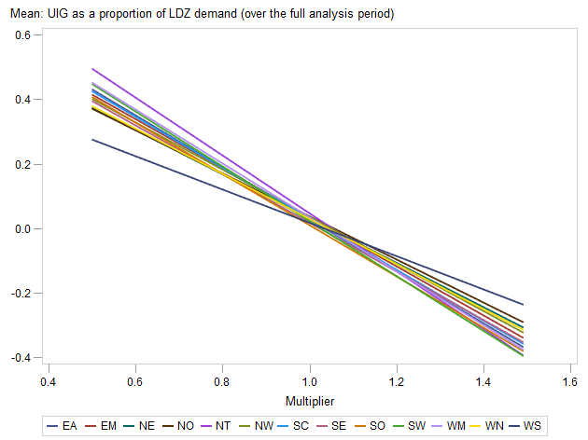
Results: ALP Adjustment
This graph shows the average UIG proportion of national demand for each multiplier applied.
While changing the DAFs did not have much overall impact on the bias of UIG over the analysis period, as expected, adjusting the ALPs had a very large impact.
For all LDZs:
The original ALPs lead to a positive bias in UIG;
The point where each LDZ line crosses 0 (where no bias was seen), requires a small positive multiplier.
Therefore, a increasing the ALPs can cause both a decrease in volatility and Bias.

Slide 13
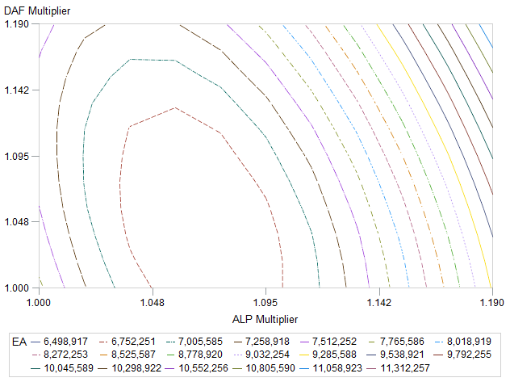
Results: Adjusting both ALPs and DAFs
For illustration, this contour plot of UIG standard deviation for the EA LDZ shows the ALP and DAF values that best improve the volatility of UIG.
For EA, the best standard deviations can be found by increasing the ALP slightly more than the DAF.

Slide 14
Results: Adjusting both ALPs and DAFs
Adjusting both ALPs and DAFs together can produce a reduction in volatility of between
4% and 17% depending on LDZ
LDZ | Best ALP Multiplier | Best DAF Multiplier | Change in Standard Deviation
EA | 7% | 4% | -17.0%
EM | 6% | 5% | -14.3%
NE | 8% | 9% | -4.1%
NO | 5% | 9% | -8.8%
NT | 2% | 4% | -5.2%
NW | 9% | 0% | -16.1%
SC | 4% | 9% | -9.1%
SE | 2% | 6% | -4.5%
SO | 6% | 6% | -14.1%
SW | 4% | 7% | -9.3%
WM | 4% | 2% | -7.9%
WN | 10% | 0% | -15.7%
WS | 5% | 4% | -5.5%

Slide 15
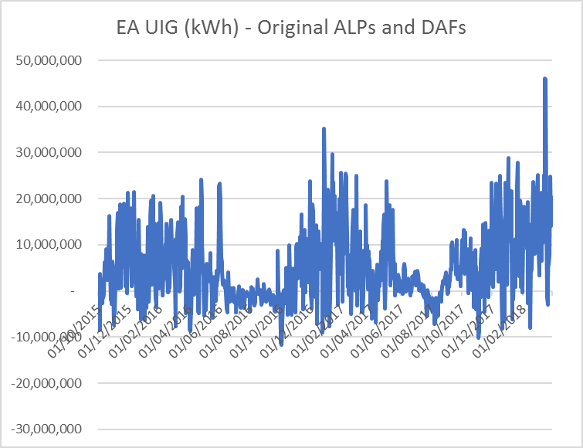
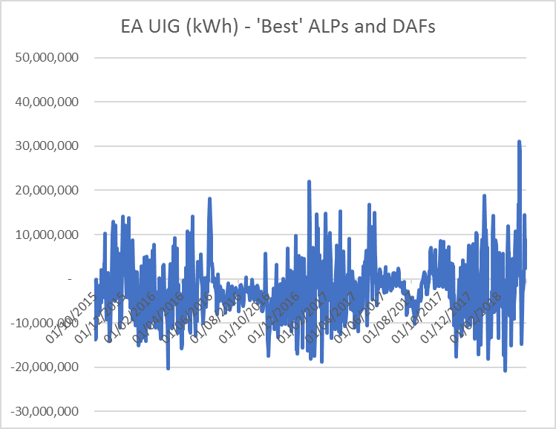
Results: Adjusting both ALPs and DAFs
For illustration: Example of original and new UIG based on the updated optimum ALPs and DAFs for EA

Slide 16
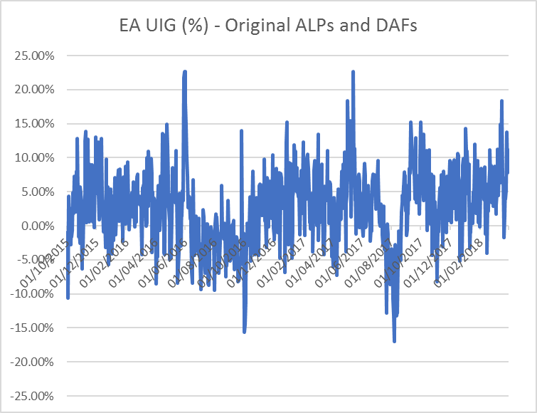
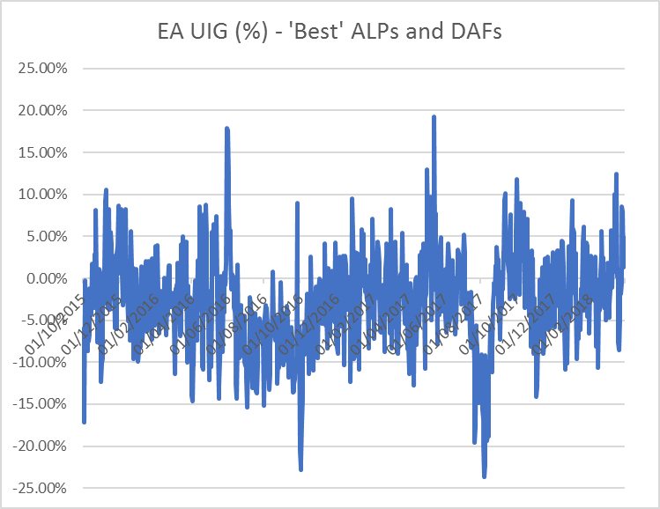
Results: Adjusting both ALPs and DAFs
For illustration: Example of original and new UIG, as a proportion of total LDZ demand, based on the updated optimum ALPs and DAFs for EA

Slide 17
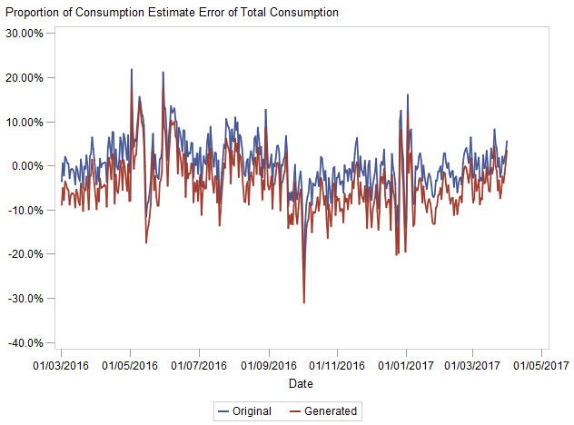
Results: Sample Data
Unfortunately, when looking at the sample data, the same relationships do not seem to hold true.
This graph shows the differences between the sum of sample consumption data, and generated NDM demand for those meters (both using original and previously derived ‘best’ ALPs and DAFs).
While at national LDZ level, UIG is positive because not enough is being allocated, when focussing in on the sample data, generated NDM demand is missing the positive bias, and actually tends to be negative (meaning generated demand is generally higher than actual consumption)
*EUC E01-E04 only

Slide 18
Results: Sample Data
Preliminary results also suggest that the AQs supplied with the 16/17 year of sample data are a good fit against those sites consumption over the year.
However to fully confirm this, the true weather correction that is used to calculate AQs will be needed.
The table on the right shows as an example for one EUC the relationship between AQ error and Weather difference to seasonal normal, which are highly correlated suggesting the AQ error seen here could be mostly down to the aggregated consumption not being weather corrected.
EUC | LDZ | Difference between AQs and Aggregated Consumption | Difference between CWV and SNCWV over the year
01B | EA | 0.8% | 0.5%
01B | EM | 2.6% | 1.7%
01B | NE | 2.3% | 1.7%
01B | NO | 4.0% | 3.5%
01B | NT | 1.7% | 0.6%
01B | NW | 1.1% | 0.8%
01B | SC | 1.7% | 1.4%
01B | SE | 0.8% | 0.5%
01B | SO | 1.3% | 0.7%
01B | SW | 0.2% | -0.1%
01B | WM | 2.5% | 1.5%
01B | WS | 0.9% | 0.2%

Slide 19
Limitations and Recommendations
Limitations of the final analysis:
Performed at LDZ level only (not EUC)
Multiplier applied flat to all ALPs/DAFs
Sample Data Analysis only covers one year and EUCs 1 to 4
No investigation into the impact of changing the ALPs without changing the total sum of ALPs
No assessment of system impact of ALPs not adding to 365 on Shippers, GTs or IGTs
No assessment of impact on LFs
Recommendation for next steps:
Xoserve to work with E.ON to define a new set of ALPs and DAFs. This should include:
Analysis at EUC level
Validation using the latest sample data
This work should be incorporated into the spring analysis
The new ALPs and DAFs should be loaded and applied as soon as possible

