Slide 1
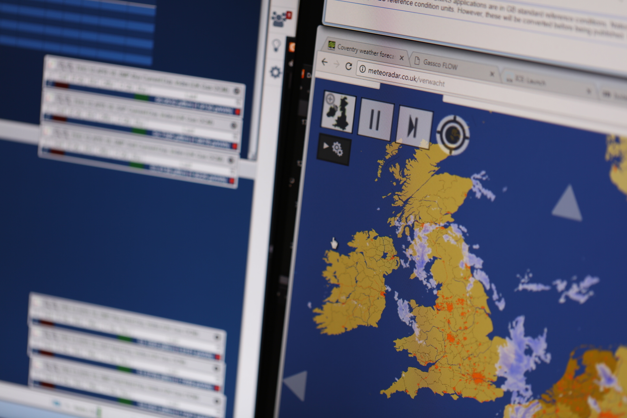


0669R – Review of MN & GDW Arrangements
2nd May 2019

Slide 2
Contents page
01 | Recap of Proposal | 03
02 | Interconnector Methodology | 05
03 | LNG Methodology | 07
04 | Next Steps | 10

Slide 3
01
Recap of Proposal

Slide 4
Proposed new process for Margins Notice calculation
Margins Notice triggered if: Total Max Use (NSS Assumption + Storage Max Use + LNG Assumption + Interconnectors Assumption) < Demand Forecast
    NSS [Monthly review] – Just UKCS & Norway, with LNG & Interconnectors removed
    Storage [Daily process] – Current process to remain
    LNG [Daily process] – New methodology
    Interconnectors [Daily process] – New methodology
    And an ANS to be issued when we reach a certain percentage of the Margins Notice trigger.
    We propose to include in UNC these changes to the methodology, and the frequency of these processes and reviews.

Slide 5
02
Interconnector Methodology

Slide 6
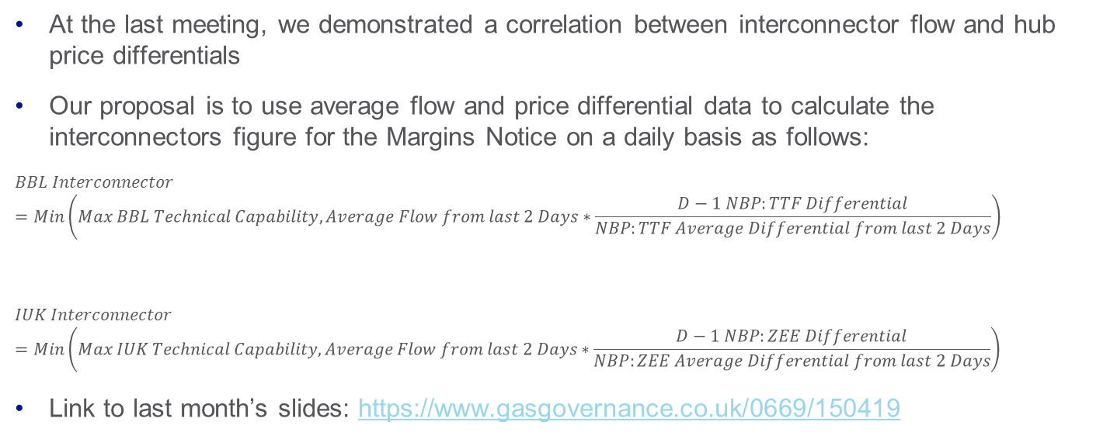
Interconnector Methodology – Re-cap
    At the last meeting, we demonstrated a correlation between interconnector flow and hub price differentials
    Our proposal is to use average flow and price differential data to calculate the interconnectors figure for the Margins Notice on a daily basis as follows:
    $$BBL Interconnector=Min\left(Max BBL Technical Capability,Average Flow from last 2 Days∗\frac{D−1 NBP:TTF Differential}{NBP:TTF Average Differential from last 2 Days}\right)$$
    $$IUK Interconnector=Min\left(Max IUK Technical Capability, Average Flow from last 2 Days∗\frac{D−1 NBP:ZEE Differential}{NBP:ZEE Average Differential from last 2 Days}\right)$$
    Link to last month’s slides: https://www.gasgovernance.co.uk/0669/150419

Slide 7
03
LNG Methodology

Slide 8
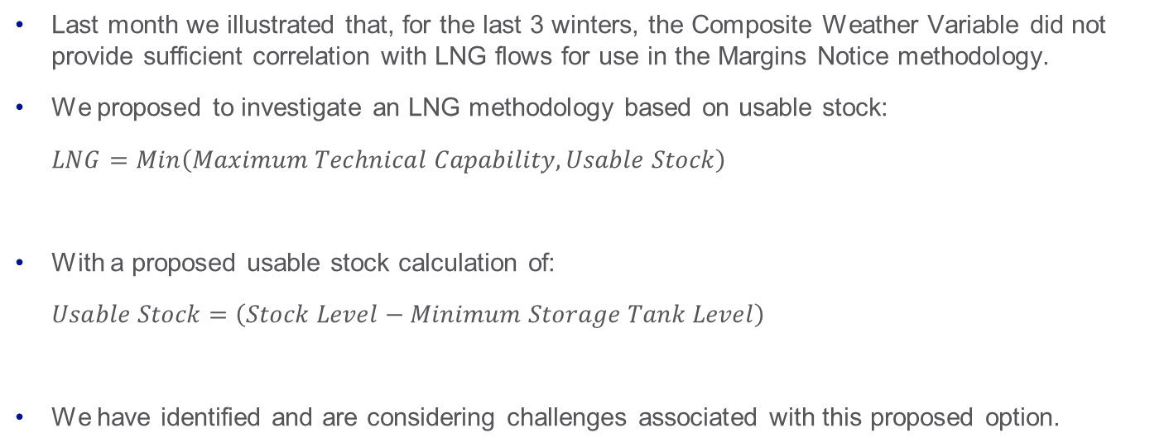
LNG Methodology
    Last month we illustrated that, for the last 3 winters, the Composite Weather Variable did not provide sufficient correlation with LNG flows for use in the Margins Notice methodology.
    We proposed to investigate an LNG methodology based on usable stock:
      $$LNG=Min\left(Maximum Technical Capability,Usable Stock\right)$$
    With a proposed usable stock calculation of:
      $$Usable Stock=\left(Stock Level−Minimum Storage Tank Level\right)$$
    We have identified and are considering challenges associated with this proposed option.

Slide 9
LNG Methodology
    We have applied this equation for recent winters
    The output was consistently the maximum capability
    This is problematic, as using this would provide a much higher figure for LNG for the Margins Notice, and triggering it would be less likely than using current arrangements
    An alternative option is to use the nth percentile of historic winter period LNG flow data to establish an ‘expected cold weather capability’ at the start of a winter
    This could then potentially be fed with new data as the winter progresses to reflect changes to LNG flow behaviours
    To establish the aggregate Minimum Storage Tank Level for the Usable Stock calculation, we could use the Minimum Inventory data from the last few years for each importation facility, and we already have access to the Stock Level data.
Minimum Stock Level
Boil Off Rate
E.g. 15 Days

Slide 10
04
Next Steps

Slide 11
Next Steps
Develop and quantify LNG methodology
Analyse the impact of the proposed new IC and LNG methodologies on Margins Notice historically
Agree recommendations with the Workgroup
Close 0669R, Workgroup Report to Panel – possible extension required
Raise a new mod to implement recommendations
| 0669R – Review of MN & GDW Arrangements | 2nd May 2019

Slide 12
Updated UNC Timeline
Pre-Mod Discussion
Raise New Mod
Changes Effective
Mod Panel to close 0669R
0669R Workgroups
Consultation
Decision
Sept 2018
Oct 2018
Nov 2018
Dec 2018
Jan 2019
Feb 2019
Mar 2019
Apr 2019
May 2019
Jun 2019
Jul 2019
Aug 2019
Sept 2019
Oct 2019
Notes:
So this is just to show the proposed UNC timeline.

