Slide 1
Capacity Access Review
Transmission Workgroup
6th February 2020

Slide 2
01
Overruns

Slide 3
Revenue from Overruns (New Action 0103: National Grid (ASt) to investigate where the revenue is collected and how and where the credits are redistributed methodology in relation to cost neutrality.)
How are fees collected?
Overrun charges are invoiced each month on the NTS Entry and NTS Exit Capacity invoices – they are invoiced 1 month in arrears after M+15 input closeout.
How are fees redistributed?
Entry revenue from overruns
Total charges are credited to Neutrality monthly.
Revenue is not smeared equally. Neutrality is shared out based on each User’s end of the day firm capacity as a percentage of the total system end of the day firm capacity for all Users. It is based on a total system level and not on individual ASEPs.
Exit revenue from overruns
Total value is deducted from SO Commodity Charges for the following gas year.
The Commodity Charge is a standard price across all shippers. Any shippers who incur overruns would still pay the same commodity price as those who don’t.

Slide 4
Zero or no overrun charge (New Action 0101: National Grid to investigate instances where zero or no overrun charges apply to overruns at ASEPs where no bookings were made and how this will change following implementation of Modification 678A.)
A zero or no Overrun charge may be currently generated
where no NTS Entry Capacity has been booked at an ASEP on a Gas Flow Day by any User.
The new charging regime will not change that outcome as the entry Overrun calculation is based on highest bid price. Where there has been no bid, the Overrun calculation will use a zero price.
where the NTS Entry Capacity allocated at an ASEP is at zero price.
There should be no instances where zero or no Overrun charge is incurred from 1st October (subject to Mod 678A implementation) as no entry capacity will be allocated at an ASEP is at zero price.

Slide 5
Overruns and Constraints New Action 0102: National Grid (ASt) to investigate the revenue overrun charges at a more granular level; to ascertain if there was a constraint on the days the overruns were charged, and if so, provide the necessary evidence.
Transmission Workgroup Minutes (9th January 2019)
‘From an Ofgem perspective they believed overruns were necessary to prevent under booking’
‘Overruns should be accepted as a penalty and exist to encourage pre-booking of shipper specific capacity requirements’.
The potential amendment to the multiplier in the Overrun charge calculation doesn’t include instances where there is a constraint on the NTS.

Slide 6
Overrun Options
National Grid has put forward a pre-modification proposal to reduce the multiplier used to calculate Overrun charges to x4 for Entry and x6 for Exit
The aim of the proposal is to find a multiplier which would maintain the status quo; keep the penalty and incentive to book capacity at the same level as today.
Revenue was used as a measure of maintaining the status quo. It was assumed capacity booking behaviour will not worsen if revenue remains similar as in previous years.
The new charging regime will have an impact on capacity booking behaviours. While we know that the behaviour will change, we don’t know to what extent. We have based this proposal on historic quantifiable data rather than future uncertain predictions.

Slide 7
Overrun Options
The pre-modification recognises that if Mod 678A is implemented, there will be differences in the increase/decrease of reserve price at individual entry and exit points. The entry points average reserve price increase, on average, will be greater than exit points. That will be delivered as a part of charging review and something this proposal has no influence over.
This proposal has taken a holistic view of all entry and all exit points (it would be impossible to have Overrun charges varying per location). By changing the multiplier as proposed, the overall penalty will not be increased.
This proposal seeks to safeguard Users from excessively penal Overrun charges caused by an unintended consequence of the implementation of Modification 678A. At the same time, it recognises that it is imperative the keep appropriate level of Overrun charges to maintain the incentive on shippers to book capacity required.
The proposal is subject to Mod 678A being implemented
It is proposed to review Overruns 12 months after implementation of the new charging regime once we know more about how it will impact on booking behaviour and with the purpose to ensure Overruns remain fulfilling their primary objective.

Slide 8
02
NTS Exit Capacity Substitution & User Commitment

Slide 9
Context
Through the Capacity Access Review National Grid have requested that issues with the current capacity regime are raised. These have been collated into a “short-term issues” list.
Some parties have identified issues with NTS Exit Substitution Processes and User Commitment.
These issues have initially been explored in further detail with the Distribution Networks and so these slides reflect their views.
These slides attempt to provide a summary and replay of the issues raised in this area. By inclusion of a issue in these slides, it does not at this stage, reflect the views of National Grid.
Recognise that there are similar issues on the NTS Entry Capacity Regime or wider issues which need to be explored further.

Slide 10
Issues
A | Overruns | Are Over-run charges appropriate? | Is the incentive appropriate particularly with the introduction of the Charging Review. Anomaly that zero over-run charge maybe possible Longer-term: review basis of overrun charges in light of change of behaviours following Charging Review
B | Signalling & Allocation of Capacity | Are the PARCA processes (including User Commitment) appropriate? | Can the timescales for the substitution process be reduced? Can rules be made clearer, simpler? More clarity on process methodology. Affected Users able to respond to potential Substitution considered during the Annual Application Window Exchanges of NTS exit capacity between NTS exit points within same exit zone where capacity does not go above baseline Should User Commitment be applied to every enduring capacity release? Could a zonal capacity regime be an alternative?
 |  | Are the substitution processes (including User Commitment) appropriate?
 |  | Could a zonal capacity regime be introduced?
 |  | Are there any issues with Trade and Transfer? Are Retainers still required?
C | Capacity Products & Auctions | Are new products required or redundant products? | Development of a “mothballed” capacity product following baseline review at Theddlethorpe Development of a “tradeable” entry capacity product Within day, shorter term capacity product development Incentive for advance, long-term capacity bookings? Disaggregating NTS Exit capacity purchases for embedded “large” offtakes from DN capacity bookings. Temperature / seasonal based product Flexibility product
Governance
UNC / Methodology
Are the rules contained in the right place?

Slide 11
How are exit capacity requirements signalled and delivered?
There are 3 ways in which Users can signal the need for Enduring Exit Capacity:
PARCA (only way that Funded Incremental Obligated Capacity can be released)
Within the Enduring Annual (Flat) Exit Capacity annual application window held in July each year
Ad hoc EAFLEC process which runs from 1st October – 30th June*
There are different ways to deliver this capacity depending on how the additional capacity has been signalled :
Remining available NTS Exit (Flat) Capacity
Exit Capacity Substitution
Non-funded incremental Capacity
Funded Incremental Capacity
National Grid will only release Incremental Obligated Exit Capacity if User Commitment is made
The User will remain the registered User for any additional and existing EAFLEC for 4 years from the date the increased capacity allocation becomes effective (User’s can’t reduce until after 4 years). Except where the User Commitment is satisfied early where actual Charges paid (or to be paid) by the relevant User is respect of the NTS Exit Point equal or exceed the User Commitment Amount.
Notes:
* Where, if approved, would result in User’s, in aggregate holding in excess of 125% of the Baseline NTS Exit (Flat) Capacity for the year in which the application is made and is for an amount which exceed 1Gwh/d.

Slide 12
DN Issues
DN’s weigh up booking capacity that subsequently don’t require vs risk of capacity being substituted
Difficult for DN’s to forecast demand accurately, particularly over 4 years ahead, as dependent on their customer behaviour. Increased embedded generation increases this uncertainty and may mean capacity requirements fluctuate.
DN’s don’t want to overbook capacity that they subsequently don’t need as this would;
sterilise the capacity market
potentially lead to inefficient delivery of additional Enduring Exit Capacity (particularly substitution)
risk costs of unused capacity increasing DNs costs (and ultimately end consumer bills)
User Commitment means that DN’s will not / cannot release exit capacity when no longer required;
User Commitment requirements must have been met before any reductions can be made
If need the capacity again in the future then would have to restart User Commitment process
Over-booking capacity would mean capacity bookings are not reflective of flows and does not enable efficient access to the NTS

Slide 13
DN Issues
The substitution process for identifying the Donor NTS Exit Point as defined in the ExCS methodology is complicated and has many variables meaning it is difficult to understand where a donor point is likely to be located
Risk of incorrectly identifying donor site
When a PARCA notice is published there are only 20 days to understand impact and release required funds
Substitution could cause security of supply issues on DN networks and risk of being able to meet 1 in 20 obligations
Where no investment is required, should levels of User Commitment required be the same as when investment is required?

Slide 14
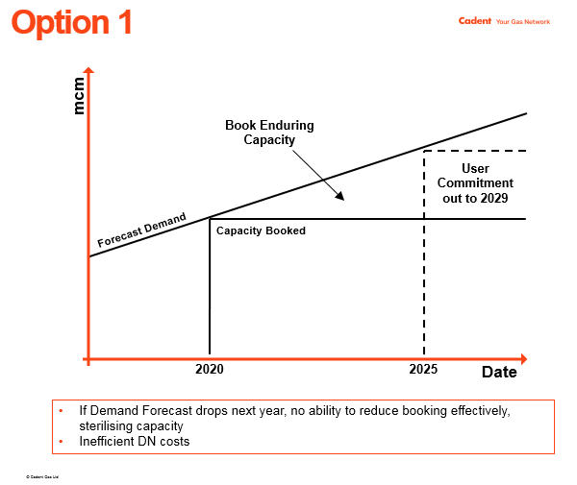

Slide 15
