Slide 1
DESC Technical Workgroup Review of draft 2017/18 NDM Algorithms
10th July 2017

Slide 2
Agenda
Recap on Timetable
Summary of 2017 Modelling and Smoothed Model Outcomes
Summary of TWG responses to proposed Algorithms and Xoserve clarifications
Conclusions and next steps

Slide 3
Objectives of this meeting
Key objective of this meeting:
Review TWG and DESC comments
Required Outcome – TWG support for proposals prior to DESC review and discussion

Slide 4
Demand Estimation: Agreed Work Plan for 2017
Spr. Approach
Approved by
DESC 15 Feb
Process ‘Back-Runs’ and validate sample data
Data received for Analysis Year
Form data aggregations and define WAR band limits
TWG
26 April
Small & Large NDM single year EUC modelling
TWG
17 May
Model smoothing and calculation of Derived Factors
Today’s TWG
checkpoint
TWG / DESC review of Derived Factors (ALP,DAF,LF)
Completed DESC/TWG
checkpoints
TWG /
DESC
10 July
Wider industry review and manage any representations
Future DESC/TWG
checkpoints
DESC
26 July
Final Derived Factors for Gas Year 2017/18 are announced
All systems updated with Derived Factors for 2017/18
Work plan for 2017 Modelling included as part of Spring Approach document which was confirmed and agreed at 15th February DESC meeting
Work plan provides more transparency of process and includes checkpoints for DESC/TWG review

Slide 5
Summary of modelling
Data aggregations & WAR Band limits agreed at April TWG meeting (26th)
Single year modelling approved at May TWG meeting (17th)
Model smoothing process followed in second half of May along with production of draft Derived Factors
Smoothed model outcomes summarised on slides 6 and 7
Note: All modelling / output parameters produced using Composite Weather Variable (CWV) definitions and Seasonal Normal (SN) basis effective 01/10/2015

Slide 6
Small NDM: Smoothed Model outcomes
Small NDM represents approx. 89% of current NDM AQ
 | 2017 | 2016
Straight Models | 63 | 62
Cut-Off Only | 39 | 31
Summer Reductions Only | 43 | 54
No Slope | 0 | 0
Cut-Off and Reductions | 11 | 9
Total Number of EUCs | 156 | 156

Slide 7
Large NDM: Smoothed Model outcomes
Large NDM represents approx. 11% of current NDM AQ
 | 2017 | 2016
Straight Models | 173 | 181
Cut-Off Only | 41 | 37
Summer Reductions Only | 38 | 48
No Slope | 20 | 0
Cut-Off and Reductions | 1 | 7
Total Number of EUCs | 273 | 273

Slide 8
TWG Responses / Comments on Proposals
Email sent on 2rd June asked for feedback by no later than close of play 23rd June in order to prepare for meeting on 10th July
EON, British Gas and SSE have provided a response with comments on the proposals. Following slides takes these questions in turn

Slide 9
Modelling Background
Profiles (ALPs, DAFs and LFs) are based on the parameters from the smoothed model
Smoothed model exhibits ‘average characteristics’ from 3 individual years
Each smoothed model includes 2 individual years which are the same as the previous year’s smoothed model with oldest year being replaced with the sample data from the new year
The results for each individual model are dependent on the make up of the sample and their behaviour in that specific year alongside the weather conditions experienced
Underlying reasons why the sample behaves in certain ways each year are not possible to explain
The CWV intercepts (-C1/C2) provide a guide to how the weather sensitivity of the sample behaviours change (or not). Note: Higher CWV intercept = less weather sensitive
The C1 and C2 parameters are provided in the Demand Model Supporting Files area
Smoothed model C1 and C2 can be viewed in EUCPAR17S.txt or EUC PAR17L.txt
Individual Years C1 and C2 can be viewed in MDLPARyy_17S.txt or MDLPARyy_17L.txt

Slide 10
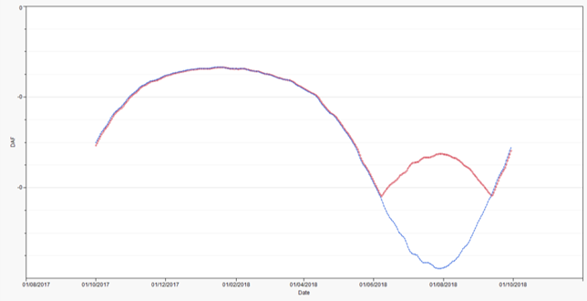
EON - DAF 1: LC:E04B
The DAFs do not follow the same shape as last year profile for many EUCs. What is driving this change?
DAFs for LC:E04B (Blue= 2016/17 Profiles, Red= Draft 2017/18 Profiles)
The profile this year for LC:E04B has a summer cut off applied. The summer cut off value is 14.4 and can be found in the EUCPAR17S.txt file.
There was no summer cut off applied in 2016/17, hence why there is a difference in shape.

Slide 11
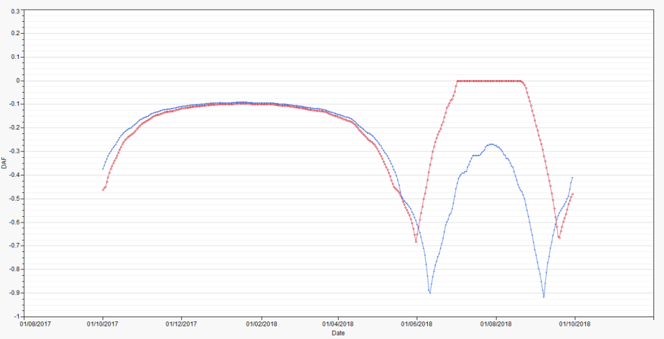
EON - DAF 2: LC:E04W04
The DAFs do not follow the shame shape as last year profile for many EUCs. What is driving this change?
DAFs for LC:E04W04 (Blue= 2016/17 Profiles, Red= Draft 2017/18 Profiles)
The profile this year for LC:E04W04 has a summer CWV cut off value of 12.4. Last year the CWV cut off value was 13.2.
This means the process of applying the summer cut-off to the DAF is triggered at a lower CWV in this year’s model. This process is explained further in section 9 of the NDM Algorithms Booklet.

Slide 12
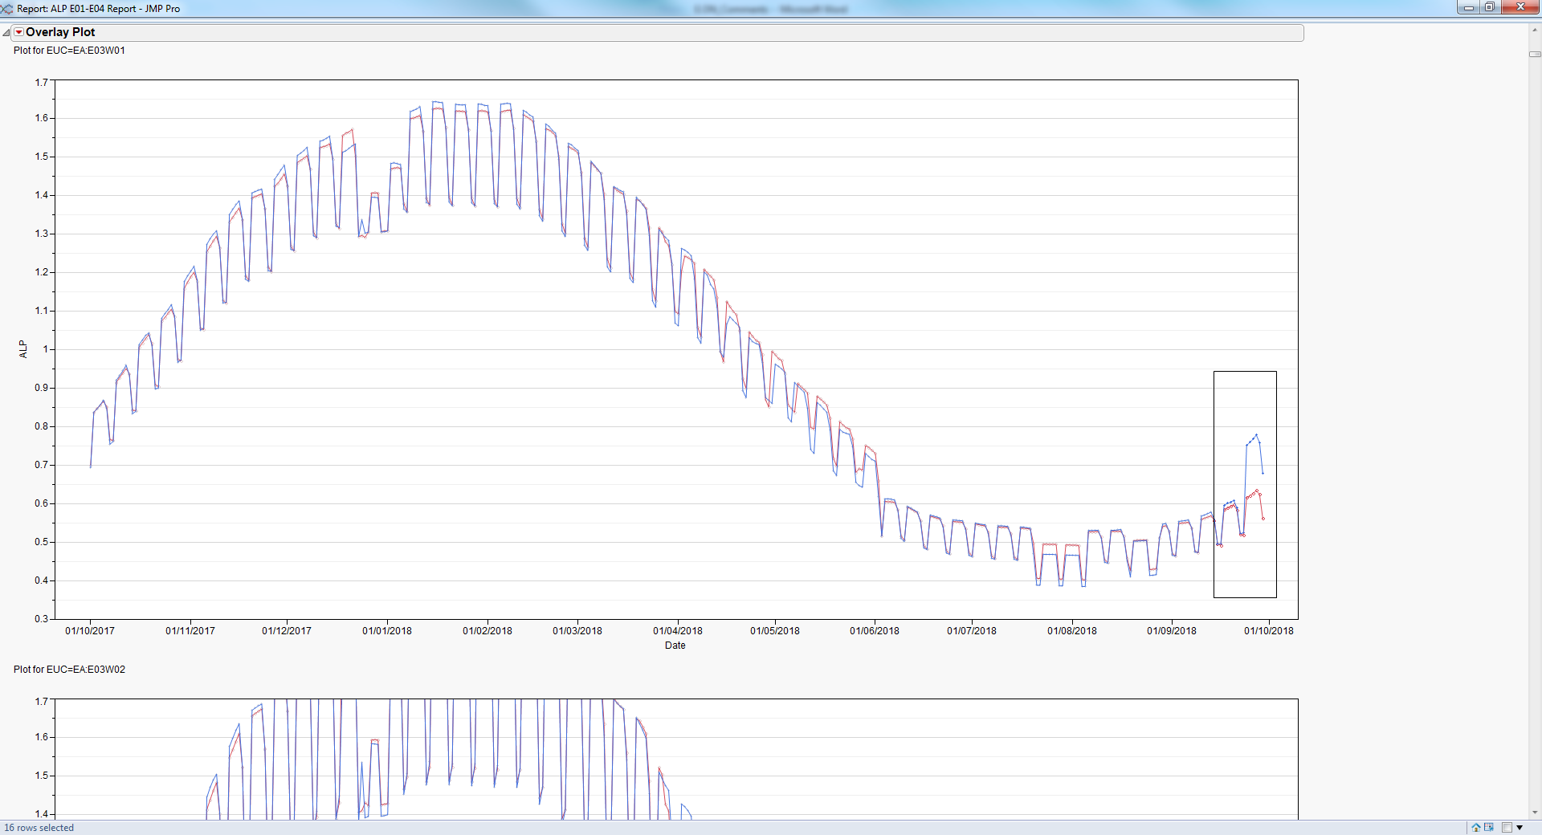
EON - ALP 1: EA:E03W02
Last years ALPs spike for the last week of September. This years profiles do not follow the same shape. We see this as a correction but please could you explain the reasoning behind this?
ALP for EA:E03W02
(Blue= 2016/17 Profiles, Red= Draft 2017/18 Profiles)

Slide 13
EON - ALP 1: EA:E03W02 - Response
EA:E03W02 has had a summer reduction applied to it in both 2016/17 and 2017/18
A correction has not been applied to the ALP for 2017/18. The rules on summer reductions are as follows:
“Summer reductions can apply to EUC models over the period Sunday before Spring Bank Holiday Monday to the last Sunday in September”
This year, the Summer Reduction ends on the 30th Sep ’18, which is why the change in shape is not evident on the chart.
The WKHOLDEFyy.txt file shows the summer reduction period (holiday codes 17 to 20) ends on 24th Sep 2017 and ends on 30th Sep 2018.
(opposite is an extract from the file mentioned
above).
HXWR,17/09/2017, 0, 20
HXWR,18/09/2017, 0, 17
HXWR,19/09/2017, 0, 17
HXWR,20/09/2017, 0, 17
HXWR,21/09/2017, 0, 17
HXWR,22/09/2017, 0, 18
HXWR,23/09/2017, 0, 19
HXWR,24/09/2017, 0, 20
HXWR,25/09/2017, 0, 0
HXWR,24/09/2018, 0, 17
HXWR,25/09/2018, 0, 17
HXWR,26/09/2018, 0, 17
HXWR,27/09/2018, 0, 17
HXWR,28/09/2018, 0, 18
HXWR,29/09/2018, 0, 19
HXWR,30/09/2018, 0, 20

Slide 14
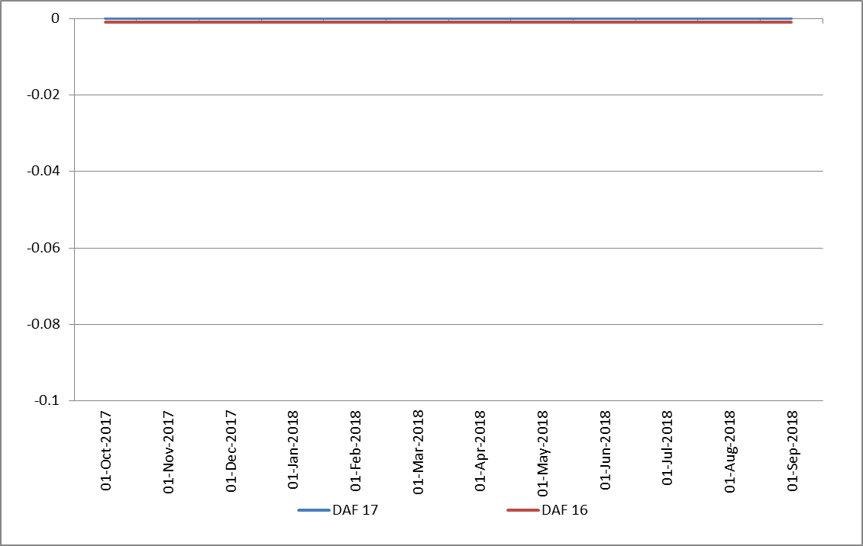
British Gas - DAF 1: EA:E07W01

Slide 15
British Gas - DAF 1: EA:E07W01 cont…

Slide 16
British Gas - DAF 1: EA:E07W01 - Response
The zero DAF does imply that the EUC exhibited zero weather sensitivity in the smooth model. This information is confirmed in the EUCPAR17L.txt file and table S4.3 of the booklet.
The behaviour of the sample in the 3 years is what determines the smoothed model outcome.
The C2 (slope) in the individual year files provided for these models, found in:
MDLPAR15_17L, MDLPAR16_17L and MDLPAR17_17L, will show zero weather
sensitivity. In the equivalent files last year there would have been a small amount
of weather sensitivity for these models which meant the DAF was not zero.
WAR Band 1 is the least weather sensitive of the 4 WAR Bands and can often result in a flat profile.
The same applies to all of the EUCs mentioned on the previous slide.
(Please note: Bands 7 and 8 are modelled together).

Slide 17
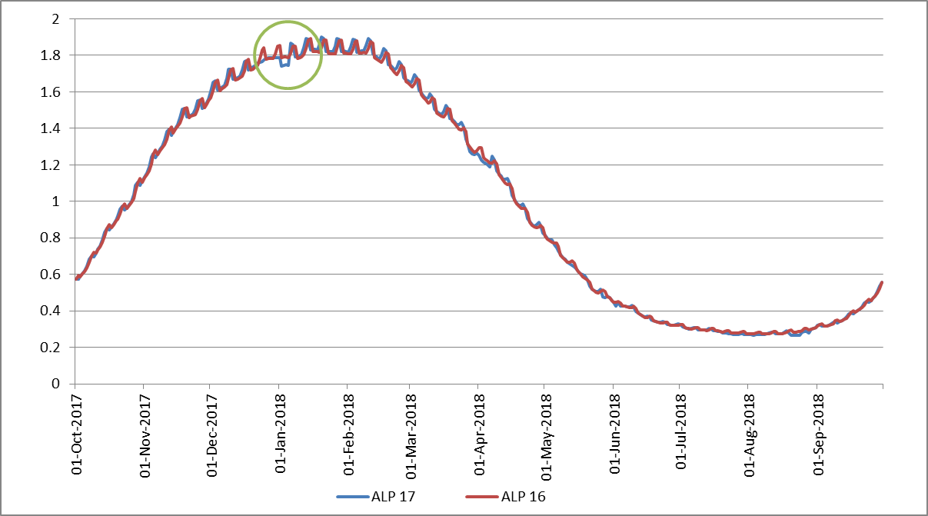
SSE – 01B ALPs
“Just an observation around the “trough” in the ALP for many of the 01B models (EA, NW, SE for example) in the period 2-5 Jan 2018. As this to me is the most immediately apparent consequence of the holiday change perhaps we could make sure we are happy with the logic behind it at the meeting?”

Slide 18
Holiday Codes Background
Christmas/New Year (Holiday codes 1, 2, 3, 4 and 5)
Holiday period starts on the Monday before 25th December (but if 25th December falls on a Monday, Tuesday or Wednesday, starts on the Friday before 25th December) and ends on the first Friday on or after the second New Year bank holiday in Scotland.
Holiday Code 1:
25th December
Holiday Code 2:
26th December, January 1st and any remaining bank holidays (except second Scotland New Year bank holiday) and any other Saturdays and Sundays in the period.
Holiday Code 3:
Any remaining Mondays to Fridays between 24th December and day before second Scotland New Year bank holiday inclusive .
Holiday Code 4:
Remaining days before 24th December.
Holiday Code 5:
Remaining days (will always include second Scotland New Year bank holiday).

Slide 19
Holiday Codes Applied
This year is the first year holiday codes have been applied to 01B. The main objective of this decision was to improve the Summer fit, but modelling rules cover all holiday days, including Christmas and New Year.
For the period mentioned, holiday code 5 is applied. When this value is below 1, a reduction in the profile would be apparent. This is the case for all LDZs in EUC 01B, except SC.

Slide 20
Next Steps…
Are TWG happy to recommend this years NDM Algorithm proposals to DESC?

