Slide 1
UKL Future Release 2 Cutover/Implementation
30th April 2018

Slide 2
Background
At the DSG on 23rd April, there was a Customer query on the Release 2 Implementation Plan to confirm file exchange and processing

Slide 3
Query Response
Based on the analysis conducted, it is recommended that adhoc jobs are triggered for all files where file formats will be changed as part of R2 implementation (CNC,CNF,SFN and ACR)
Adhoc processing will be triggered at 23:00 hours on 29th June 2018 to cover all pending data to be processed for the business day
All outbound response files for CNC,CNF,SFN and ACR will be processed and submitted before 23:59 hours on 29th June 2018 in the old file format
CNC,CNF,SFN and ACR inbound files submitted after 23:00 hours on 29th June 2018 will be held at the Xoserve gateway and will be processed post R2 Go Live as per the agreed implementation plan
CNC,CNF,SFN and ACR inbound files submitted after 23:00 hours on 29th June 2018 are expected to be in the new file format (validation will be completed by AMT and file rejections sent if in the old format for CNC,CNF,SFN and ACR)
GT (EDL & EWS) & iGT (IDL) Portfolio outbound files will be sent in the old file format for the final time on Saturday morning. The new file formats will be submitted from 01/07/18 (IDL files will contain migrated PSR data for iGTs, GTs will receive EDL files that do not include migrated PSR data as EQL & EWS files will include this data on the files to be sent on 02/07/18)
As part of the lower level implementation plan we will agree a communication plan with \Customers

Slide 4
Option 1 File Formats – All impacted File Formats Transition Plan
Change ID | Last inbound in Old File Format (Time = File Processing) | Last Outbound in Old File Format (Time = File Processing) | First Inbound in New File Format (Time = File Processing) | First outbound processed in New File format (Time = File Processing)
XRN3477 (UKLP112) | NA | 29/06/2018 AES – 23:00PM | NA | 02/07/2018 AES – 23:30PM
XRN4303 (UKLP267) | 29/06/2018 SFN – 23:00PM | 29/06/2018 SFR will be processed after SFN execution at 23:00PM | 30/06/2018 SFN – 20:00PM (Files will be held and processed on 01/07/18) | 01/07/2018 SFR will be processed as usual as there is no file format change
XRN3283 | 29/06/2018 ACR – 23:00PM | 29/06/2018 ARS will be processed after ACR execution at 23:00PM | 02/07/2018 ACR – 8:00AM | 02/07/2018 ARS will be processed as usual as there is no file format change
XRN4449 (UKLP273) | 29/06/2018 CNC – 23:00PM CNF – 23:00PM | 29/06/2018 CNR and CFR will be processed after CNC and CNF execution at 23:00PM 30/06/2018 IDL – 10:00AM EDL – 06:00AM EWS – 06:00AM | 02/07/2018 CNC – 18:00PM CNF – 11:00AM | 02/07/2018 CFR – 12:15PM CNR – 18:00PM Refresh of Portfolio Files (EQL & EWS) – 17:00PM 01/07/18 IDL – 10:00AM EDL – 06:00AM EWS – 06:00AM
Note: This table aligns to Option 1 and based on the chosen option this may have to be revisited.
Full details will be defined in the lower level cutover/implementation plan

Slide 5
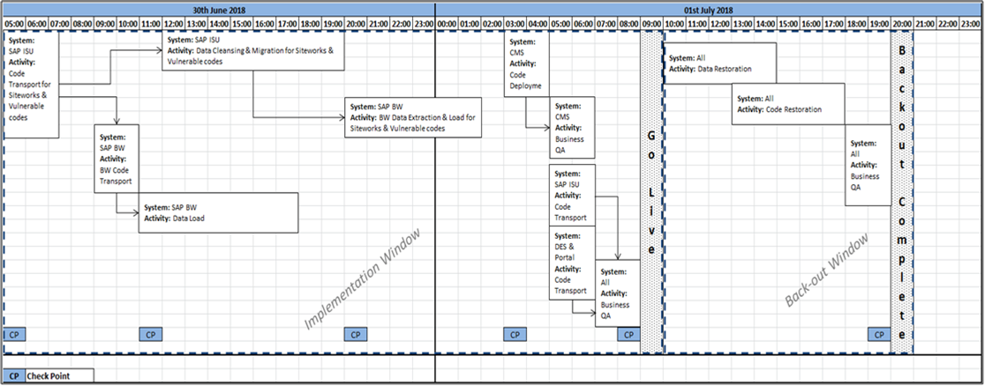
Appendix 1 - Xoserve High Level Cutover/Imp Plan

