Slide 1
PARR Dashboards
12 June 2018
PAFA

Slide 2
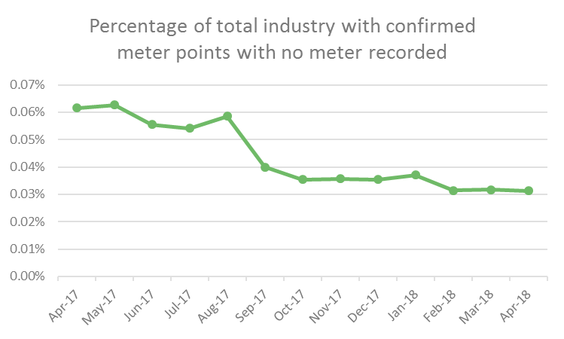
2A-2 No Meter Recorded
Report measures percentage of each Shippers portfolio of confirmed meter points with no meter recorded on the Supply Point Register as at the report snapshot date
Monthly change
0.05% ↓ Birnbeck
0.02% ↓ Burnham-on-Sea
0.02% ↓ Gravesend
0.03% ↑ Morecambe Central
0.01% ↑ Lytham
0.01% ↑ Southsea Clarence
0.00% ↓ - Monthly change
0.03% ↓ - Annual change
0.51% Lytham
0.49% Eastbourne

Slide 3
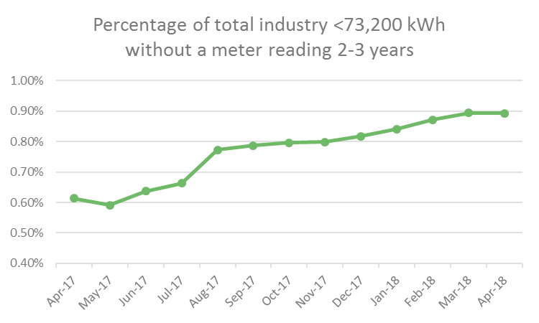
2A-7.1 No Read 2 - 3 Years <73200 kWh
Report measures percentage of Shipper's portfolio in the <73,200 kWh AQ band without a meter reading for the 2-3 year period as at the report snapshot date
Monthly change
0.80% ↓ Walton-on-the-Naze
0.46% ↓ Torquay
0.43% ↓ Weymouth Bandstand
1.03% ↑ Southport
0.49% ↑ Blackpool South
0.24% ↑ Worthing
0.00% ↓ - Monthly change
0.28% ↑ - Annual change
29.40% Torquay
6.99% Weymouth Bandstand

Slide 4
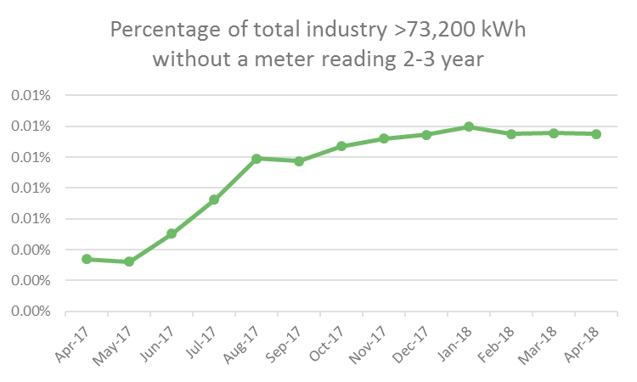
2A-7.2 No Read 2 - 3 Years >73200 kWh
Report measures percentage of Shipper's portfolio in the >73,200 kWh AQ band without a meter reading for the 2-3 year period as at the report snapshot date
Monthly change
0.06% ↓ Burnham-on-Sea
0.02% ↓ Hastings
0.01% ↓ Worthing
0.02% ↑ Mumbles
0.01% ↑ Birnbeck
0.01% ↑ Morecambe Central
0.00% ↓ - Monthly change
0.00% ↑ - Annual change
1.60% Walton-on-the-Naze
0.79% Burnham-on-Sea

Slide 5
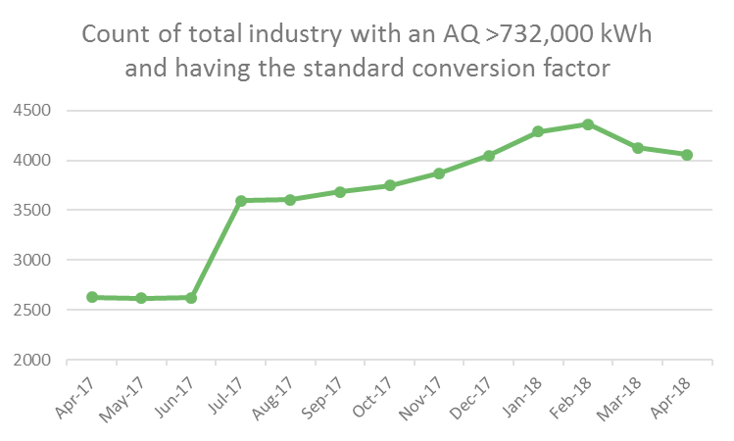
2A-9 Standard CF AQ > 732000 kWh
Report measures count of sites with an AQ >732,000 kWh, but having the standard conversion factor (i.e. 1.02264) as at the report snapshot date
Monthly change
107 ↓ Deal
8 ↓ Burnham-on-Sea
7 ↓ Southport
23 ↑ Colwyn Bay
14 ↑ Mumbles
9 ↑ Falmouth
66 ↓ - Monthly change
1429 ↑ - Annual change
962 Falmouth
873 Morecambe Central

Slide 6
PAFA@Gemserv.com
Nirav Vyas

