Slide 1
Cost Allocation review – CoMC update July 18

Slide 2
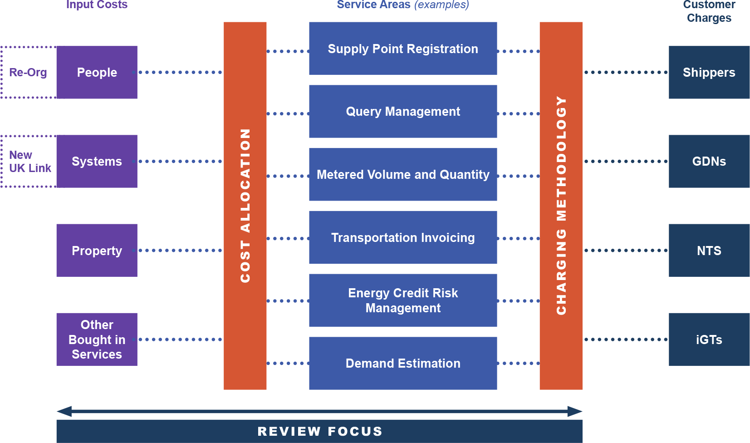
Recap from BP19 Principles presentation

Slide 3
Management Summary
People
Updated cost centre allocation across General Services, Investment and Support activities (based on the new organisation structure)
Additional granularity allows us to allocate Investment resource costs more accurately thus reducing the common sharing pool
Resource allocations to General Service Lines are still under review we expect to see some adjustments resulting from this (E.g. Switching & Reporting)
Systems Costs
Updated the allocation of input costs across applications / shared products
Challenges on how to split and allocate new UK Link costs
Property & Other Bought in Services
Initial review suggests there are no changes required to current allocation rules
This presentation covers principles not £ or FTE values
Any agreed changes to the allocations are not retrospective and will apply 2019/20 onwards

Slide 4
High Level Principles
The overall principle for cost allocation will not change – the detail will give rise to an opportunity for realignment to known cost bases.
General Service (Maintain the Business) Service Lines
Direct allocation from appropriate cost centres
Investment and Change
Dedicated people cost
Support people cost
Allocated by proportion of dedicated FTE resource measured above
Property and other BIS
Allocated by proportion of dedicated FTE resource measured above or directly
Systems
Allocated to General Service and Investment and change by internal service user
For the purposes of concept illustration only. Inferred allocations are indicative.

Slide 5
Current state General Services - People
Current allocations of people costs to the 21 service lines are based on pre DSC and Project Nexus allocations of personnel. Support allocations are also based on these FTE allocations
Operations
Direct People Cost
Customer Department
Reporting team
A
B
D
A
C
D
A
B
C
D
Support People Cost
Operations
Customer Department
A
C
D
A
B
D
Reporting team
A
B
C
D
Total General Service People Cost
For the purposes of concept illustration only. Inferred allocations are indicative.
A
B
C
D

Slide 6
Proposed future state General Services -People
We have changed our ways of working following Nexus go live. This will reflect in the FTE allocation for the individual service lines, respecting the current cost allocation principles
Operations
Direct People Cost
Customer Department
Reporting Team
A
D
A
D
A
B
C
D
Support People Cost
Operations
Customer Department
Reporting Team
A
D
A
D
A
B
C
D
Total General Service People Cost
For the purposes of concept illustration only. Inferred allocations are indicative.
A
B
C
D

Slide 7
Current state Investment and Change - People
Costs allocated to constituencies where possible on a usage basis. Where this is not possible, people costs are currently allocated on a basis of adjusted MTB charge (taking into account dedicated constituency MTB spend)
Constituency a
Constituency b
Constituency c
Constituency d
Direct Investment 1
Direct Investment 2
Direct Change 3
Common investment and change people costs
For the purposes of concept illustration only. Inferred allocations are indicative. These people costs are fully loaded, including support services

Slide 8
Proposed Investment and Change - People
Costs will continue to be allocated to constituencies where possible on a usage basis. We have more visibility of these costs. Where this is not possible, our reporting structure has improved to give a more reliable allocation for project resource
Constituency a
Constituency b
Constituency c
Constituency d
Direct Investment 3
Direct Investment 7
Direct Change 8
Common investment and change people costs
For the purposes of concept illustration only. Inferred allocations are indicative. These people costs are fully loaded, including support services

Slide 9
Systems - Input costs to applications & shared services
System Input cost component | “New” UK Link | Gemini | CMS | IX | Support Component | Shared
Desktop / Network | - | - | - | - | - | ✓
Environment & Code Mgmt | ✓ | ✓ | ✓ | - | - | -
UK Link Hosting | ✓ | - | - | - | - | -
Other Hosting (inc helpdesk) | - | ✓ | ✓ | - | ✓ | ✓
Telecoms & IX Connections | - | - | - | ✓ | - | -
S/W Licence - SAP | ✓ | - | - | - | - | -
S/W Licence - Oracle | - | ✓ | ✓ | - | - | -
S/W Licence – Application Specific | ✓ | ✓ | ✓ | - | - | -
S/W Licence – Other | - | - | - | - | - | ✓
System Maintenance | ✓ | ✓ | ✓ | - | - | -
Application Support | ✓ | ✓ | ✓ | - | - | -
Application descriptions have been updated and there is a more distinct allocation of Input costs

Slide 10
Challenges
Support Component costs
We propose to allocate the costs of support components across those applications they support using total cost.
There doesn’t appear to be a quick win for allocating costs of “New” UKLink between:-
“Old” UK Link and subsequently to SPA, Invoicing, Sites & Meters functionality
Information Provisioning and
Data Enquiry
We would be interested in understand if you have similar issues and how you resolved them.

Slide 11
Applications / Shared to Service Lines
Application | Current Service Line Allocation Method | Review Conclusion
UK Link - SPA | 100% to SL 1 Manage the Supply Point register | No change
UK Link – S&M Database | Multiple SLs | To be reviewed
UK Link - Invoicing | 100% to SL 7 Invoicing | No change
UK Link – Information Provisioning | 100% to SL 18 Provision of User reports and Information | No change
UK Link – Data Enquiry | Specific Service | No change
Gemini | 100% to SL 20 Gemini System Services | No change
CMS | 100% to SL 2 Provide Query Management | No change
IX | 100% to UK Link Services Connections – Specific Service | No change
Other shared | Prorata based on FTE | No change
1:1 Application to Service Line relationships are still fit for purpose, Sites & Meters database element of UK Link may need to be revisited

Slide 12
Property & Other Bought In Services
Bought in Service | Current Service Line Allocation Method | Review Conclusion
M Numbers | 100% to SL16 – Provision of Supply Point Info… | No change
Lansdowne Gate Property | Prorated to Direct FTE by SL | No change
Data Recorders | 100% to SL15 – Demand Estimation | No change
AUGE | 100% to SL3 – Record, Submit Data in Compliance with UNC | No change
PAFA | 100% to SL3 – Record, Submit Data in Compliance with UNC | No change
Others (Finance, Insurance, HR etc) | Prorated to Direct FTE by SL | No change
The current Service Line allocation method is still fit for purpose

