Slide 1
UIG Task Force Progress Report
ChMC 10th October 2018

Slide 2
Background
Modification 0658: ‘CDSP to identify and develop improvements to LDZ settlement processes’ approved by Ofgem on 6th July 2018
Modification raised to authorise the CDSP to assign resources and incur costs related to a task force to investigate the causes and influencers of Unidentified Gas (UIG), with a target of reducing the volatility and scale of UIG and developing a robust predictive model for daily UIG for use by all parties.
BER for Change Reference Number XRN4695: ‘Investigating causes and contributors to levels and volatility of Unidentified Gas’ approved at ChMC on 11th July 2018
This Change Proposal added an additional service line into the DSC to enable Xoserve access to investigate, using resources and technology, causes and contributors to levels and volatility of Unidentified Gas. Xoserve is to provide monthly update reports and recommend proposals and subsequent changes or modifications for the industry.
The following slides provide:
Task Force Dashboard
POAP
Executive Summary of Sprint 1
Post Sprint 1: Areas Of Investigation (placeholder)
Shipper dashboards (placeholder)
Reporting on budget

Slide 3
UIG Task Force: Dashboard
Overall RAG status:*
G
Executive Summary | RAG
In Sprint 1 the Task Force carried out a range of investigations which have led us to identify several potential drivers of volatility of varying impact. Our most significant findings were that components of the NDM algorithm appear to be strongly correlated with UIG. These findings suggest that the NDM algorithm does not react quickly enough to significant day-on-day weather changes, and that holiday factors do not reflect real usage patterns. Additional modelling is now needed to further substantiate and quantify these findings. Conversely, the analysis confirmed that the weekend vs. weekday component of the algorithm has no correlation to UIG. In Sprint 2 we will therefore continue the most promising current lines of investigation to validate early findings by the use of data across a wider date range. In addition to this, Sprint 2 will also incorporate new areas of investigations to quantify additional UIG causes; the accuracy of DM Nominations, the role of standard conversion factors and the NDM sample data set. Lastly, the production of industry reports on Class 1-4 meter read submissions and AQ value-at-risk highlight the need to raise submission levels to UNC standards. We recommend these are included in the specification for the initial shipper dashboards – to be discussed with shippers at DSC ChMC before we commission the build. | Time | G
 | Cost | G
 | Benefit | N/A
Progress since last month - key milestones | Workstream | Date | Status
Knowledge transfer completed with CC | AA + IA | 07/09 | C
JIRA boards in place for effective Sprint working | AA | 07/09 | C
Produce initial industry reports on key areas of performance, e.g. meter read submission and quantify value-at-risk | IA | 15/09 | C
Complete Sprint 1 | AA + IA | 24/08 | C
Sprint 2 Kick off Workshop / Deliverable prioritisation | AA + IA | 24/08 | C
Publication of Sprint 1 Executive Summary | AA + IA | 27/08 | C
Design functional requirements for initial shipper dashboards on high-priority issues | IA | 07/09 01/10 | C
Priorities for next month – key milestones | Workstream | Date | Status
Proposed dashboard specification complete | Customer | 05/10 | G
Complete Sprint 2 | AA + IA | 08/10 | G
Sprint 3 Kick off Workshop / Deliverable prioritisation | AA + IA | 08/10 | G
Agree appropriate forum for creation of shipper dashboards | Customer | 10/10 | G
Publish Industry Data Tree | IA + AA | 12/10 | G
Publication of Sprint 2 Executive Summary | AA + IA | 12/10 | G
Action plan template developed | Customer | 22/10 | G
Synthesis Report published for first 3 sprints | IA + AA | 05/11 | G
*R = programme objectives at risk and no agreed plan to resolve; A = programme objectives at risk, with agreed plan in place to resolve; G = on track.

Slide 4
Plan On A Page
C
Completed activity
Delivery team milestone
Advanced Analytics
DSC ChMC governance
I
 | August |  |  |  |  | September |  |  |  | October |  |  |  |  | November |  |  |  | December
 | 01/08 | 06/08 | 13/08 | 20/08 | 27/08 | 03/09 | 10/09 | 17/09 | 24/09 | 01/10 | 08/10 | 15/10 | 22/10 | 29/10 | 05/11 | 12/11 | 19/11 | 26/11 | 03/12 | 10/12 | 17/12
08/08 DSC ChMC
I
12/09 DSC ChMC
02/10 Extraordinary DCS ChMC
I
I
07/11 DCS ChMC
12/12 DCS ChMC
I
I
10/10 DCS ChMC
TBC Extraordinary DCS ChMC
I
I
03/09 Kick-off workshop with Vendor
27/08 Sprint 1 Exec Summary published
12/10 Sprint 2 Exec Summary published
Develop Investigation Log
C
C
C
C
Sprint 1
05/11 Synthesis Report published for first 3 sprints
Sprint 2
Develop Industry Data Tree
Sprint 3
Develop Data Dictionary
Customer Engagement Manager Day 1
C
Sprint 4 (dates indicative)
24/8 Data Package 1 to vendor
03/9 Data Package 2 to vendor
14/9 Data Package 3a to vendor
27/9 Data Package 3b to vendor
12/10 Publish Industry Data Tree
Sprint 5 (dates indicative)
C
C
C
C
Sprint 6 (dates indicative)
C
Finalise inputs to data hamper
C
Develop stakeholder comms & engagement plan
Sprints 4-6 to continue at the same pace and follow directly after the initial sprints to maintain momentum and ensure existing team resources are fully utilised. A 14-day stand-down period applies at any time.
Mobilisation activity completed
C
Customer Advocate
Briefing Session
Confirm UIG points of contact & allocate Relationship Mgrs
Develop and manage shipper action plans (linked to Investigation Log)
C
05/10 Initial specification complete
22/10 Action plan template developed
Identify initial reporting inputs and outputs
10/10 Agree appropriate forum for creation of shipper dashboards
Define functional requirements for initial dashboard
C
Issue analysis and tracking (Investigation Tracker updated and published weekly)
Establish units of measurement & glide path

Slide 5
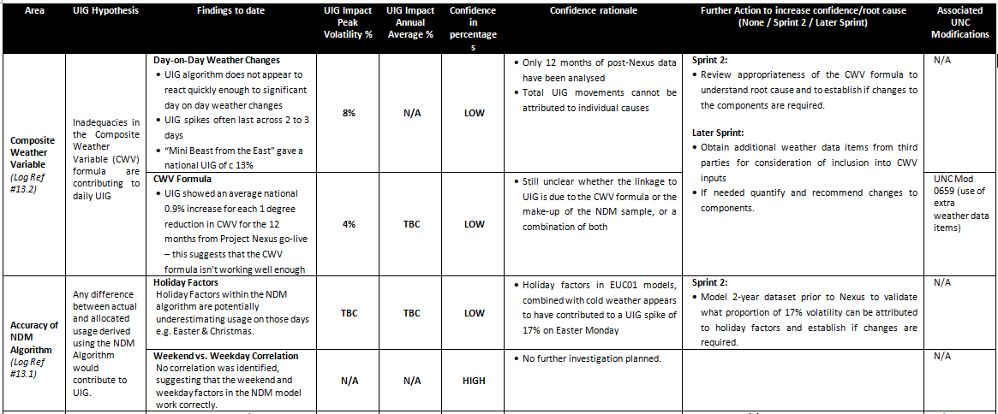
Sprint 1: Executive Summary (1/4)
NDM

Slide 6
Sprint 1: Executive Summary (2/4)

Slide 7
Sprint 1: Executive Summary (3/4)

Slide 8
Sprint 1: Executive Summary (4/4)
Additional initiatives* pending for future sprints:
Theft of Gas (Ref #11)
Sites on CSEPs (IGT Networks) not recorded on CDSP system (Ref #15)
CSEP-LDZ Mapping (Ref #4)
LDZ Measurement Errors (Ref #5)
Unregistered/Shipperless (Ref #6)
LDZ Shrinkage Assessment (Ref #7)
Shrinkage on IGT networks (Ref #8)
Accuracy of NDM Read Estimates (Ref #10)
Use of standard conversion factors for NDM sites >732,000 kWh AQ (Ref #12.1)
Use of a non-standard conversion factor for all NDM sites with AQ <732,000 (Ref #12.3)
Live sites in DE (Dead) status (Ref #14)
Inaccuracy of metering equipment at end consumer property (Ref #16)
Incorrect or missing data on the supply point register (Ref #17)
*References link to the Investigation Log on the UIG Task Force website

Slide 9
Sprint 2 Outcomes And Sprint 3 Areas Of Investigation
Issue Description and Ref # | Sprint 2 Findings | Sprint 3 Next Steps
Use of Composite Weather Variable (CWV) within NDM Allocation (Ref #13.2) | Day on Day weather changes – Whilst a significant relationship exists, a better fit could not be found by increasing, decreasing or removing the “memory” of previous days’ temps in the formula, there was no overall improvement to UIG Overall sensitivity analysis of the NDM Formula Sensitive: To temperature (including wind chill co-efficient) Within Day weightings – the current set of weightings within the CWV formula may require review. Insensitive: Wind speed Cold weather parameters | Expand CWV analysis, amend current values, include new variables and introduce non-linear modelling, to identify which of these map to historic UIG volatility, to enable recommendations.

Slide 10
Sprint 2 Outcomes And Sprint 3 Areas Of Investigation
Issue Description and Ref # | Sprint 2 Findings | Sprint 3 Next Steps
Accuracy of NDM Algorithm – Holiday Factors (Ref # 13.1) | 6 years of data analysed suggests that the holiday factors are working as intended (previous holiday spike was a data ‘echo’ caused by the higher overall demand on holiday days and was not an outlier in terms of UIG levels) | No further analysis required
Standard National Conversion Factor for smaller sites (Ref # 12.2) | Initial comparison to post-Nexus UIG does not suggest a direct correlation between larger errors in the standard conversion factors against LDZ levels of UIG | Other evidence provided by customers warrants further investigation, therefore carrying forward to Sprint 3.
Meter Points in "Isolated" status which are registering consumption (Ref # 18) | Evidence found shows that known sites contribute around 0.006% of total throughput. | Known sites passed to BAU. Further investigation to estimate possible scale of unreported isolated sites which are consuming gas

Slide 11
Sprint 3 Further Areas Of Investigation
Sprint 3 Activities
Accuracy/out of date AQs (Ref # 3.2) – Carried forward
Analyse trend of AQs, including up to 5 years of high level market data, to see if there is a relationship to UIG levels.
DM Nomination Accuracy (Ref # 9) – Carried forward
Data extract delivered to Taskforce, need to validate data received and analyse data for relationship between DM Noms accuracy and UIG.

Slide 12
Shipper Dashboards
For discussion: which industry forum(s) should we consult as part of the design and build
The estimated effort to produce a Minimum Viable Product (including contingency) translates to a delivery time of no less than 3 weeks but is not envisaged to be more than 6 weeks to create, this is purely based on the drafted reports specified below. (any changes to this would need further assessment).
Current view on costs – included under current budget approval - Only o/s query is regarding licence costs – tbc.
Current thinking of reports required:

Slide 13
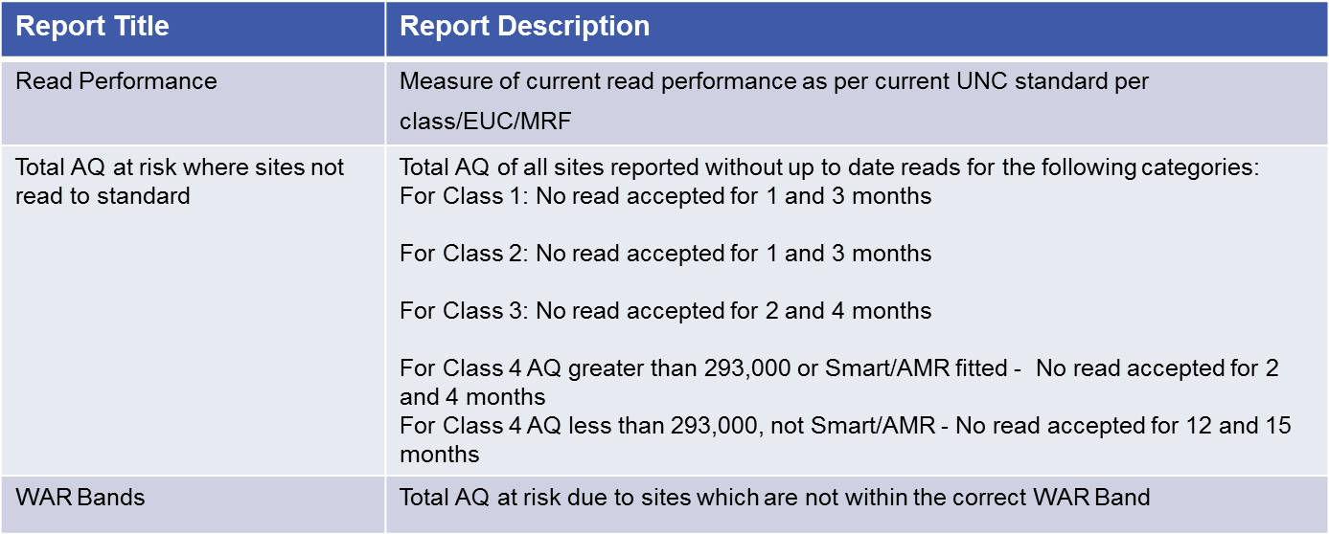
Shipper Dashboards continued.

Slide 14
Shipper Dashboards continued.
Reporting capabilities considered for inclusion on drafted reports:
Trending – All of the reports to indicate if trending is up or down against historic data
Comparison to market – Shipper ranking, 1st, 2nd etc out of the number of shippers this metric applies to. Note Shippers will not have visibility of other shippers rankings
LDZ/Post code drill down – Capability for counts to be available at LDZ/Post code level
Shipper filter – To enable a user to view data for an individual supplier (if required)

Slide 15
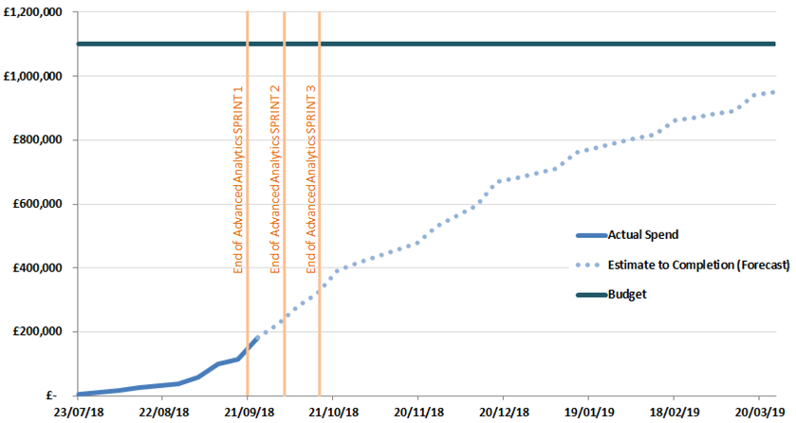
Overview Of Taskforce Funding
DSC ChMC in July approved a BER of £1.1m for XRN 4695 to enable Xoserve to lead on the investigation to the causes and contributors to levels and volatility of UIG. Included within this £1.1m exists the £350k reserved as a placeholder for UIG-related activities in Xoserve’s approved 2018 Business Plan (BP18).
The Task Force is currently tracking to forecast spend. Xoserve’s Q2 forecast process is running through October – an update will be provided in due course.
UIG Taskforce Spend Profile

