Slide 1
Number of Solution Options Presented at the Delivery Sub Group for 2018

Slide 2
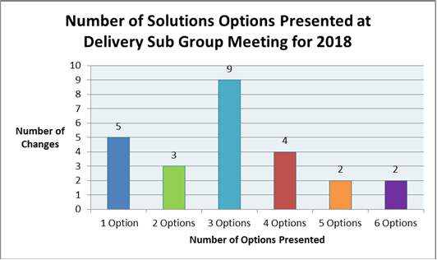
Graph

