Slide 1
UIG Task Force Progress Report
DSC ChMC 12/12/18

Slide 2
Background
Modification 0658: ‘CDSP to identify and develop improvements to LDZ settlement processes’ approved by Ofgem on 6th July 2018
Modification raised to authorise the CDSP to assign resources and incur costs related to a task force to investigate the causes and influencers of Unidentified Gas (UIG), with a target of reducing the volatility and scale of UIG and developing a robust predictive model for daily UIG for use by all parties.
BER for Change Reference Number XRN4695: ‘Investigating causes and contributors to levels and volatility of Unidentified Gas’ approved at ChMC on 11th July 2018
This Change Proposal added an additional service line into the DSC to enable Xoserve access to investigate, using resources and technology, causes and contributors to levels and volatility of Unidentified Gas. Xoserve is to provide monthly update reports and recommend proposals and subsequent changes or modifications for the industry.
The following slides provide:
Task force dashboard
POAP
Sprint 6 (placeholder)
Reporting on budget
Task force recommendations:- Ref 1 Use of Estimates for DM sites, Ref 3.2.1 EUC09 sites, Ref 12.1 & 12.3 Non Standard Conversion Factors & Ref 12.2 Standard Conversion Factors.

Slide 3
UIG Task Force: Dashboard
RAG
Time | G
Cost | G
Benefit | N/A
Overall RAG status:*
G
Progress since last month - key milestones | Workstream | Date | Status
Complete Sprint 2 | AA + IA | 08/10 | C
Sprint 3 Kick off Workshop / Deliverable prioritisation | AA + IA | 08/10 | C
Agree appropriate forum for creation of shipper dashboards | Customer | 10/10 | C
Publish Data Tree | AA + IA | 12/10 | C
Publication of Sprint 2 Executive Summary | AA + IA | 12/10 | C
Publication of Sprint 3 Executive Summary | AA + IA | 25/10 | C
Attend UIG working group - dashboard | IA & AA | 31/10 | C
Publication of Sprint 4 Executive Summary | IA & AA | 08/10 | C
Publication of Sprint 5 Executive Summary | IA & AA | 22/10 | C
Priorities for next month – key milestones | Workstream | Date | Status
Publication of Sprint 6 Executive Summary | IA & AA | 06/12 | G
Publication of Findings - ongoing | IA & AA | 07/12 | G
Present documented Recommendations at ChMC December | IA & AA | 12/12 | G
Attend UIG working group | IA & AA | 07/12 | G
Present documented Recommendations at ChMC January | IA & AA | 09/01 | G

Slide 4
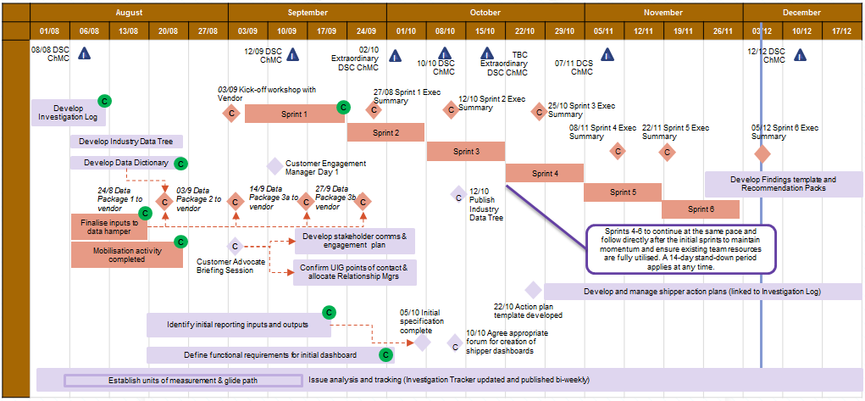
Plan on Page
C
Completed activity
Delivery team milestone
Advanced Analytics
DSC ChMC governance
I

Slide 5
Sprint 6 (placeholder)

Slide 6
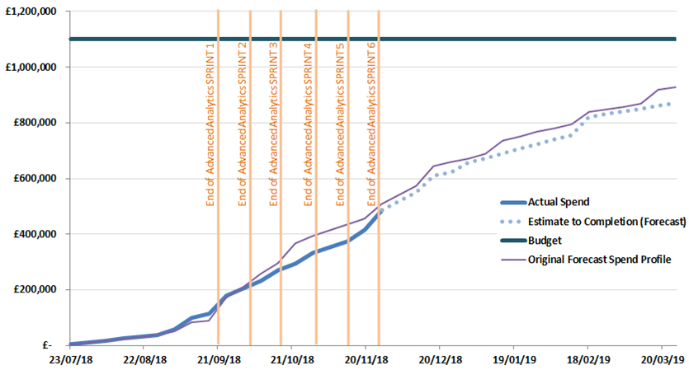
Overview Of Taskforce Funding

Slide 7
UIG Task Force Recommendations
Investigation Item 1 - Use of Estimates for DM sites
Investigation Item 3.2.1- EUC09 Sites
Investigation Item 12.1 & 12.3 - Conversion Factors
Investigation Item 12.2 - Conversion Factors

Slide 8
UIG Task Force Recommendations
Investigation Item 1
Use of Estimates for DM Sites

Slide 9
Background
Item 1
What is the finding?
Where actual reads are not received or are rejected, for Class 1 and 2 sites a D-7 estimate is used (i.e. the same consumption as 7 days ago is used if available otherwise other AQ/365)
This may not be a good representation of the actual consumption and any difference would contribute to UIG
As at 01/10/18, c. 3bn kWh of Class 1 and 2 (i.e. DM) AQ has not had an actual meter reading accepted for over 3 months
Read submission rate is 45% for Class 2 against a UNC target of 97.5%
How does it contribute to UIG?
This AQ without an actual meter read equates to c 0.6% of total LDZ AQ and creates a risk of both base UIG and volatility, if the actual usage is not well represented by the D-7 estimation processes.
DM sites’ consumption can sometimes vary by -50% and +100% from the average on any given day, so this may contribute spikes of around 0.6% on a day
Assuming 10% change in usage since last reading, this could be contributing around 0.06% to base usage (i.e. 10% x 0.6% AQ at risk).

Slide 10
Options to Address the Finding
Item 1
No. | Option | Likelihood of Success | Implementation Lead Times
1. | No action (“Do Nothing” option) | Very low | N/A
2. | Engagement with DMSPs – monitor read rejections for Class 1. Resurrect previous initiatives to monitor and help resolution Engagement with Shippers – monitor read rejections for Class 2. Provide encouragement for action to be taken. Xoserve to monitor monthly and notify relevant Shippers/DMSPs | Low to medium – requires Shipper/DMSP co-operation | Short to medium
3. | Notify Ofgem of individual sites and associated Shippers | Low to medium – requires Shipper co-operation unless Ofgem can apply any financial leverage | Short to medium
4. | PAC reporting and monitoring – PAC to engage with shippers on basis of existing and/or new reports in Performance Assurance Report Register. Consideration of any additional reporting to PAC | Low to medium – requires Shipper co-operation unless financial incentives are also introduced | Medium
5. | Changes to UNC – see next slide | Low to high | Medium to long

Slide 11
Possible UNC Modifications
Item 1
No. | Option | Likelihood of Success | Implementation Lead Times
A. | Review DMSP read incentive framework (Class 1) | Low to medium, depending on structure of incentives | Short to medium
B. | Reduce the duration for the Class 2 Must Read trigger & extend to include Class 1 | Medium to high, depending on access rates for must reads | Medium
C. | Introduce incentives or liabilities for low submission rates for Class 2, and/or extend Class 1 liabilities to apply to shippers | Medium to high, depending on structure of regime | Medium/long – UNC Mod timescales plus system changes
D. | CDSP obtains reads by installing AMR | Medium to high, depending on accuracy of asset details | Long
E. | Amend the industry processes to allow CDSP to obtain the reads directly from the read provider (DMSP/DCC etc) | High | Very long

Slide 12
Xoserve Recommendations
Item 1
Xoserve recommendation – combination of activities
2. Shipper Engagement
Short-term via Xoserve Account Managers and internal reporting
3. PAC Reporting
Medium-term via agreed change to PAC Report Register (UNCC governed) and Change Proposal for extra reports
6B & C: Shorten/Extend Must Read timescales and introduce incentives/ penalties
Long-term via UNC Modification and Change Proposal (raised and sponsored by Industry party)

Slide 13
UIG Task Force Recommendations
Investigation Item 3.2.1
EUC09 Sites

Slide 14
Background
Item 3.2.1
What is the finding?
We have identified a number of large sites where the AQ is above the Class 1 threshold of 58.6m kWh
These sites are currently NDM (Class 3 or 4)
These sites should be re-confirmed as Class 1 by the Shipper after 3 consecutive AQ calculations above the threshold in a 6-month period, or after 18 months if every calculated AQ is above the threshold (UNC G1.6.15)
How does it contribute to UIG?
Sites of this size are likely to have a unique usage pattern
The NDM Profile for EUC09B is based on national data and is unlikely to be a good representation of each site’s usage
Any difference between the actual usage and the NDM allocation will contribute to UIG each day
These sites are estimated to be contributing around 0.4% of UIG on an average day

Slide 15
Options to Address the Finding
Item 3.2.1
No. | Option | Likelihood of Success | Implementation Lead Times
1. | No action (“Do Nothing” option) | Very low | N/A
2. | Engagement with Shippers – highlight the individual sites, provide support, encourage action to re-confirm. Xoserve to monitor monthly and notify relevant Shippers | Low to medium – requires Shipper co-operation | Short to medium
3. | PAC reporting and monitoring – add new reports to Performance Assurance Report Register | Medium | Medium (Mod 0660 now approved). Requires a CP to create reports
4. | Notify Ofgem of individual sites and Shippers | Low to medium – requires Shipper co-operation unless Ofgem can apply any financial leverage | Short to medium
5. | Improve NDM Profiles for EUC09, e.g. create WAR Band EUCs | Low – usage of these sites may not follow any pattern | Start of next Gas Year (Oct 2019 earliest)
6. | Changes to UNC – see next slide | Low to high | Medium to long

Slide 16
Possible UNC Modifications
Item 3.2.1
No. | Option | Likelihood of Success | Implementation Lead Times
A. | Reduce the qualifying period for Class 1 (currently 18 months or 6 consecutive calculations) | Low (unless combined with other measures) | Medium – UNC Mod timescales but no system changes
B. | Automatically convert sites to Class 1 after qualifying period | High – after qualifying period | Medium/long – UNC Mod timescales plus system changes
C. | Use the UIG Weighting Factors to create a incentive to change to Class 1 (i.e. increased rate for Classes 2 to 4). Might need protection for sites which have not yet passed the qualifying period – would add complexity | Medium/high – depending on the size of the incentive. | Medium/long – UNC Mod timescales plus changes to AUG Table from next Gas Year. May also require system changes
D. | Create financial penalties for sites which have not been re-confirmed to Class 1 | Medium/high – depending on the size of the penalty. | Medium/long – UNC Mod timescales plus system changes

Slide 17
Xoserve Recommendations
Item 3.2.1
Xoserve recommendation – combination of activities
2. Shipper Engagement
Short-term via Xoserve Account Managers and internal reporting
3. PAC Reporting
Medium-term via agreed change to PAC Report Register (UNCC governed) and Change Proposal for extra reports
6A and D: Shorten timescales and introduce incentives/ penalties
Long-term via UNC Modification and Change Proposal (raised and sponsored by Industry party)

Slide 18
UIG Task Force Recommendations
Investigation Item 12.1, 12.3
Site-Specific Conversion Factors

Slide 19
Background
Item 12.1
What is the finding?
How does it contribute to UIG?
12.1 Use of standard conversion factors for NDM sites > 732,000 kWh AQ
All sites of this size should have a specific conversion factor (to convert volume to energy) based on altitude, temp and pressure rather than the industry standard value
There are currently around 5,000 of c.26,000 eligible sites without a site-specific conversion factor.
Around 18% of eligible sites have a standard CF but this is a relatively small section of the market (c.1% of AQ)
Any difference between the standard value and a more accurate value would mean that the gas was under or over metered and would contribute to UIG. Once the reads have been used to calculate an AQ, nominations and allocations would also be affected
Comparison to average of specific CFs in each LDZ suggests an annualised understatement of 7.4% on consumption of affected sites
UIG estimate 0.1% of total throughput (assumes all sites were in EUC04B, based on average AQ in dataset of 1.6m kWh).

Slide 20
Background
Item 12.3
What is the finding?
How does it contribute to UIG?
12.3 Use of non-standard conversion factors for NDM sites < 732,000 kWh AQ
All sites of this size should have the industry standard value (not a specific conversion factor based on altitude, temp and pressure)
Around 10,000 relevant sites, with a total AQ of 2.8bm kWh (c.5% of total market), have a specific CF
The average AQ of the dataset is around 270,000 kWh, suggesting that many sites were previously eligible for a site specific conversion factor, and have not yet had an update back to the standard value, following AQ degradation (or the AQ may actually be erroneous and awaiting correction)
Any difference between the standard value and a site-specific value would mean that the gas was under or over metered and would contribute to UIG.
Once the reads have been used to calculate an AQ, nominations and allocations would also be effected.
Comparison of standard CF to specific CFs for affected sites in each LDZ suggests an annualised error of 3.77% on consumption of affected sites.
This is currently reducing UIG by 0.02%

Slide 21
Options to Address Findings 12.1 & 12.3
No. | Option | Likelihood of Success | Implementation Lead Times
1. | No action (“Do Nothing” option) | Very low | N/A
2. | Engagement with Shippers – highlight the individual sites, provide support, encourage action to update correction factors. Xoserve to monitor monthly and notify relevant Shippers | Low to medium – requires Shipper co-operation | Short to medium
3. | PAC reporting and monitoring – add new reports to Performance Assurance Report Register for 12.3 (already exists for 12.1) | Low to medium – requires Shipper co-operation | Medium
4. | Notify Ofgem of individual sites and Shippers | Low to medium – requires Shipper co-operation unless Ofgem can apply any financial leverage | Short to medium
5. | Changes to UNC – see next slide | Medium to high | Medium to long

Slide 22
Possible UNC Modifications to Address Finding 12.1 (Standard Conversion Factor used where AQ >732,000 kWh)
No. | Option | Likelihood of Success | Implementation Lead Times
A. | Introduce incentives or penalties on inappropriate CFs as an addition to the existing PAC reports | Medium/high – depending on the size of the incentive. | Medium/long – UNC Mod timescales plus system changes
B. | Introduce new process to allow Xoserve to liaise with MAM to obtain the new correction factor – either update UKLink or provide to Shipper to update | Medium/high – depending on the support of the MAM/ Shipper | Medium/long – UNC Mod timescales plus system changes
C. | Introduce new process to allow Xoserve to trigger either a desktop process or a site visit to obtain the new correction factor – either update UKLink or provide to Shipper to update | Medium/high – depending on the success of site visits | Medium/long – UNC Mod timescales plus system changes

Slide 23
Possible UNC Modifications to Address Finding 12.3 (Non-Standard Conversion Factor used where AQ <732,000 kWh)
No. | Option | Likelihood of Success | Implementation Lead Times
D. | Introduce incentives or penalties as an addition to the new PAC reports | Medium/high – depending on the size of the incentive. | Medium/long – UNC Mod timescales plus system changes
E. | Default the Conversion Factor to standard when the AQ drops below 732,000 [after a qualifying period] | Medium/high – depending on length of any qualifying period | Medium – UNC Mod timescales plus system changes

Slide 24
Xoserve Recommendations – 12.1 (Standard Conversion Factor used where AQ >732,000 kWh)
Xoserve recommendation – combination of activities
2. Shipper Engagement
Short-term via Xoserve Account Managers and internal reporting
3. PAC Reporting
Medium-term via agreed change to PAC Report Register (UNCC governed) and Change Proposal for extra reports
5A: Introduce penalties
Long-term via UNC Modification and Change Proposal (raised and sponsored by Industry party)

Slide 25
Xoserve Recommendations – 12.3 (Non-Standard Conversion Factor used where AQ <732,000 kWh)
Xoserve recommendation – combination of activities
2. Shipper Engagement
Short-term via Xoserve Account Managers and internal reporting
3. Introduce PAC Reporting
Medium-term via agreed change to PAC Report Register (UNCC governed) and Change Proposal for extra reports
5D and E: Introduce penalties/incentives, revert to standard [after qualifying period]
Long-term via UNC Modification and Change Proposal (raised and sponsored by Industry party)

Slide 26
UIG Task Force Recommendations
Investigation Item 12.2
Standard Conversion Factors

Slide 27
Background
Item 12.2
What is the finding?
12.2 Use of standard conversion factors for NDM sites < 732,000 kWh AQ, regardless of variations in LDZ or geography
All sites under 732,000 AQ should have a single industry standard conversion factor specified in legislation (also referred to as a Correction Factor)
Any difference between the standard value and more accurate value would mean that gas was under- or over-metered and would contribute to UIG.
Once the reads have been used to calculate an AQ, Nominations and Allocations would also be affected
How does it contribute to UIG?
Analysis of the impact of using actual temperatures instead of the standard 12.2 degrees in a colder than average LDZ indicates that the annual effect is non-zero, i.e. that summer over-recording of actual energy does not fully offset the winter under-recording of actual energy.
Analysis of effect of standard v actual hourly temps on first year post-Nexus shows national impact of standard conversion is 0.4% additional UIG. Using actual temps would have reduced UIG by up to 3% on peak days and increased it by up to 4% on the warmest days.

Slide 28
Options to Address Finding 12.2 (Use of Standard national Conversion Factor)
No. | Option | Likelihood of Success | Implementation Lead Times
1. | No action (“Do Nothing” option) | Very low | N/A
2. | Use actual temperatures to convert consumptions used to develop the NDM Profiles (ALPs and DAFs) | Medium – improves daily allocation but does not correct calculation of metered energy or AQ | Short/medium – could be implemented for October 2019
3. | Influencing strategy to amend Thermal Energy Regulations | Unknown? | Probably long?
4. | Changes to UNC – see next slide | Medium to high | Medium to long

Slide 29
Possible UNC Modifications
Item 12.2
No. | Option | Likelihood of Success | Implementation Lead Times
A. | Amend AUGE process to re-distribute UIG based on estimated impacts of conversion factors (forecast basis) | Medium/high – depending on actual weather for the year | Medium – requires governance changes but probably no system changes
B. | Retrospective adjustment to allocations based on actual weather for the year | Medium/high – depending on methodology applied | Medium to long depending on complexity of arrangements
C. | Introduce an LDZ level conversion factor (permanent/per year/per month) | Low to medium – depending on whether annual/monthly | Medium to long depending on complexity of arrangements
D. | Amend UNC/legislation to require site specific conversion for every site | Low to medium due to scale of workload | Short/medium – creation of capability only

Slide 30
Xoserve Recommendations
Item 12.2
Xoserve recommendation
2. Use actual temperatures in NDM Profile development
Short-term via Demand Estimation processes
Rationale: Other options would be complex and have unpredictable impacts – annualised impact is likely to be low
The revised ALPs and DAFs would also be used in AQ calculation, removing some of the annualised impact of this error

