Slide 1
Retail & Networks ChMC Update
13/03/19

Slide 2
November 19 Release – Market Trials
November 2019 Release Scope:
4725 - New Read Reason Type for LIS Estimate Readings
4621 – Suspension of Validation between Meter Index and Unconverted Index
4679 - Requiring a Meter Read following a change of Local Distribution Zone or Exit Zone
4621 is the only scope item that may require Market Trials.
To reduce cost, Xoserve propose to remove Market Trials from scope and, where acceptable, manually test over the IX.

Slide 3
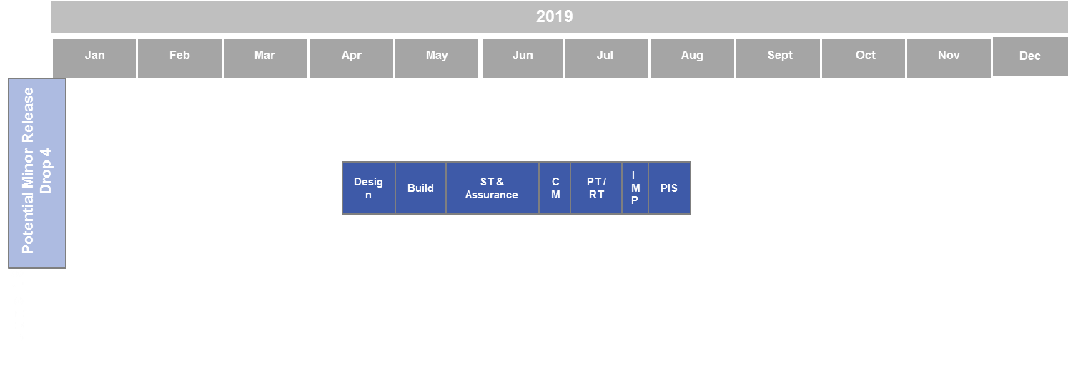
Potential Minor Release Drop 4 Timeline & Scope
Xoserve propose to schedule a Minor UK Link Release for July 2019
Potential Scope Items:
XRN4777 – Acceptance of Contact Details – awaiting ChMC decision on solution option
XRN4780 - Inclusion of Meter Asset ID Provider Identity (MAPID) in UKLink – in Capture
XRN4803 – Removal of Validation for AQ Correction Reason 4 – Resource constraints may remove this from scope.
Note:
MOD665 – Introduction of Suitable Classification of Ratchetable Supply Points and ensuring accurate capacity allocations.

Slide 4
R&N Timeline
2018 | 2019 | 2020
Oct | Nov | Dec | Jan | Feb | Mar | Apr | May | Jun | Jul | Aug | Sep | Oct | Nov | Dec | Jan | Feb | Mar | Apr | May | Jun | Jul | Aug | Sep | Oct | Nov
Release 2
Release 3
Feb-19
June-19
Sept-19 (EUC)
Nov-19
Minor Release D3
Minor Release D4
CSS CC
CSSB (Procurement)
RETRO
UIG
Mod 621 – GB Charging
Feb-20
June-20
Nov-20
Assumes February Release continue to be documentation only release
Assumes RETRO will be June 2020 Major Release Delivery
Please note that this is all potential activity within UK Link over the next 36 months

Slide 5
2018 / 2019 R&N Delivery Timeline
2018 | 2019 | 2020
Oct | Nov | Dec | Jan | Feb | Mar | Apr | May | Jun | Jul | Aug | Sep | Oct | Nov | Dec | Jan
R3
T1 - Imp
Testing
T2 - IMP
Closedown
Feb-19
Imp
Jun-19
Design
Build
Testing
Imp
PIS
EUC
Design
Build
Testing
Imp #1
Imp #2
Nov-19
Capture
Governance
Design
Build & UT
ST
SIT
UAT
MT
Imp
PIS
MR
Design
Build
ST & Assurance
CM
PT / RT
IMP
PIS
Potential Activity
cssB
Procurement
CSS CC
Procurement
High Level Design
Detailed Design
Build / Test
Retro
Jun-2020
UIG
2019 / 2020
Mod621 – Uk Link Impacts
CUT
ST
SIT
UAT
UT
IDR
Imp
PIS
UKL CUT
UKL ST
UKL AT & RT
Code Merge
UKL PT
UKL RT
Assumes February Release continue to be documentation only release
Assumes RETRO will be June 2020 Major Release Delivery
Please note that this is all potential activity within UK Link over the next 36 months

Slide 6
2018 / 2019 R&N Governance Timeline
2018 | 2019 | 2020
Oct | Nov | Dec | Jan | Feb | Mar | Apr | May | Jun | Jul | Aug | Sep | Oct | Nov | Dec | Jan
Feb-19
Change Pack Issued
June 18
Change Pack Issue
09/11/18
BER Approval 09/01/19
Jun-19
Sep-19 / EUC
Change Pack Issue
21/12/18
BER Approval 09/01/19
ChMC Scope Approval
12/12/18
EQR Approval
06/02/18
Nov-19
BER Approval
10/04/18
Change Pack Issue
14/06/18
MR
Change Pack Issue 07/12/18
BER Approval 09/01/10
ChMC Scope Approval
13/03/18
Potential Activity
cssB
Procurement
No Governance planned - Awaiting BID Outcome Feb 2019
cssCC
RETRO
Potential Activity
Mod621 – Uk Link Impacts
Change Pack Issue
Key
Complete
On track
At risk
Assumes February Release continue to be documentation only release
Assumes RAASP will be June 2020 Major Release Delivery
Please note that this is all potential activity within UK Link over the next 36 months

Slide 7
Change Index – R&N Allocated Change
Proposed Release | XRN | Change Title | Current Status | Xos Proposed Prioritsation Score | Proposed R&N Release | Complexity | Finance
June 19 | 4670 | Reject a replacement read, where the read provided is identical to that already held in UK Link for the same read date | In Delivery | 27% | June 2019 | Low | Xoserve
 | 4687 | PSR updates for large domestic sites | In Delivery | 37% | June 2019 | Low | Shippers
 | 4676 | Reconciliation issues with reads recorded between D-1 to D-5. | In Delivery | 67% | June 2019 | Medium | Xoserve
Feb-19 | 4454 | Cadent Billing – DN Sales (outbound services) | In Delivery | 61% | Feb 2019 | High | Cadent Gas
Feb 19 Doc Release | 4453.1 | Amendment to Job/UPD hierarchies to show ‘irrelevant’ datasets | - |  | Feb 2019 | - | Tbc
 | 4770 | NDM Sample Data – Mod 0654 Delivery | Awaiting HLE | 35% | Feb 2019 | Medium | Tbc
 | - | 1972.7 Ability to Accept Extended Reading Indexes of up to 12 characters | - | - | Feb 2019 | - | Tbc
 | - | 2024 The inclusion of rejection code SAN00001 in the rejection code list | - | - | Feb 2019 | - | Tbc
Sept 19 | 4376 | GB Charging & Incremental (IP PARCA) Capacity Allocation Change Delivery (2019) | In Delivery | 31% | September 2019 | High | NTS
 | 4665 | Creation of new End User Categories | In Delivery | 52% | June/Sep-2019 | High | Shippers
Minor Release Drop 3 | 4690 | Actual read following estimated transfer read calculating AQ of 1 | In Delivery | 32% | Feb 2019 | Medium | Shippers
 | 4717 | Use of up to date Forecast weather data in first NDM Nominations Run | Undergoing HLSOIA | 35% | Feb 2019 | High | Shippers
Nov-19 | 4679 | Requiring a Meter Reading following a change of Local Distribution Zone or Exit Zone | CP high level solution approved at ChMC | 41% | November 2019 | Medium | Xoserve
 | 4725 | New read reason type for LIS estimate readings | CP high level solution approved at ChMC | 28% | November 2019 | Medium | Xoserve
 | 4621 | Suspension of the validation between meter index and unconverted index | CP high level solution approved at ChMC | 29% | November 2019 | Tbc | Shipper

Slide 8
Change Index – R&N Unallocated External Impacting Changes
Proposed Release | XRN | Change Title | Current Status | Xos Proposed Prioritsation Score | Indicative R&N Release | Complexity | Finance
Unallocated | 4474 | Delivery of Retro | A9 - Internal change progressing through capture | 48% | 2020 | Tbc | DN
 | 4584 | Central Switching Services | A9 - Internal change progressing through capture | 20% | 2019/2020 | Tbc | Shippers
 | 4627 | Consequential Central Switching Services | B1 - Start Up In Progress (Awaiting PAT/RACI) | 51% | 2019/2020 | Tbc | Shippers
 | 4645 | The rejection of incrementing reads submitted for an Isolated Supply Meter Point (RGMA flows) | A5a - Solution Development | 44% | Unallocated | Tbc | Shippers/DN
 | 4713 | Actual read following estimated transfer read calculating AQ of 1 (linked to XRN4690) | A5b - Undergoing Solution Impact Assessment | 32% | Unallocated | Tbc | Shippers
 | 4772 | Composite Weather Variable (CWV) Improvements | A7 - CP awaiting ChMC solution approval | 44% | Unallocated | Tbc | Shippers / DN
 | 4780 | Inclusion of Meter Asset Provider Identity (MAP Id) in the UK Link system (CSS Consequential Change) | A5 - CP in capture with DSG | 27% | Unallocated | Tbc | Tbc
 | 4795 | Amendments to the PARR (520a) reporting | A7 - CP awaiting ChMC solution approval | 44% | Approved for delivery | Tbc | PAC
 | 4801 | Additional information to be made viewable on DES | A5 - CP in capture with DSG | 29% | Unallocated | Tbc | Tbc
 | 4777 | Acceptance of Contact Details Updates | A7 - CP awaiting ChMC solution approval | 32% | Minor Release Drop 4 | Tbc | Shippers
 | 4674 | Corrective meter exchange to be reflective on DES | A9 - Internal change progressing through capture | 32% | Unallocated | Medium | Tbc
 | 4803 | Removal of validation for AQ Correction Reason 4 | A5 - CP in capture with DSG | 71% | Minor Release Drop 4 | Tbc | Shippers
 | 4850 | Notification of Customer Contact Details to Transporters | A2 - CP proposed for ChMC | 33% | Unallocated | Tbc | Tbc
 | 4851 | Moving Market Participant Ownership from SPAA to UNC/DSC | A2 - CP proposed for ChMC | 47% | Unallocated | Tbc | Tbc
 | 4853 | UIG Recommendation 3.1 option 5 – Interim process to monitor & manually load rejected reads into UK Link where to read was rejected for reason code MRE00458 only. | A2 - CP proposed for ChMC | 34% | Unallocated | Tbc | Tbc
 | 4854 | Transfer of NDM sampling obligations from Distribution Network Operators to the CDSP | A5 - CP in capture with DSG | 29% | Unallocated | Tbc | Tbc
 | 4856 | Amendment to Treatment and Reporting of CYCL Reads | A2 - CP proposed for ChMC | 41% | Unallocated | Tbc | Tbc
 | 4866 | UIG Recommendation – removal of validation on uncorrected read | A3 - CP within initial view | 28% | Nov-19 | Tbc | Tbc
 | 4871 | Modification 0665-Changes to Ratchet Regime | A3 – CP within initial view | 25% | Unallocated | Tbc | Tbc

