Slide 1
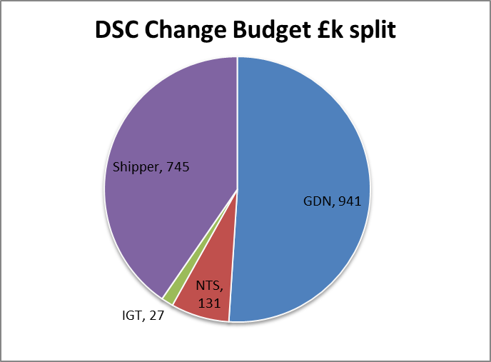
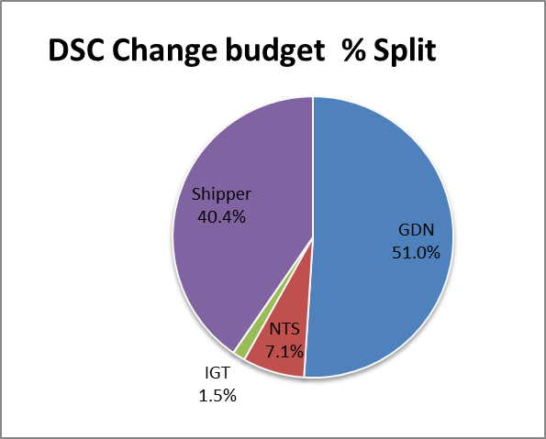
FY18 DSC Change Budget Split
Key Messages:
FY 18 DSC change budget total was £1844k ( Excluding UIG )
£941k (51%) was funded by GDN, £745k (40.4%) Shippers, £131k (7.1%) NTS
and £27k (1.5% ) IGT

Slide 2
Q3 Forecast
Key Messages:
Q3 forecast for DSC change is £1278k
There was prepayment of c£989k for Cadent billing and £80k of carry forward
Prepaid amount and carry forward distributed amongst constituents as part of Q3 charging statements

Slide 3
What would CHMC like to see in FY19 from financial information point of view
?
It will be good to understand what would be regarded as useful insight by
CHMC relating to Change budget in FY19 so that reporting can be tailored
to meet the requirement

