Slide 1


January
Market Intelligence Service (MIS) Overview
Change Management Committee (ChMC)
10/04/19

Slide 2
MIS Origins
January
RP0 | RP1 | RP2 | RP3
No system or process changes. No Improvement to reliable switching. 21 day switch. | Use existing systems. Address matching to improve reliability. Key Process changes (harmonised where possible) to deliver 3 to 7 day switch. | New central switching service (core data). Enduring reliability improvement to data quality. Harmonised and simplified next day switching process. | New central switching service and market intelligence services. Enduring reliability improvement, and improved access to broader range of switching data. Harmonised and simplified next day switching process.
Ofgem set out 4 reform packages:
Do nothing
Enhance existing
CSS
CSS and MIS
As a result of the consultation Ofgem refined option 2 and the new option became 2A, and determined that the industry was best placed to develop and fund the MIS services
Ofgem then asked Xoserve and Gemserv to take forward the MIS initiative
  MIS is a suite of Data Products and services that support improvement in the reliability of switching, and enhanced consumer experience

Slide 3
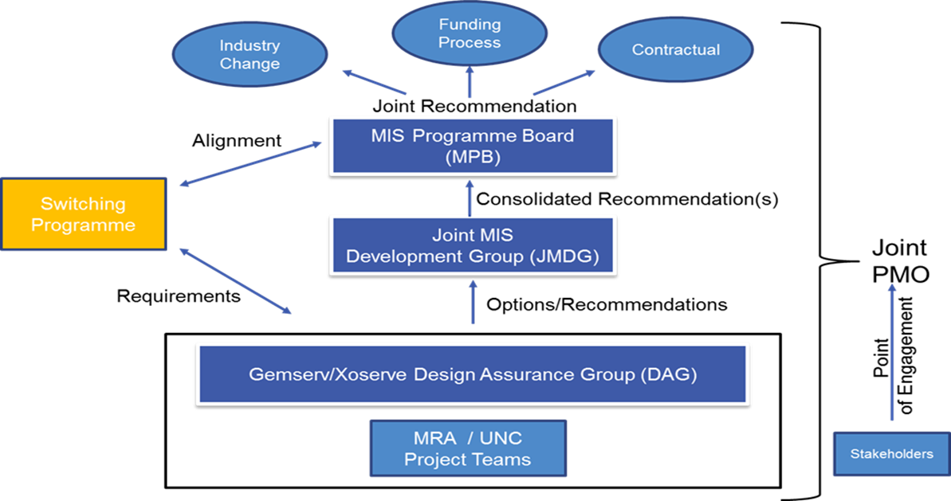
MIS Governance
January

Slide 4
Industry Consultation
January
Open Letter published 4th January
The Open Letter was the first stage of an ongoing consultation approach
Over 20 responses: range of stakeholders: suppliers, networks, metering organisations, water/business customer, Citizens Advice, medium/large suppliers, as well as from Alt Han Co
Wide spread support
Broad consensus for an unconstrained approach
Initial priorities focusing on extending the API service to energy suppliers and support for Ofgem’s Faster and More Reliable Switching Programme (switching programme)
Over 55 Use Cases identified, more Use Cases are evolving

Slide 5



Services Delivered
January
Twin Fuel Price Comparison Website (PCW) API Service
The service provides PCWs and other Third Party Intermediaries (TPIs) access to domestic switching data
  Supports faster, more reliable switching
Twin Fuel Supplier API Service
Provides Suppliers with a richer set of data items and includes non-domestic data
  Supports faster, more reliable switching
  Can be used for portfolio management activities and data cleansing
Find My Supplier Portal (www.findmysupplier.energy)
A portal that allows consumers to find their gas details. E.g. Current Supplier, MPRN
  Provides an enhanced consumer experience
Gas M-Number Download Service
Provides Supplier and Shippers access to a monthly download of M-Number data
  Harmonisation with the Electricity industry

Slide 7
Thank you
January
Questions?
If you have any questions after the forum, please contact us on either:-
MIS@gemserv.com
Or
uklink@xoserve.com

