Slide 1
UIG Task Force Progress Report
Change Management Committee 10/04/19

Slide 2
Background
Modification 0658: ‘CDSP to identify and develop improvements to LDZ settlement processes’ approved by Ofgem on 6th July 2018
Modification raised to authorise the CDSP to assign resources and incur costs related to a Task Force to investigate the causes and influencers of Unidentified Gas (UIG), with a target of reducing the volatility and scale of UIG and developing a robust predictive model for daily UIG for use by all parties.
BER for Change Reference Number XRN4695: ‘Investigating causes and contributors to levels and volatility of Unidentified Gas’ approved at ChMC on 11th July 2018
This Change Proposal added an additional service line into the DSC to enable Xoserve access to investigate, using resources and technology, causes and contributors to levels and volatility of Unidentified Gas. Xoserve is to provide monthly update reports and recommend proposals and subsequent changes or modifications for the industry.
The following slides provide:
Task Force dashboard
POAP
Recommendation stats
Reporting on budget
Task Force next steps

Slide 3
UIG Task Force: Dashboard
RAG
Time | G
Cost | G
Benefit | N/A
Overall RAG status:*
G
Progress since last month - key milestones | Date | Status
Draft Mod/support Eon – 12.1 & 12.3 - Site specific Conversion factors | W/c 4/03/19 | Complete
Draft Mod – 12.2 - Standard conversion factors | W/c 4/03/19 | Complete
Draft Mod – 3.2.1 - Automatically change meter read frequency to monthly where AQ increases above 293,000 | W/c 4/03/19 | Complete
Draft Mod – 3.2.1 – Reduce qualifying period for Class 1 | W/c 4/03/19 | Complete
Draft Mod – 3.2.1 – Automatically convert site to Class 1 and install DM equipment. | W/c 4/03/19 | Complete
Attend UIG working group | 25/03/19 | Complete
Attend March Change Management Committee | 13/03/19 | Complete
Attend March Contract Management Committee | 20/03/19 | Complete
Priorities for next month – key milestones | Date | Status
Attend April Change Management Committee | 10/04/19 | G
Attend UIG work group | 08/04/19 | G
Support Modification Development – Draft Modifications | 08/04/19 - ongoing | G
Actions to support recommendation 3.2.5 – Inaccurate or out of date AQs – impact of rolling AQ | 08/04/19 - ongoing | G
Final walk through of AUG weighting factors (teleconference) for vote | 12/04/19 | G
Executive Summary Update | w/c 29/04/19 | G
Attend UIG work group | 29/04/19 | G
Attend May Contract Management Committee | 01/05/19 | G

Slide 4
Plan on Page
C
Completed activity
Delivery team milestone
Advanced Analytics
DSC ChMC governance
I
 | January |  |  |  | February |  |  |  | March |  |  |  | April |  |  |  |  | May |  |  |  | June
 | 07/01 | 14/01 | 21/01 | 28/01 | 04/02 | 11/02 | 18/02 | 25/02 | 04/03 | 11/03 | 18/03 | 25/03 | 01/04 | 08/04 | 15/04 | 22/04 | 29/04 | 06/05 | 13/05 | 20/05 | 27/05 | 03/06 | 10/06 | 17/06 | 24/06
I
C
I
I
I
I
I
09/01 DSC ChMC
28/01 CUSTOMER RECOMMENDATION DAY
13/02 DSC ChMC
13/03 DSC ChMC
10/04 DSC ChMC
08/05 DSC ChMC
12/06 DSC ChMC
15/2 Post Sprint Exec Summary
28/03 Exec Summary
w/c 29/4 Exec Summary
C
C
Develop Xoserve owned Recommendation options – update and publish recommendation tracker in line with UIG working group meetings
Develop Findings template and Recommendation Packs
Investigation Analysis
15/2 Published Investigation Guide
03/05 Attend Customer Training Day
C
Draft Mods to support recommendations
Support Mod development
I
I
I
01/05 CoMC
15/05 CoMC
19/06 CoMC
I
I
I
I
I
I
I
16/01 CoMC
20/02 CoMC
20/03 CoMC
08/04 UIG WG
29/04 UIG WG
21/05 UIG WG
24/06 UIG WG
Issue analysis and tracking (Investigation Tracker updated and published bi-weekly)

Slide 5
Recommendations - where we are
13 finding & recommendations = 85 recommendation lines
38 CLOSED
10 do nothing
8 lines PAC /Xoserve – covered under existing changes 4876 & 4795. 4 with Xoserve
3 lines MOD 0681 – EON & Xoserve = 1 MOD referred to UIG WG
9 lines MOD – Xoserve (12.2) = 1 MOD – Drafted
3 lines MOD – Xoserve (3.2.1) = 3 MODS - Drafted
1 BAU
5 completed
22 other option progressed
6 In progress
18 Future review
2 ongoing engagement using existing MI
1 CP4866 in progress – Nov target
1 CR4867 in progress – April go live
1 CP4853 in progress – April go live
1 CR4868 in progress - TBC
7 review April
2 review May
3 review July
2 review November
4 review December
All future reviews include non Task Force related changes that are pending, defects with planned resolution dates, other options which may be considered if engagement/PAC reporting does not deliver results. (PAC can look to deliver these when PAC reporting is updated).
As at 01/4/19
Notes:
85 lines in recommendation tracker
37 lines closed =
10 do nothing: 3.2.1 option 1, 3.2.2 option 1, 1 option 1, 12.1/12.3 option 1, 12.2 option 1, 3.2.8 option 1, 3.1 option1, 13.2.5 option 1, 2 option 1, 13.2.2 option 1.
Bau=1. 3.2.2 option 5
Completed =5. 2 option 2, 2 option 3, 13.2.2 option 2, 13.2.5 option 2, 13.2.5 option 3.
Progressed another option =22. 1 option 5,8. 3.2.1 option 5,8,9. 3.2.2 option 2,3,4,7a,8. 12.1/12.3 option 5,7,8,9b. 3.2.8 option 6, 10, 11. 3.1 option 2,3,4,8,9.
8 lines PAC/Xoserve action = 3.2.1 option 3 & 4 – with Xoserve/pac to deliver. 12.1/12.3 option 6 with xoserve/pac. 1 option 7 with xoserve/pac to deliver 3.2.2 option 10 covered under 4876. 1 option 4 covered under 4795. 12.1&12.3 option 3 covered under 4876 . 3.2.8 option 5 covered under 4876.
3 lines EON/Xoserve MOD = 12.1&12.3 option 9a, 10, & 11.
9 lines Xoserve draft mod – 12.2 options 2,3,4,5,6,7,8,9&10.
3 lines Xoserve draft mod 3.2.1 options 6,7 & 10.
6 lines in progress =
2 ongoing engagement 12.1&12.3 option 2, 3.2.8 option 2 – using current MI shipper performance packs
1 CP in progress - 3.1 option 5 – CP4853 manual workaround starts April 2019
1 CP in progress – CP4866 removal of validation on uncorrected read – review in Nov 3.1 option 7
1 CR in progress – 3.2.1 option 2 - CR4867 sites over 58.6m kWh that need reconfirming
1 CR in progress – 1 option 2 - CR4868 class 1&2 read rejections
18 lines for future review =
7 review April 3.2.2 option6, 7b & 9. 1 option 3, 6 & 9. 12.1&12.3 option 4.
2 review May 2 option 5 & 6.
3 review July 3.2.1 option 11. 3.2.8 option 3 & 4.
2 review November 3.1 option 6, 2 option 7.
4 review December 3.2.8 option 7, 8 & 9. 2 option 4.

Slide 6
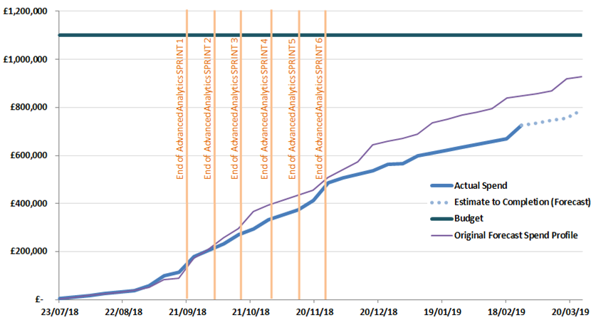
Overview Of Task Force Funding

Slide 7
Task Force Next Steps
Use the UNC UIG Work Group as the mechanism to share progress on all recommendations where options residing with Xoserve.
Provide updates to the “Recommendation Tracker” in line with UNC UIG Work Group timescales.
Continue analysis on investigation lines & publish investigation tracker updates fortnightly.
Publish any new findings/recommendations drawn from investigation lines which are currently “work in progress” when completed.
Present recommendation options for 3.2.5 Inaccurate or out of date AQs – impact of rolling AQ at UNC UIG Work Group 8th April 2019 – Xoserve take action on all options agreed.
Continue the customer engagement, progress the CPs & CRs raised to support the recommendation options agreed at 28th January UIG-Recommendation session.
Supporting MOD development to progress agreed recommendation options where Xoserve have drafted the mods.
Continue the development of existing non Task Force changes 4876 & 4795 to support the PAC report recommendations.

