Slide 1
Data Changes: Agenda
Data Discovery Platform: Drop 1 and Drop 2 Update
PAFA Changes Update
PAFA Options for Access to DDP

Slide 2
Data Discovery Platform – Drop 1 Update
Drop 1 Scope
Meter Status | P
Meter Point Status | P
No Reads (Class 4) | P
Blank MAM’s | P
Dead report | P
Portfolio AQ | P
Portfolio count | P
Data Discovery Platform update:
The Data Discovery Platform Drop 1 was delivered on time with no scope deviation
Shipper feedback has been positive
Circa 50% (and this is rising) of all Shippers are regularly using the product
Alignment of the existing Shipper Pack and PARR report:
The existing Shipper Pack and PARR have been reviewed and aligned to provide one truth
Two PARR topics have not been included into the Shipper Pack as there is an open defect, they are:
No Meter Recorded
No Meter Recorded with Data flow
Once the defect is resolved, the 2 topics will be included into the Shipper Pack (please note they plan to resolve the defect in time for Septembers PARR / Shipper Pack)

Slide 3
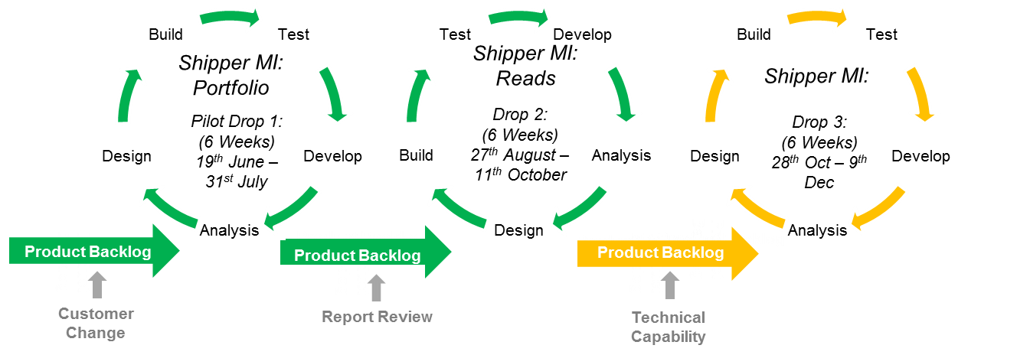
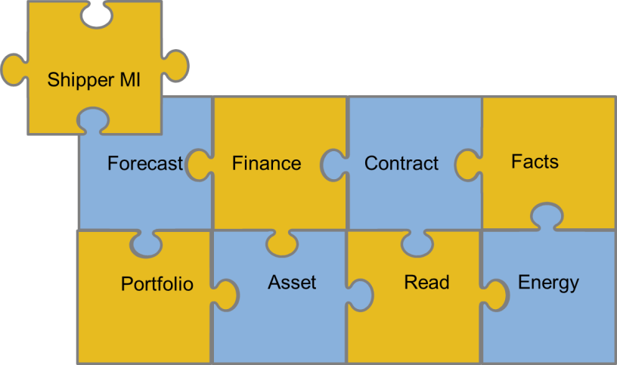
Data Discovery Platform – Drop 2 Scope
Approach:
Shipper MI Drop 2 will be an Agile delivery
The delivery team will look to improve on the success of Drop 1
Anything not delivered will go back into the product backlog and considered for future releases
Reads - Data Package
What do we deliver:
An online portal for Shippers to access Read data
Produce pre-defined set of dashboards for Read topics
Increase the available data within the data discovery platform
Shippers Can:
Access MPRN Read Data via an online portal
Gain insight from predefined dashboards to support meeting industry obligations including:
Actual vs estimates
Estimate read trends
Transfer / Opening Read Performance
No Reads (class 1, 2 & 3)
Read data availability increased from monthly to daily (where applicable)
Enhance the Portfolio dashboards (Drop 1) based on customer feedback / Beta team comments

Slide 4
APPENDIX: Shipper Pack / PARR report alignment detail
Shipper Pack PARR Alignment – Appendix
PARR Topic | Shipper Performance Pack Topic | Shipper Pack report changes
No Meter Recorded in Supply Point (SP) register | Confirmed No Asset | Due a defect with the PARR topic, it has not been included in the latest Shipper Pack.
No Meter Recorded in SP and dataflow | NA | Due a defect with the PARR topic, it has not been included in the latest Shipper Pack.
No Read for 1,2,3 or 4 | No Reads | Align the topic from the PARR table and show actual count.
Standard Correction Factors | Potentially Incorrect Correction Factors | PARR topic replaces Shipper Pack topic
Estimated & Check Reads | NA | Include PARR topic within the Shipper Pack (split by class)
Shipper Transfer Read Performance | NA | Include PARR topic within the Shipper Pack (split by class)
Read Performance | NA | Include PARR topic within the Shipper Pack (split by class)
Meter Read Validity Monitoring | NA | Include PARR topic within the Shipper Pack
AQ Correction by Reason Code | NA | Include PARR topic within the Shipper Pack
Replaced Meter Reads | NA | Include PARR topic within the Shipper Pack
**Topics marked in red have been provided with low level information for Shippers**

Slide 5
Data Changes: PAFA XRNS
The below details the options around delivering the PAFA XRN Changes:
Change Proposals | Option 1 | Option 2 | Option 3
4795 - Amendments to the PARR (520a) reporting | Change is In-flight delivery end of November. This is being delivered under R and N platform.
4876 - Changes to PARR reporting – provide further data to PAFA to aid analysis of performance reporting | Continue to deliver reporting via Business Objects (with call on priority v. other data changes made at ChMC); Wouldn’t impact current trajectory of DDP scope 4876 constitutes a large change to existing PARR reporting, which also might require further updates – is a BO delivery still the optimal route to deliver this? 4779 is more appropriate for BO delivery approach as less complex | Deliver the reporting requests through DDP. Move the DDP team to focus on PAFA changes from Drop 3 (Dec delivery) or 4 (Feb delivery) Estimated 4 drop duration to fulfil changes (July 2020) Impact will be on progression of Shipper product on DDP | Fund a ring-fenced ‘PAC DDP Drop Team’ Deliver PAC changes alongside Shipper product focussing on the requests made through XRNS and access to DDP Would take an estimated 4-8 weeks to mobilise If this option is viable further cost analysis can be under taken. Consideration of BAU DDP activity would need to be made
4779 - UNC Modification 0657S - Adding AQ reporting to the PARR Schedule reporting suite
4864 - Supply of Meter Point data as part of the PARR Reports | Completed: Delivered as part of Drop 1

Slide 6
Data Changes: PAFA Options: DDP Access
This does not address the XRNS raised this is focussed on access to Data Discovery Platform (DDP) options
These options are based on the Data Items available to Shippers and dependant on any licence and legal discussions being completed
Any drop will require a Beta Test group from PAFA included in the Drop period
Options |  | Impact
Option 1: Drop 3 December Delivery | Focus on delivering access to PAFA to DDP and access to what shippers see already (if data permissions the same) Legal sign off that we can utilise existing licences to provide PAFA access (Legally are they a customer, or licence cost for PAFA) | Is a slower roll out for Shippers with the next roll out for shippers in 2020 after the October delivery. It would impact the ability to enrich the content for Shippers and not provide the detail that PAFA have requested.
Option 2: Fund an additional resource to focus on the PAFA access and Roll out alongside the Shipper MI product | Cost: £45,000, high level estimate Will require a recruitment period of around 4 to 6 weeks | This would expedite access for PAFA and look at still increasing the content available to Shippers in parallel.
Option 3: Alternative Drop | Drop 4 (February 2020) or Drop 5 (April 2020) | Focus on XRN delivery through Business Object Reports, continue to drive with Shipper roll out. This will result in a richer content for PAFA at roll out.
DISCUSSION POINT: Which option would you like to progress for PAFA access to DDP?

