Slide 1
Retro Proof of Concept Step 1 ‘Data Comparison and Aggregation’ Market Level – Results Deck

Slide 2
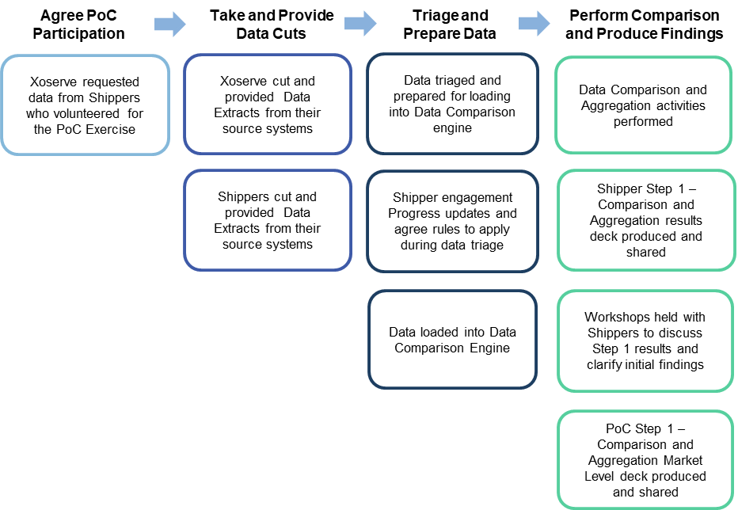
Retro Proof of Concept - the Story So Far

Slide 3
Key Points
Data Cut Timings – UK Link as of 8th December 2019
9 Shipper participating in the Proof of Concept
9.7m MPRNs received
133m data items provided across 31 data fields
This pack details the results from Step 1 ‘Comparison and Aggregation’ of the levels and types of data mismatches identified
Step 2 ‘Deep Dive’ analysis will investigate the impact & root cause of the Retro Assessable mismatches
Retro
Proof of Concept

Slide 4
Step 1 - Market Level Data Categories
Retro Proof of Concept
Step1
General Details
Asset Details
Measurement Details
AMR & Convertor Details
Reading Details
To support presenting our Step 1 findings data items have been grouped into 5 categories
Categories were defined based on the type of data items received from Shippers taking part in the PoC
This data has been compared against equivalent records held in UK Link systems
Any mismatches that have been identified will be fed into the Proof of Concept Step 2 Deep Dive analysis

Slide 5
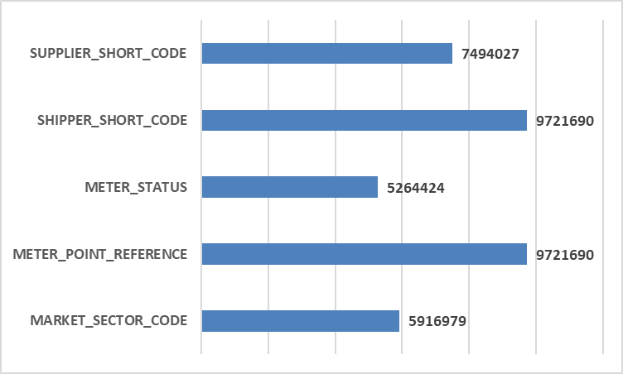
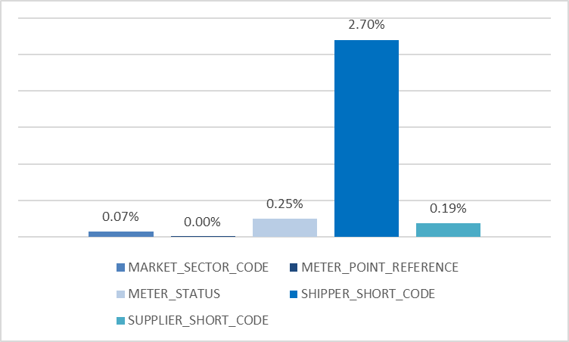
General Details – Step 1 Findings
Frequency of Data Item Provided
Average Percentage of Mismatch Identified
Key Points / Considerations
2.70% Mismatches for the Shipper Short Codes data item due to variation in data cut dates = the natural churn in MPRNs between Shippers
0.25% Mismatch between Meter Status details data item – To be investigated as part of Step 2 Deep Dive analysis
0.07% difference between Market Sector Code details provided by Shippers against equivalent record held in UK Link

Slide 6
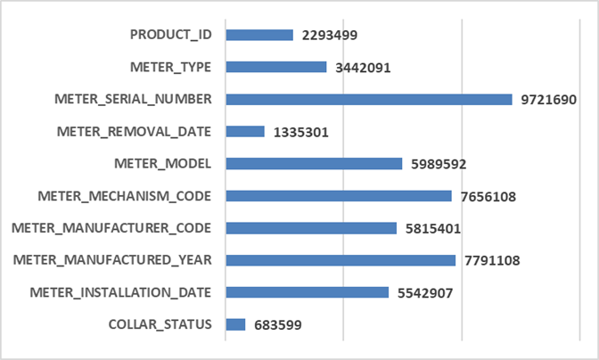
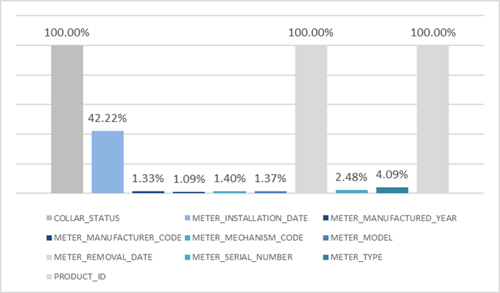
Asset Details – Step 1 Findings
Frequency of Data Item Provided
Average Percentage of Mismatch Identified
Key Points / Considerations
100% mismatches relate to data items where no equivalent UK Link values are held
Meter Installation Date data item (42.22%) and Meter Removal Date data item (4.09%) identified differences in system treatment – e.g. Future Effective Meter Removal Dates provided in Shipper datasets
2.48% mismatch between Meter Serial Number data item held in respective systems – root cause and impact of this to be assessed in Step 2 Deep Dive analysis

Slide 7
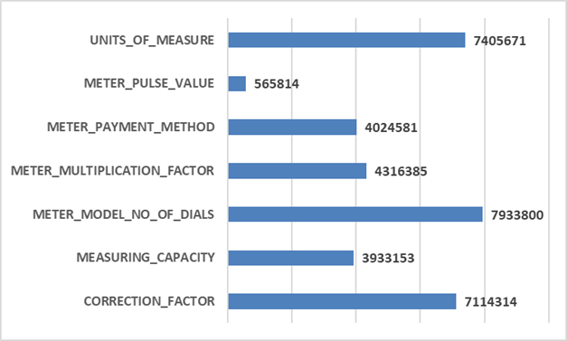
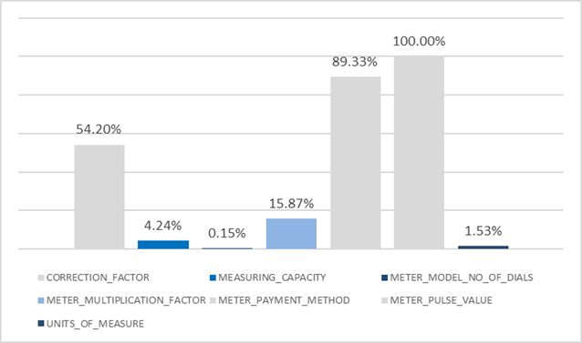
Measuring Details – Step 1 Findings
Frequency of Data Item Provided
Average Percentage of Mismatch Identified
Key Points / Considerations
Mismatches identified on Meter Payment Method data item (89.33%) and Meter Pulse Value data item (100%) due to minimal population of these data items being held in UK Link
Correction Factor mismatches data item (54.20%) due to combination of rounding and truncation anomalies within Shipper datasets
All data Items to be assessed further for root cause and impact as part of Step 2 Deep Dive analysis

Slide 8
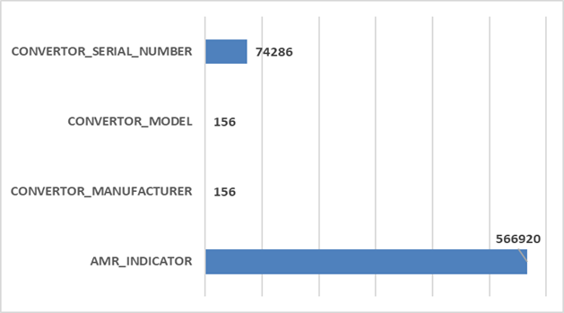
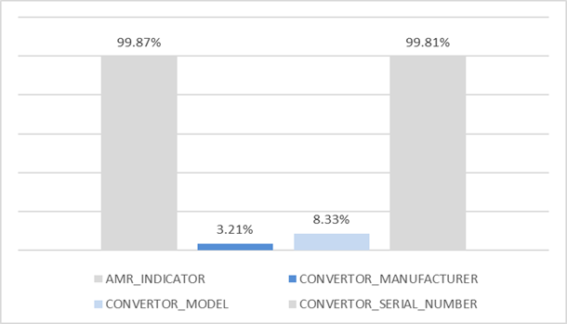
AMR & Convertor Details – Step 1 Findings
Frequency of Data Item Provided
Average Percentage of Mismatch Identified
Key Points / Considerations
AMR Indicator data item (99.87%) and Convertor Serial Number data item (99.81%) mismatches due to default values being provided in Shipper datasets
Convertor Model data item (8.33%) and Convertor Manufacturer data item (3.21%) mismatches to be investigated further during Step 2 Deep Dive analysis
All data Items to be assessed further for root cause and impact as part of Step 2 Deep Dive analysis

Slide 9
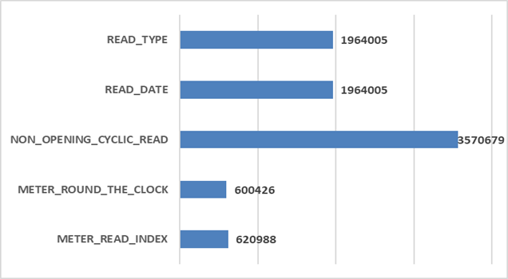
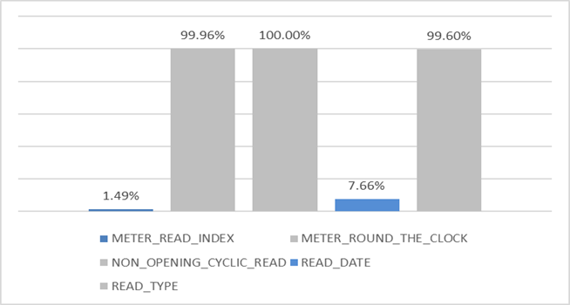
Reading Details – Step 1 Findings
Frequency of Data Item Provided
Average Percentage of Mismatch Identified
Key Points / Considerations
Meter Round the Clock data item (99.96%) due to difference in the way data is stored in respective systems (e.g. 01 provided vs 1 held in UK Link)
Mismatches against Non Opening Cyclic Read data item (100%) and Read Type data item (99.6%) expected as these items were requested to support further analysis during Step 2 Deep Dive
Differences in Meter Read Index data item (1.49%) and Read Date data item (7.66%) appear genuine and will also be assessed further during Step 2 Deep Dive analysis

Slide 10
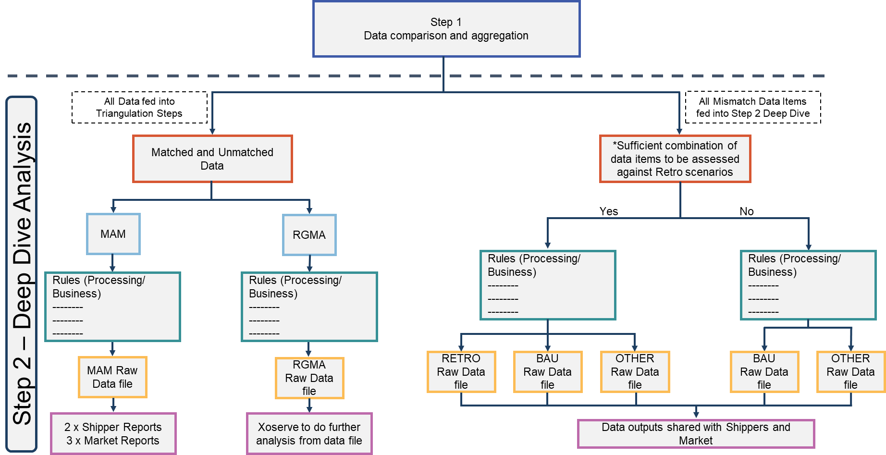
What’s Happening Next?

Slide 11
XRN4914 – Retro Proof of Concept - Timeline
2019 / 2020
November | December | January | February | March | April
Date for slicing data
8th Dec
Checkpoint 1
29th Nov
Checkpoint 2
7th Feb
Checkpoint 3
12th Mar
Customer Engagement
Initial Customer engagement
kick-off 4th Nov
Initial Customer engagement of File receipt
Still ongoing
Recommendations
Customer / Advocates encouraging participation
Kick-off prep
Test files can be accepted
Actual data files can be accepted
Weekly project update via external communication methods
Support
Design (Step 1)
Develop (Step 1)
Design (Step 2)
Business Rules for Shipper Fixed Anomalies awaiting SME Review and Input, Design Step 2 then complete
Testing (Step 1)
Develop (Step 2)
Testing (Step 2)
Support
Analysis
Test data
files in
Actual data
files in
Step 1 Compare / Outcome / Aggregate
Step 2a Categories & 2b MAM
Step 2c RGMA & 2d Deep Dive
Output from Step 1
Output from Step 2a & 2b
Output from Step 2c & 2d
today
Dates to be confirmed - task sized once
Business Rules have been performed
XRN4914 MOD 0651 - Retrospective PoC
16th March
Completed
On-target
Medium risk
Planning
Key:
Slipped / High risk

