Slide 1
XRN4996 - June 20 Release (Core UKLink Changes) - Status Update
8th July 2020 | Overall Project RAG Status:
 | Schedule | Risks and Issues | Cost | Resources
RAG Status
Status Justification
Schedule | Delivery: Implementation successful and Go Live confirmed on 27th June 5 UK Link XRN’s. Only the file format changes for xrn4850 (CNF/CNC) have been implemented. PIS: Project has entered PIS phase, project team are monitoring first usage and any defects identified CNC file processing enhancement: Workstream established to increase system capacity from 30,000 per day to enable upload of Customer Contact details. We request shippers to liaise with their Customer Advocates prior to uploading customer Contact details into UK Link
Risks and Issues | Risk – There is a risk that Shippers will send in bulk files with customer information through the CNF/CNC files because of the implementation of xrn4850 functionality leading to increased pressure on Xoserve systems.
Cost | Project Delivery costs are in line with approved BER
Resources | Weekly monitoring of Xoserve SME resources supporting multiple demands (e.g. BAU defects, Future Releases, COVID19 priorities etc.) is ongoing

Slide 2
xrn4850 New Service SMS/Email Broadcast Notification (as part of the June 20 release)
8th July 2020 | Overall Project RAG Status:
 | Schedule | Risks and Issues | Cost | Resources
RAG Status
Status Justification
Schedule | Xrn4850 Delivery: File format changes for xrn4850 (CNF/CNC) have been implemented and PO/EFT channels configured and disabled until Contract Management meeting on 15th July. Contract Management: Paper being submitted to Contract Management for approval on 15th July to seek authority from Data Controllers authorising transfer of data outside of EEA before we can commence the SMS service with Twilio New Service Implementation: Following approval from Contract Management, project team will implement the new service functionality to enable Networks to request Broadcast messages to be sent to end consumers, planned for late July/early August. PIS: PIS for the new service will commence following implementation. The original PIS duration, 3 months, will need to be extended as a result. Cost implications under analysis and will be shared. Change Requests: The CR’s from Market Trials have been captured and impact analysis is underway. Timings and costs will be shared at the next meeting for approval to be implemented during PIS/subsequent release.
Risks and Issues | Issue – The duration of PIS will need to be extended for the new service for xrn4850 due to the delay of this service going live meaning the service is not used within the original PIS window Risk - Contact Management committee do not approve the transfer of data outside of the EEA or there is a delay in them providing approval because of an unacceptable level of risk to them as data controllers leading to a delay to the implementation of the new service functionality and an extension to project timeline and costs
Cost | Project Delivery costs are in line with approved BER
Resources | Weekly monitoring of Xoserve SME resources supporting multiple demands (e.g. BAU defects, Future Releases, COVID19 priorities etc.) is ongoing

Slide 3
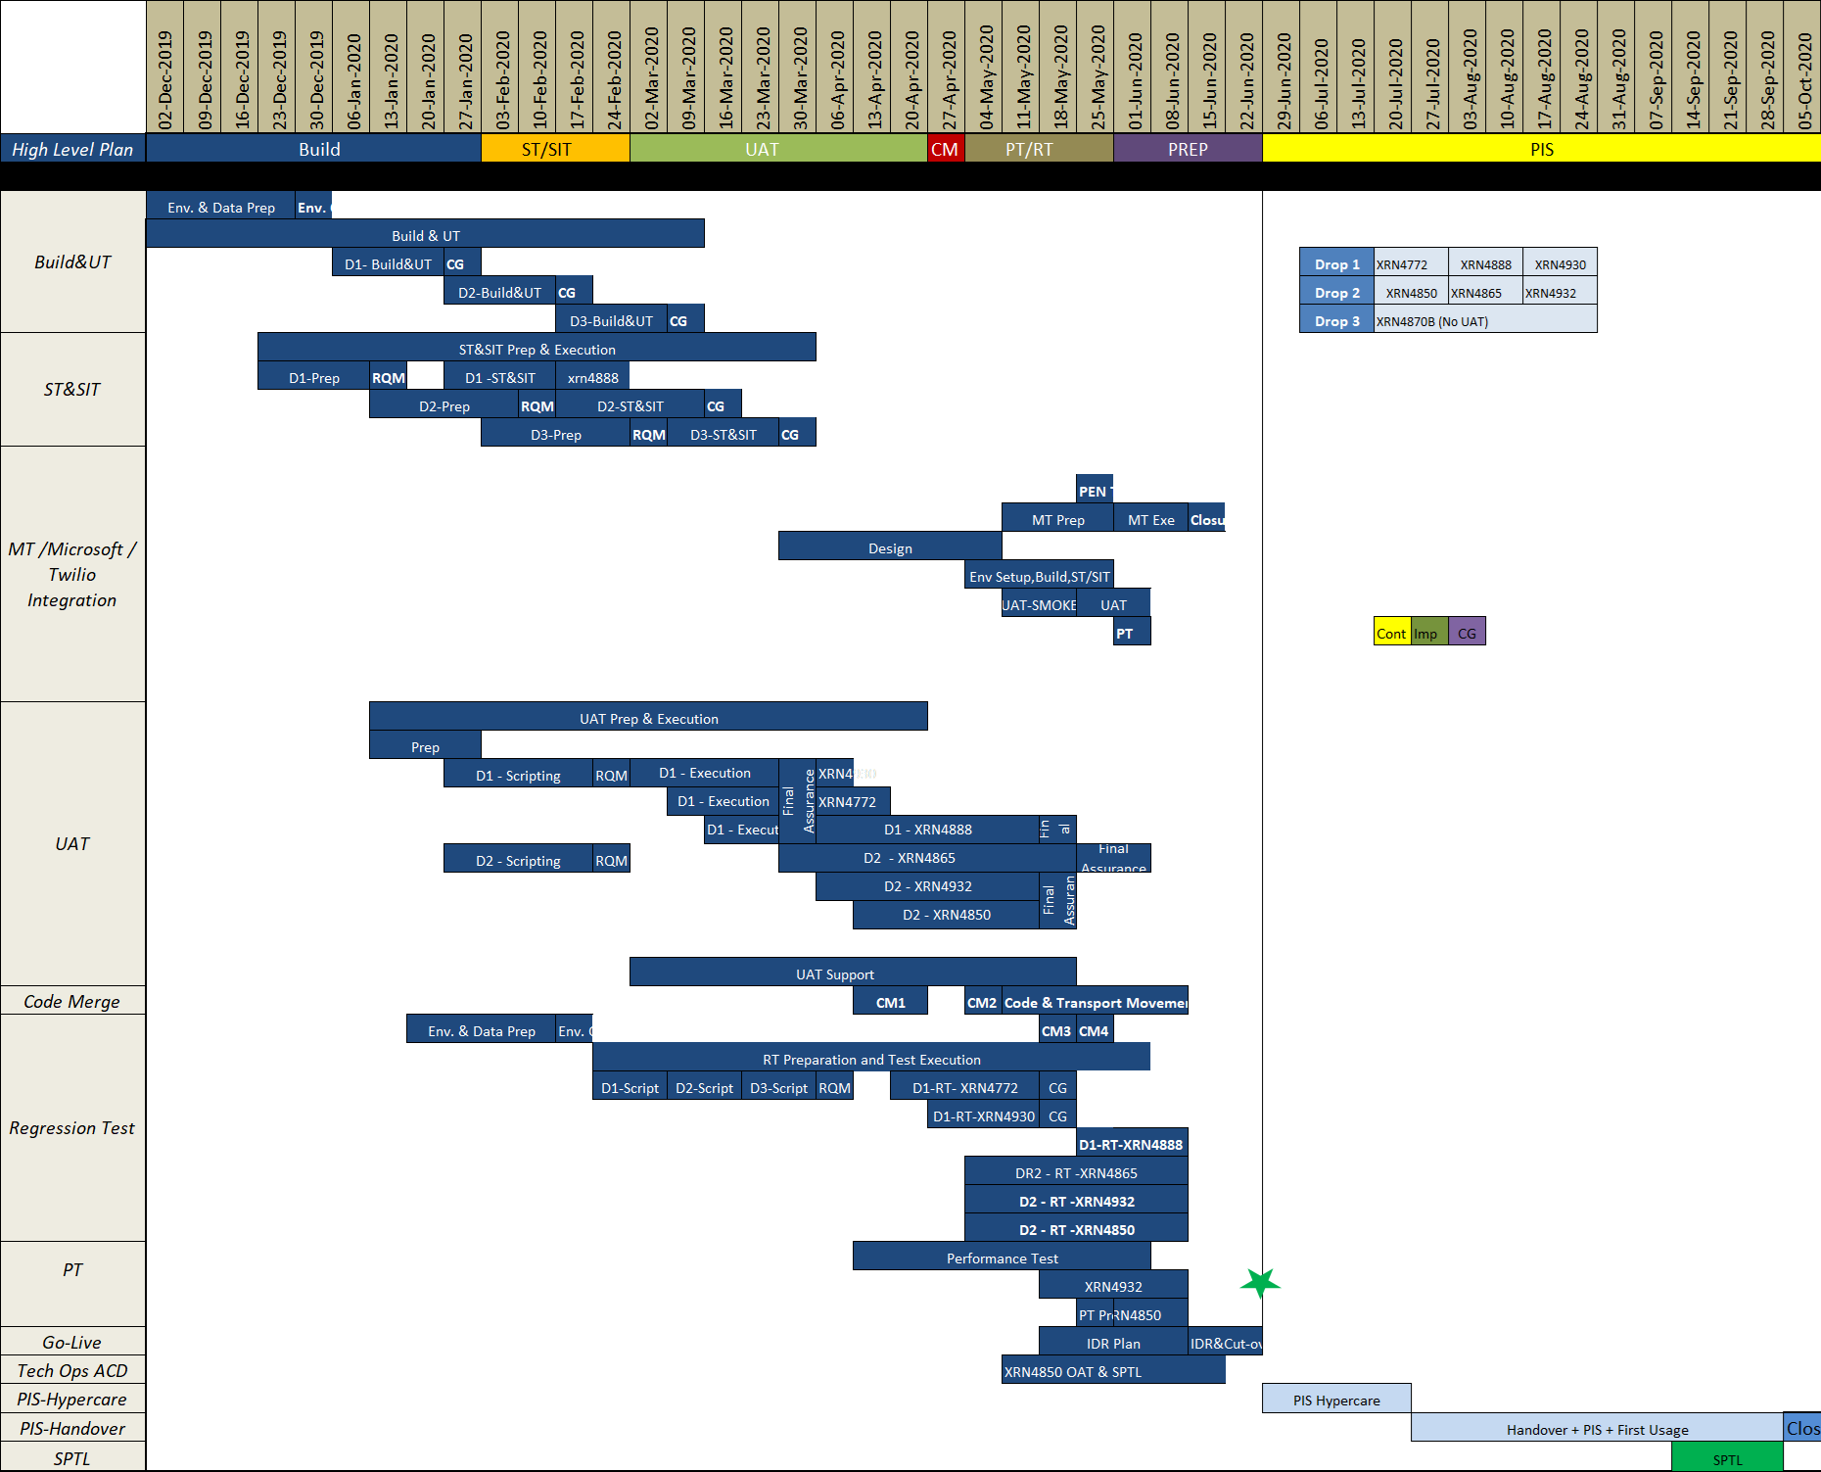
XRN4996 - June 20 Release Timelines
Key Milestone Dates:
Capture completion
- 19/09/19
Design completion
- 13/12/19
Build & Unit Test completion
- 31/01/20
System Testing completion
- 03/04/20
UAT completion
- 05/06/20
Regression Test completion
- 12/06/20
Market Trials completion
- 19/06/20
Implementation
- 27/06/20
PIS Completion
- 25/09/20 (provisional)

Slide 4
June 20 Release Summary
June 20 Release consists of 7 changes, Implementation is planned for June 2020:
In Scope
XRN4772 - Composite Weather Variable (CWV) Improvements
XRN4888 - Removing Duplicate Address Update Validation for IGT Supply Meter Points via Contact Management Service (CMS)
XRN4930 – Requirement to Inform Shipper of Meter Link Code Change
XRN4850 - Notification of Customer Contact Details to Transporters
XRN4865 - Amendment to Treatment and Reporting of CYCL Reads
XRN4932 - Improvements to the quality of the Conversion Factor values held on the Supply Point Register (MOD0681S)
XRN4780 (B)*** – Inclusion of Meter Asset Provider Identity (MAP Id) in the UK Link system (CSS Consequential Change)
Descoped
XRN4691** - CSEPs: IGT and GT File Formats (CGI Files)
XRN4692** - CSEPs: IGT and GT File Formats (CIN Files)
XRN4780 (B) - Inclusion of Meter Asset Provider Identity (MAP Id) in the UK Link system (CSS Consequential Change)
XRN4871 (B)** - Changes to Ratchet Regime (MOD0665)
XRN4941* - Auto updates to meter read frequency (MOD0692)
* Pending Solution/MOD approval by ChMC/DSG for remaining CRs. Descoped at ChMC on 08/01/20
** Descoped at eChMC on 22/11/19
*** Added to scope (revised scope from original)

