Slide 1
Website Amendments - Customer Change

Slide 2
What have we done so far?
We have implemented 6 brand new Change pages, covering all key areas. They are broken down as follows:
New to the process? – Here you will be given an overview of how a change progresses from start to end
Have an idea for Change? – This is where you will be able to submit a change to us to assess and potentially begin development.
Change Proposals – This is where you will find all Changes we are working on. As well as current CPs, this also includes changes that are on hold, withdrawn and implemented.
Change Packs – Here you will find all Change Pack Documents that have been issued to the Industry.
Our Change Programmes – We also have a number of key Change Release Programmes that are ongoing. Here is where you will find all the details.
The Change Register – Here you will find the full Change Register of all Changes that are being worked on.

Slide 3
New Homepage
We have implemented a new Change homepage, meaning everything you need for change can be found all in one place.

Slide 4
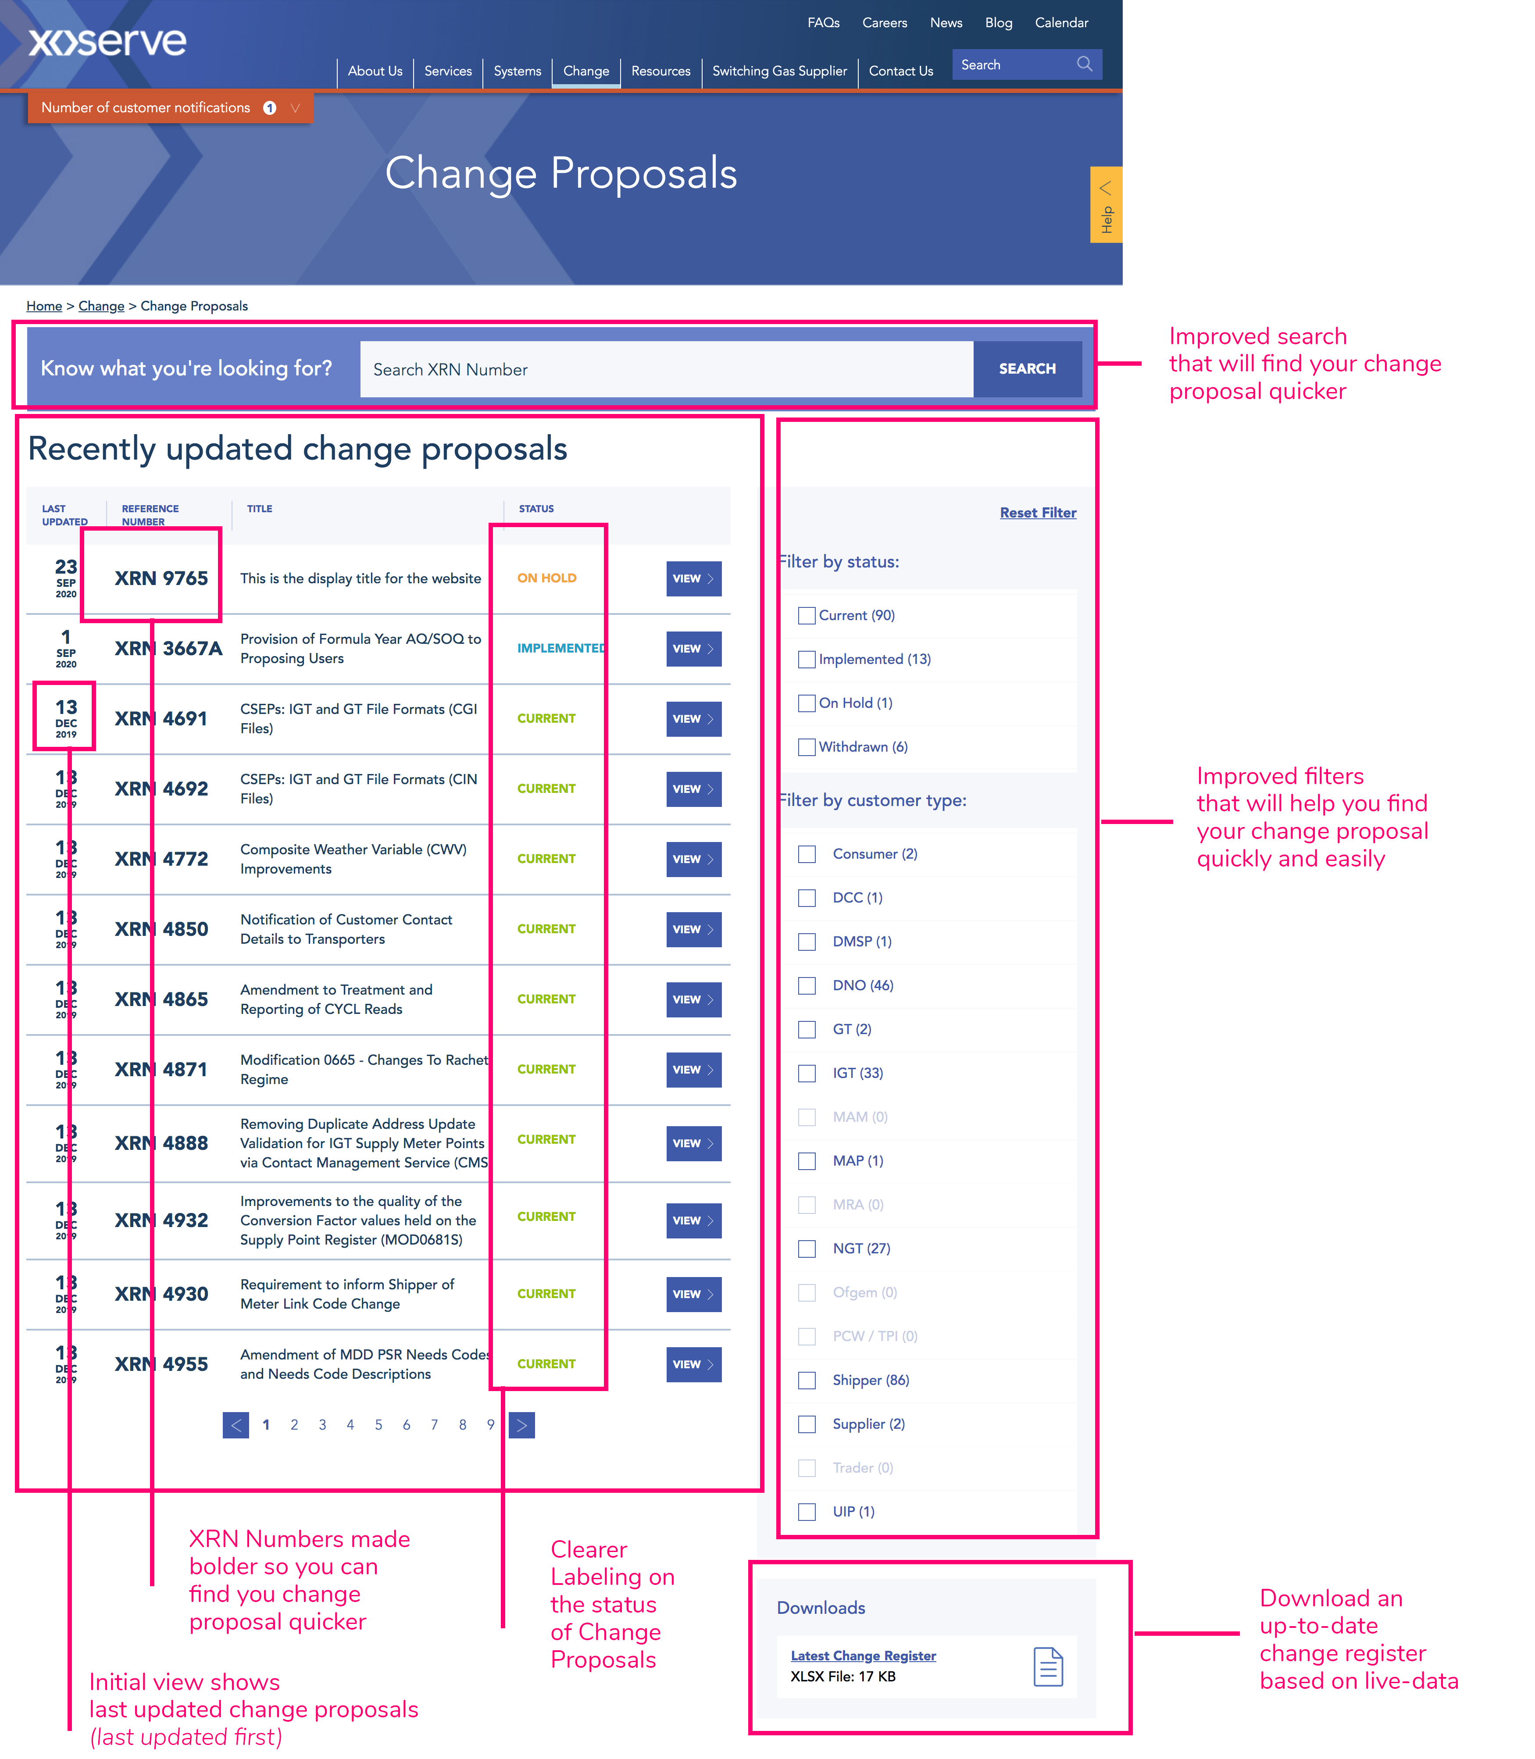
New Change Proposal Section
Here you will see what the list of all Change Proposals will look like on the website, with a whole new layout and useful additions to help find the changes you need.

Slide 5
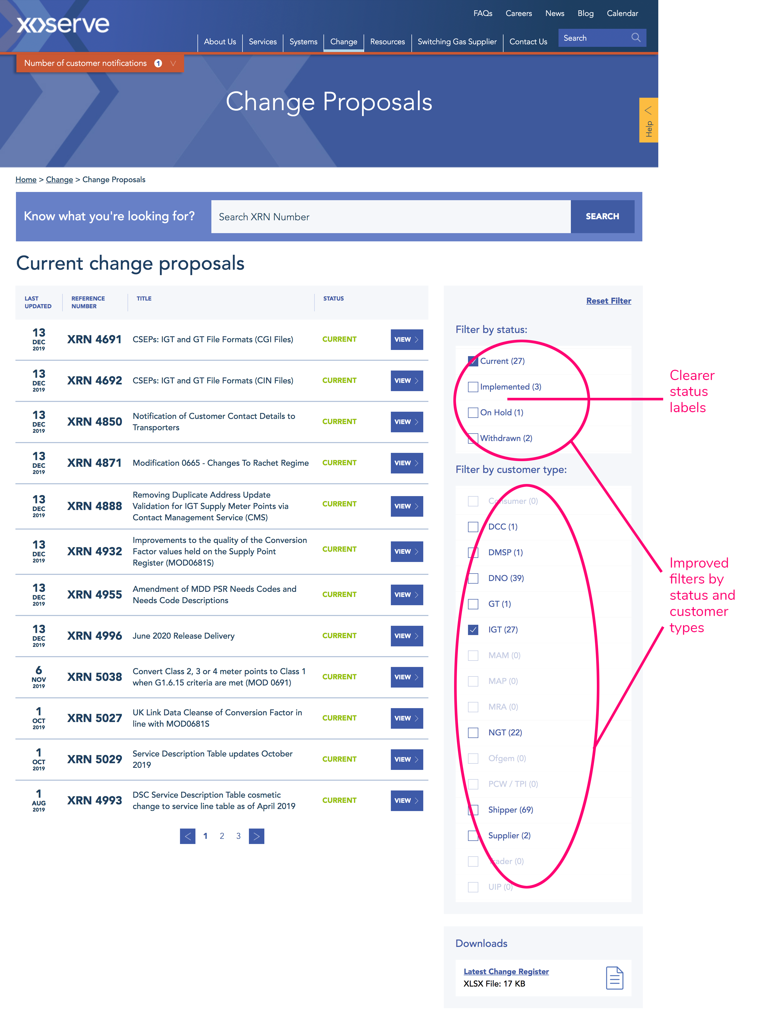
Change Proposal Filters
We have introduced new, clearer statuses, and you can also filter on Customer type.

Slide 6
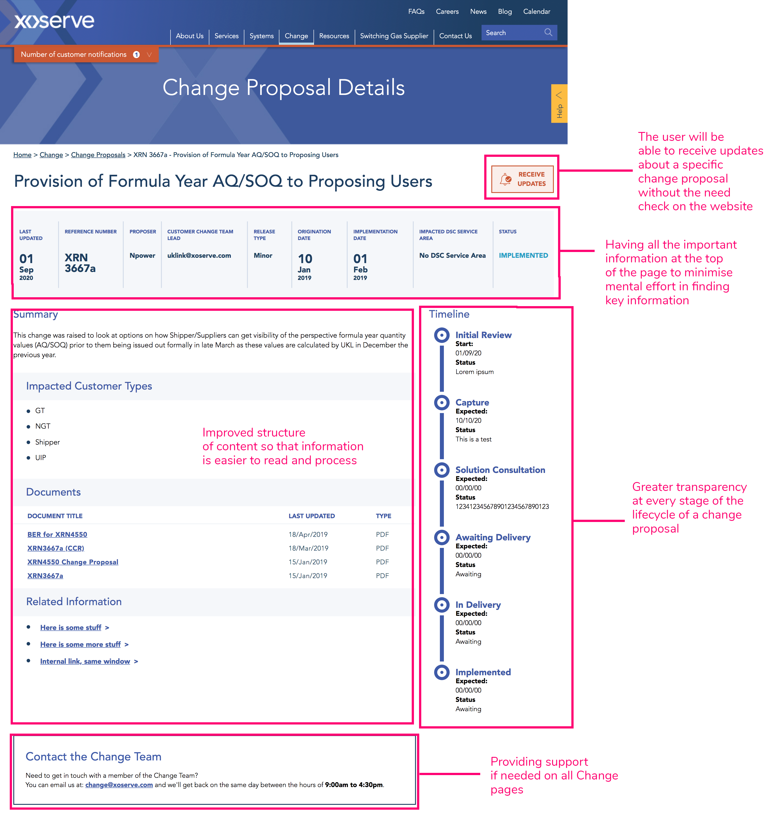
Change Proposal Detail
This shows what the detail will look like for each individual change Proposal. We have introduced update notifications, a clearer layout, and all key details you need to know at a high level for each change.

Slide 7
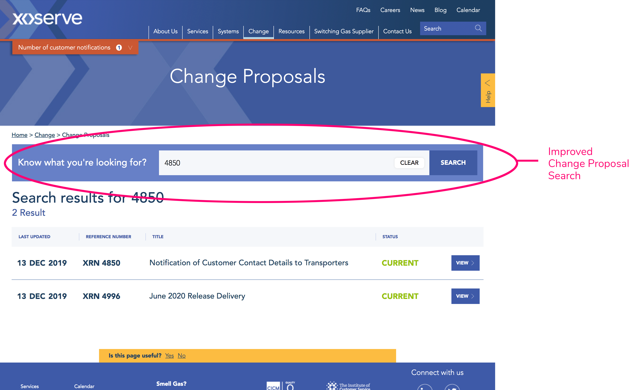
Change Search
The new and improved search function means you can search for any change, drawing back meaningful results. You can also go ‘back to results’ after clicking on any change, and your search filter will remain.

Slide 8
Customer Feedback
Now that the new Change Pages are live on our website, we now need your input.
We encourage all of our customers to take a look around the website, and feedback your thoughts to us e.g. what you like, what you don’t like, and what you would like to potentially see us provide in the future.
If you see something that you believe can be improved, please get in touch via uklink@xoserve.com as this is key to ensuring we provide the best and most logical change information for everyone.

