Slide 1
2.1 - DSC Change Budget BP20 (Financial Year To Date)

Slide 2
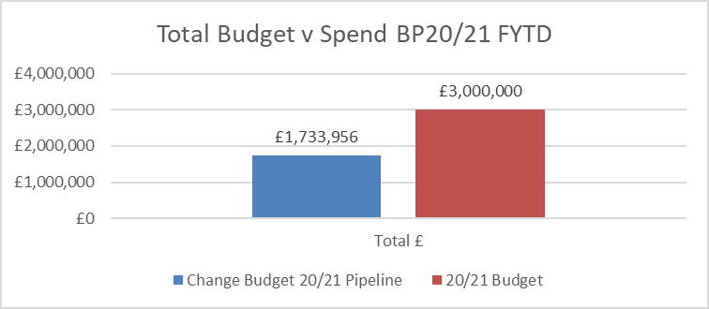
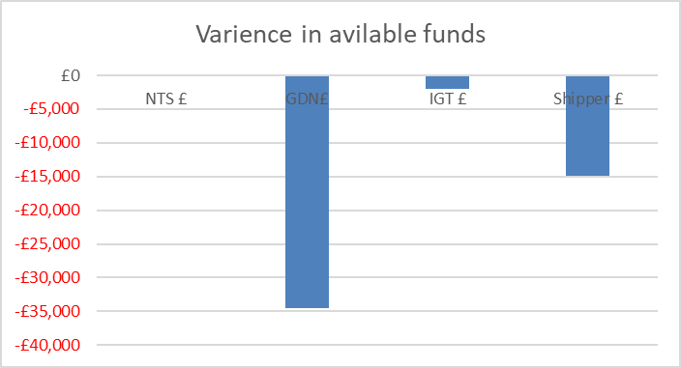
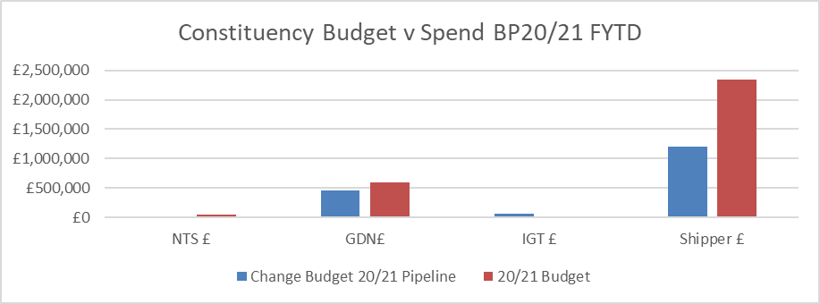
Budget v Spend BP20/21 Financial Year To Date (FYTD)
Available funds have reduced by £51k as a result of multiple changes moving through the lifecycle (i.e. HLSO) and estimated costs being entered for Nov-21 candidates. Excel doc embedded:
Costs that remain uncommitted at end of financial year will be offset against future change budget (BP21) as consensus could not be reached via addendum to BP21 or in DSC committee as to otherwise use shipper underspend in BP20
Governance to be reviewed ahead of any future discussion around management of underspend

