Slide 1
XRN5289 - November 21 Release - Status Update
 | Overall Project RAG Status
 | Schedule | Risks and Issues | Cost | Resources
RAG Status
Status Justification
Schedule | Detailed Functional Requirements have been approved Non Functional Requirements are currently being reviewed High Level Design is being reviewed and approved Design workshop plan is approved to start on the 1st February Currently planning CSSC/CSS impact assessment timeline and content
Risks and Issues | Not a full 6 months for Change Pack and delivery – proposing eChMC on the 5th May need agreement XRN5142 – Unknown plans from DCC on their plan of delivery and design Return to Green Gain agreement from ChMC on eChMC Set up regular touch points with DCC to understand their plan and design
Cost | EQR approved by ChMC on the 13th January
Resources | Resource Forecasts and Plans have been defined at a high level and approved until initiation this includes detailed requirements SME resource has been provided for design, approach for technical SME resource to support design has been agreed
Updated as of 27th January 2021

Slide 2
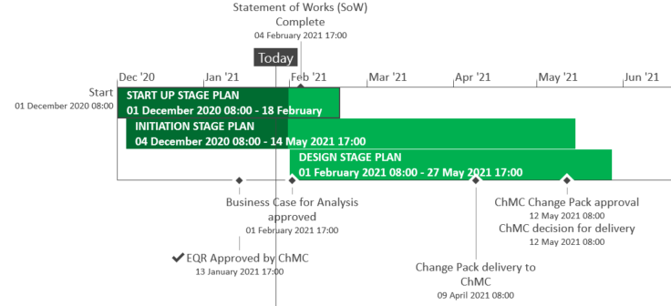
XRN5289 – November 21 Release High-Level Plan
Updated as of 27th January 2021

Slide 3
XRN5289 - November 21 Release Summary
The initial scope of the November 2021 Major Release consists of 8 changes
In Scope
XRN4941 - MOD0692 - Auto updates to meter read frequency
XRN5007 - Enhancement to reconciliation process where prevailing volume is zero
XRN5072 - Application and derivation of TTZ indicator and calculation of volume and energy – all classes
XRN5091 - Deferral of creation of Class change reads at transfer of ownership
XRN5142 - New allowable values for DCC Service Flag in DXI File from DCC
XRN5180 - Inner tolerance validation for replacement reads and read insertions
Out of Scope
Approved to removed from 13th January 21 ChMC
XRN5186* MOD0701 – Aligning capacity booking under the UNC and arrangements set out in relevant NExAs
XRN5187* MOD0696 – Addressing inequalities between capacity booking under the UNC and arrangements set out in the relevant NExAs
Updated as of 27th January 2021

