Slide 1
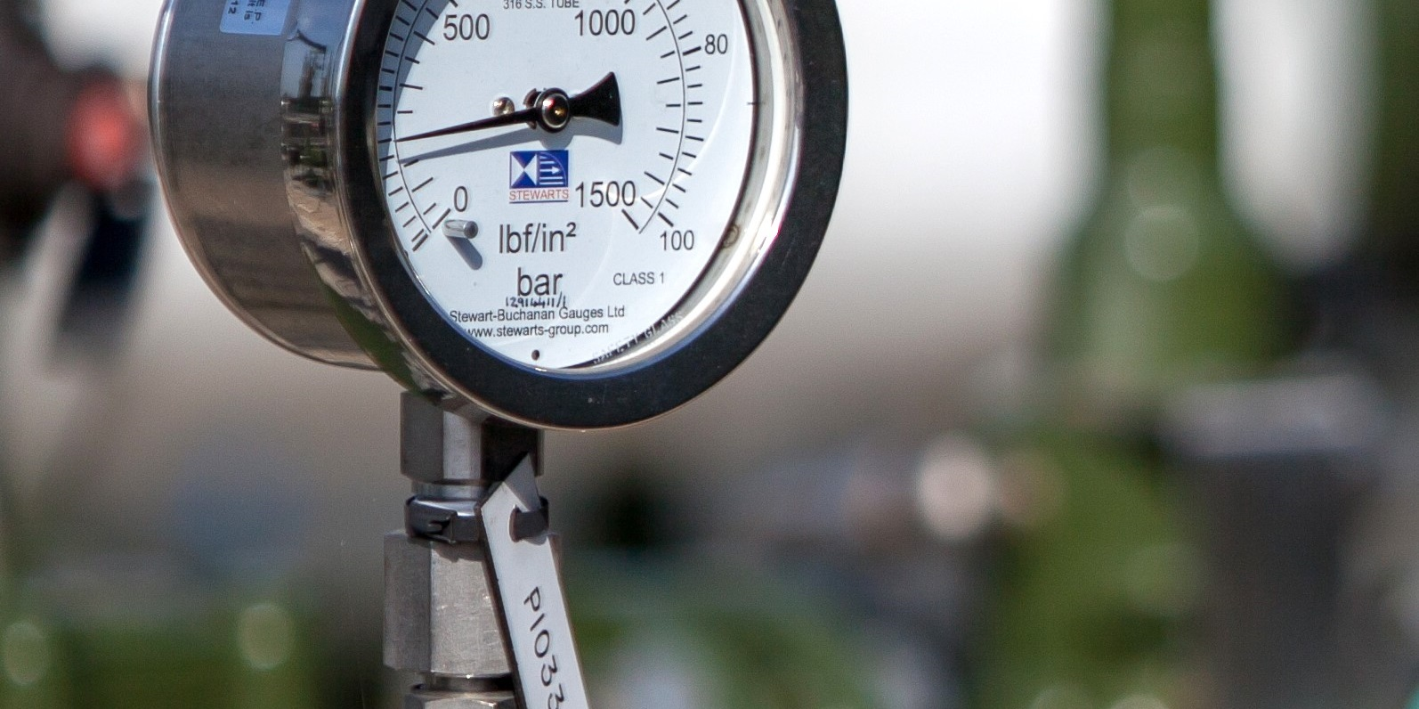


Gas Quality Update
Transmission Workgroup
4th March 2021
Phil Hobbins
Philip.Hobbins@nationalgrid.com
Notes:
2 points to mention – both follow ups to the Q4 2020 questionnaire that we issued to terminal operators

Slide 2
GS(M)R Review – CV Shrinkage Assessment
HSE issued a questionnaire to industry in mid-Dec 2020 to inform its impact assessment of the IGEM proposals
National Grid was asked to provide an assessment of the potential impact of a wider Wobbe Index range on CV shrinkage
In order to produce this analysis, we would need a view from terminal operators about what future CVs might be delivered to the NTS if wider Wobbe limits could be accessed
We therefore propose to issue a questionnaire in March to all NTS terminal operators seeking this information on a confidential basis
Analysis outputs would not identify any data supplied by any individual NTS entry terminal
Notes:
An indicative central case view in a range ideally in a world where expanded Wobbe Index was available

Slide 3
Publication of Gas Quality Limits at NTS Entry Points
We have been conducting a Gas Markets Plan (GMaP) project in conjunction with stakeholders looking at process issues in relation to gas quality changes at entry points. Our report will be published shortly.
A consistent theme has been to improve transparency
We therefore consulted NTS entry terminal operators in Q4 2020 about publishing the gas quality parameters and limits that apply in relation to their entry point(s)
    A majority of those who responded indicated no objection in principle to such publication by National Grid
We now propose to seek consent from all operators that deliver gas to the NTS (including interconnectors and storage) to publish these limits and any future changes to them on the Joint Office website
Notes:
Stakeholders would like more transparency of gas actually in the network and this will be our next project but transparency of limit is a start.
Value would be so that when a change comes forward, people can see how they might be impacted
Ofgem letter 2004 did this – would be updating that essentially
GQ limits in NEAs are currently confidential although UNC provides for any shipper to request. Project recognised that rules written in 1996 and transparency has come a long since then, gas quality hasn’t kept up.
We propose to do this by consent – UNC mod to force this wouldn’t work anyway – letter agreement with each operator

