Slide 1
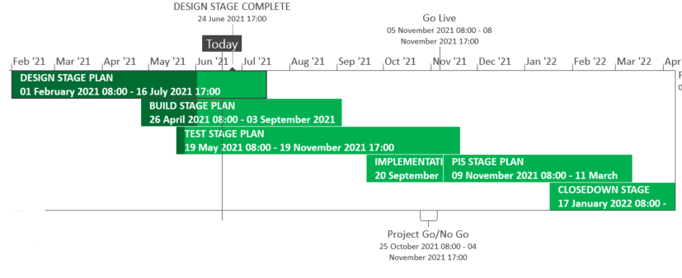
XRN5289 – November 21 Major Release - Status Update
 | Overall Project RAG Status
 | Schedule | Risks and Issues |  | Cost
RAG Status
Status Justification
Schedule | Detailed delivery plan has been baselined Build in progress for XRN4941 and XRN5007 Build is completed and System Test has commenced for XRN5142, XRN5180 and XRN5072 XRN4780C MAP ID is in the process of being scoped into the November 21 release for delivery Implementation Approach provided for information shared with July ChMC Decision In July ChMC Approval of scope change in BER to include XRN4780C MAP ID
Risks and Issues | ​None applicable
Cost | Forecast to complete delivery against approved BER
Scope | In Scope – XRN4941 - MOD0692 - Auto updates to meter read frequency In Scope - XRN5007 - Enhancement to reconciliation process where prevailing volume is zero​ In Scope - XRN5072 - Application and derivation of TTZ indicator and calculation of volume and energy – all classes​ In Scope - XRN5142 - New allowable values for DCC Service Flag in DXI File from DCC​ In Scope - XRN5180 - Inner tolerance validation for replacement reads and read insertions​ Descoped - XRN5091 - Deferral of creation of Class change reads at transfer of ownership​ Descoped - XRN5186 MOD0701 – Aligning capacity booking under the UNC and arrangements set out in relevant NExAs​ Descoped - XRN5187 MOD0696 – Addressing inequalities between capacity booking under the UNC and arrangements set out in the relevant NExAs
Complete
On Track
At Risk
Overdue
Not Baselined
Slide updated on 22nd June 2021

Slide 2
XRN5289 – November 21 Implementation Approach v1

Slide 3
High Level Implementation Timeline
The implementation for the 5 changes consists of code transports for BW, and ISU, Control M, AMT systems, UK Link Oracle web centre (DN Portal)
Go Live 5/11/21 XRN5142
XRN5142 need to align to DCC implementation date, if not aligned DXI files that are sent from the DCC on the 5th November will be rejected in the UKLink systems due to the mismatch in file formats being used across both systems
Go Live 6/11/21 Remaining Changes

Slide 4
File Transition
To incorporate the changes to files and associated processing the EFT channels will need to be closed
We will follow the standard processing times and ensure that there are none of the below files waiting for processing before we close the channels
Monitoring of all inbound files and confirmation of all response outbound files will be completed between 23:00:01 and 23:59:59 prior to any transports taking place
Channels will be re-opened for 09:00:00 for the next standard job processing time

Slide 5
File Format Transition plan - Inbound
File Type | Last inbound (Time = File Processing) | First Inbound (Time = File Processing) | Related Change
DXI | 04/11/21 23:00:00 | 05/11/2021 BAU | XRN5142
UMR | 23:00:00 | BAU | XRN5007 XRN5072 XRN5180
UBR | 23:00:00 | BAU
UDR | 23:00:00 | BAU
SFN | 23:00:00 | BAU
DLC | 23:00:00 | BAU
SPC | 23:00:00 | BAU | XRN4941
JOB | 23:00:00 | BAU | XRN4941 XRN5072
UPD | 23:00:00 | BAU
AQI | 23:00:00 | BAU | XRN5072
All timelines with the exception of DXI will be 5th – 6th November

Slide 6
File Format Transition plan - Outbound
File Type | Last outbound | First outbound | Related Change
DXR* | 04/11/21 23:59:59 | 05/11/2021 BAU | XRN5142
CFR | 23:59:59 | BAU | XRN4941
URS | 23:59:59 | BAU | XRN5007 XRN5072 XRN5180
SFR | 23:59:59 | BAU
SCR | 23:59:59 | BAU | XRN4941
JRS | 23:59:59 | BAU | XRN4941 XRN5072
URS | 23:59:59 | BAU
TRF* | 23:59:59 | BAU | XRN5142
MRI* | 23:59:59 | BAU | XRN5142
File Type | Last outbound | First outbound | Related Change
TRS* | 23:59:59 | BAU | XRN5142
IDL | 23:59:59 | BAU | XRN5142 XRN4941
CRS* | 23:59:59 | BAU | XRN5142
SNR* | 23:59:59 | BAU | XRN5142
NRF* | 23:59:59 | BAU | XRN5142
NMR* | 23:59:59 | BAU | XRN5142
PAC* | 23:59:59 | BAU | XRN5142
AQR | 23:59:59 | BAU | XRN5072
* The last outbound for these will be on the 4th and the first outbound following the changes will be on the 5th
All timelines with the exception of those against XRN5142 will be 5th – 6th November

Slide 7
Deployment timeline
Deployment window to be followed according to the below table
Sl No | System | Available window | Code deployment Date / time | Changes
01 | Control-M (configuration only) | 12pm - 2pm | 05-Nov-2021 / 12pm - 2pm | XRN4941
02 | IS-U | 5am - 7am | 05-Nov-2021 / 5am - 7am 06-Nov-2021 / 5am - 7am | XRN5142 Remaining changes
03 | AMT | 5am - 7am | 05-Nov-2021 / 5am - 7am | XRN5142
04 | BW | 5am - 7am | 05-Nov-2021 / 5am - 7am | XRN5142
05 | UK Link Oracle Web Centre (DN Portal) | 5am - 7am | 06-Nov-2021 / 5am - 7am | XRN5180

Slide 8
Contingency Date
Should we need to use a contingency date the following weekend will be utilised 12th and 13th November 2021

