Slide 1
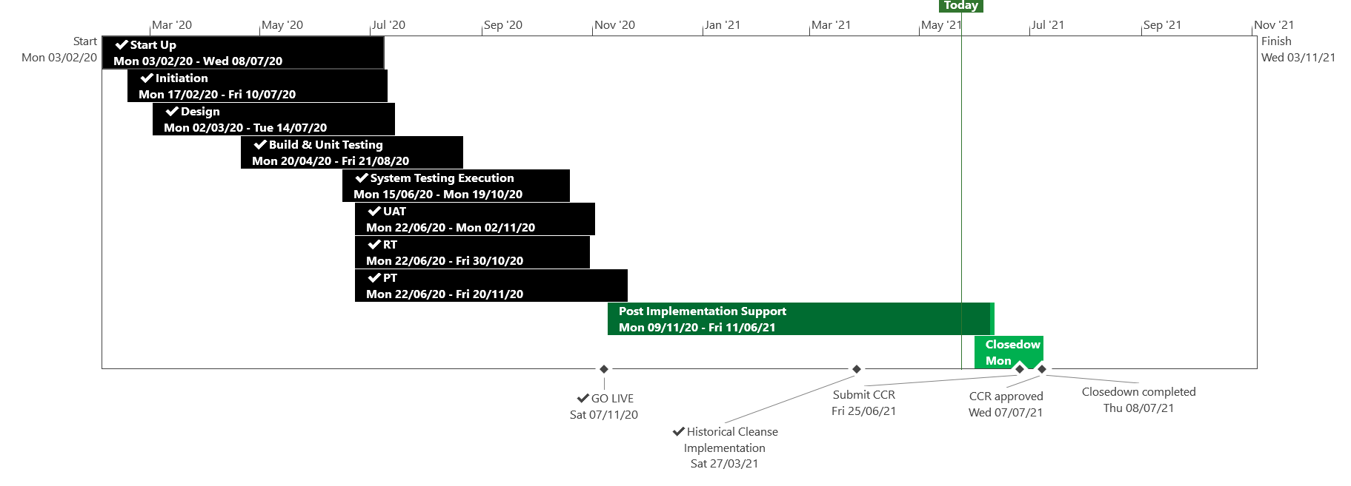
XRN5110 – Nov 20 Release - Status Update
 | Overall Project RAG Status
 | Schedule | Risks and Issues | Cost
RAG Status
Status Justification
Schedule | November 20 Release delivered, final activity for Historical Cleanse XRN4897/99 is on-going, due to be completed to schedule Historical Cleanse commenced on the 27th March and due to complete by 4th June CCR to be submitted to July ChMC Decision in June ChMC: None
Risks and Issues | ​Risk: UK Link may be non GDPR compliant following Historical Cleanse due to missing unknown scenarios Please Note: First usage has been completed and no new scenarios have been identified, risk closed Issue: XRN4897/99 Historical Cleanse Change Request needs to be completed to exit Post Implementation Support Return To Green: Completion of historical cleanse
Cost | Forecast to complete delivery against approved BER
Scope | XRN4897 - Resolution of deleted Contact Details (contained within the S66 records) at a Change of Shipper event XRN4899 - Treatment of Priority Service Register Data and Contact Details on Change of Supplier Event XRN4801 - Additional Information in DES XRN4871b - Rachet Regime Changes XRN5014 - Facilitating HyDeploy2 Live Pilot Descoped - XRN4931 Submission of a Space in Mandatory Data on Multiple SPA Files Descoped - XRN4941 MOD 692 – Auto Updates to Read Frequency Descoped - XRN4992 Supplier of Last Resort Charge Types Moved to CSSC - XRN4870c MAP ID
Complete
On Track
At Risk
Overdue
Not Baselined
Slide updated on 26th May 2021

