Slide 1
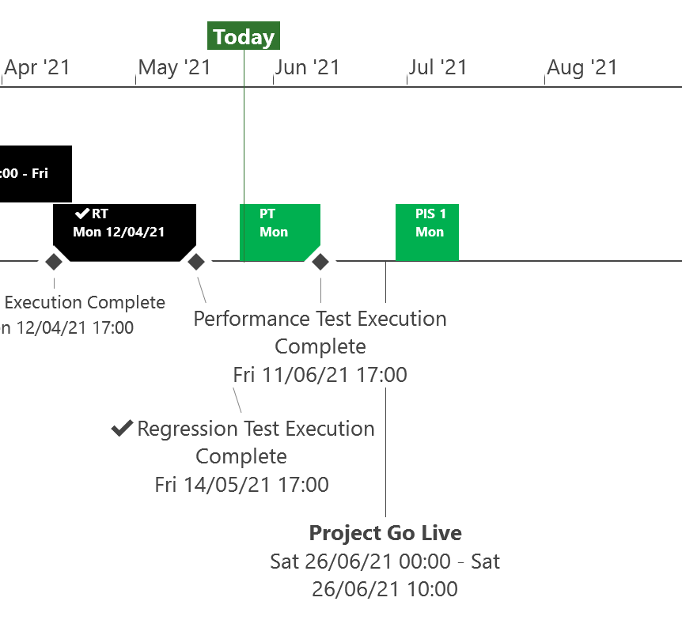
XRN5253 June 21 Major Release - Status Update
 | Overall Project RAG Status
 | Schedule | Risks and Issues | Cost
RAG Status
Status Justification
Schedule | Testing phase progressing to plan System, user and regression testing completed to plan in May Performance testing commenced to plan and due to finish by 11th June Go-live will take place on Saturday 26th June Post implementation support period agreed based on 1st usage timelines for MOD0700 (see next slide) Decision In June ChMC None
Risks and Issues | None applicable
Cost | Forecast costs on track to complete within approved BER
Scope | XRN5093 - MOD0711 – Update of AUG Table to reflect new EUC bands Descoped - XRN4992 - MOD0687 – Creation of new charge to recover last resort supply payments – Descoped at Extraordinary ChMC on 26th October 2020 Descoped - XRN4941 - MOD0692 - Auto updates to meter read frequency – Descoped at ChMC on 11th November 2020
Complete
On Track
At Risk
Overdue
Not Baselined
Slide updated on 28th May 2021

Slide 2
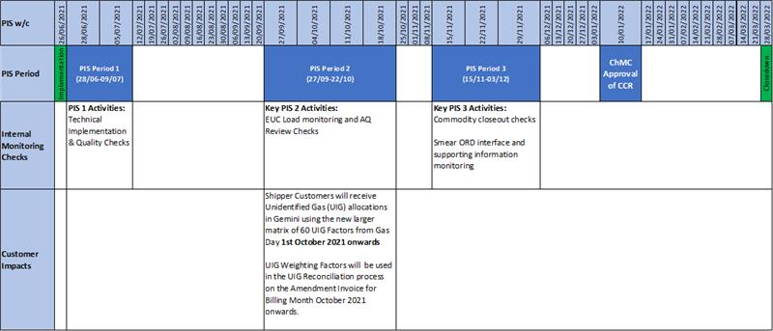
Post Implementation Support (PIS) Period
The below timeline details the PIS periods required for this Release based on 1st usage timings
NOTE: The 3 PIS Periods have been put in place to align to 1st usage

