Slide 1
CMS Rebuild Update
July CoMC Updates
Jo Williams

Slide 2
CMS Rebuild - Progress to date
Summary of progress to date
Mobilised into the next stage as per the indicative milestone Internal and External Workshop plans are being drafted Must Reads session on the 10/06/21 generated some really great discussion and we are now liaising with specialists in Xoserve to determine next steps Internal teams are still revisiting the GSR process to see if additional improvements can be identified and built into the Ideal “To Be” process The requirements log has been refined and republished for review after last month’s CoMC, we have received some feedback and questions on a few of the processes, all of which have been responded to. We have also identified some improvements in how we download and save the PDF versions of the process flows which will be utilised for the next stages Conversations are ongoing with regards to CSSC / REC, SDEP and TOG Mobilisation of CMS DSG has begun with lessons learned captured from CSSC and working alongside Xoserve to develop the ToR and guidelines.
Key Milestones | Due
Capture Exit | 30/06/2021

Slide 3
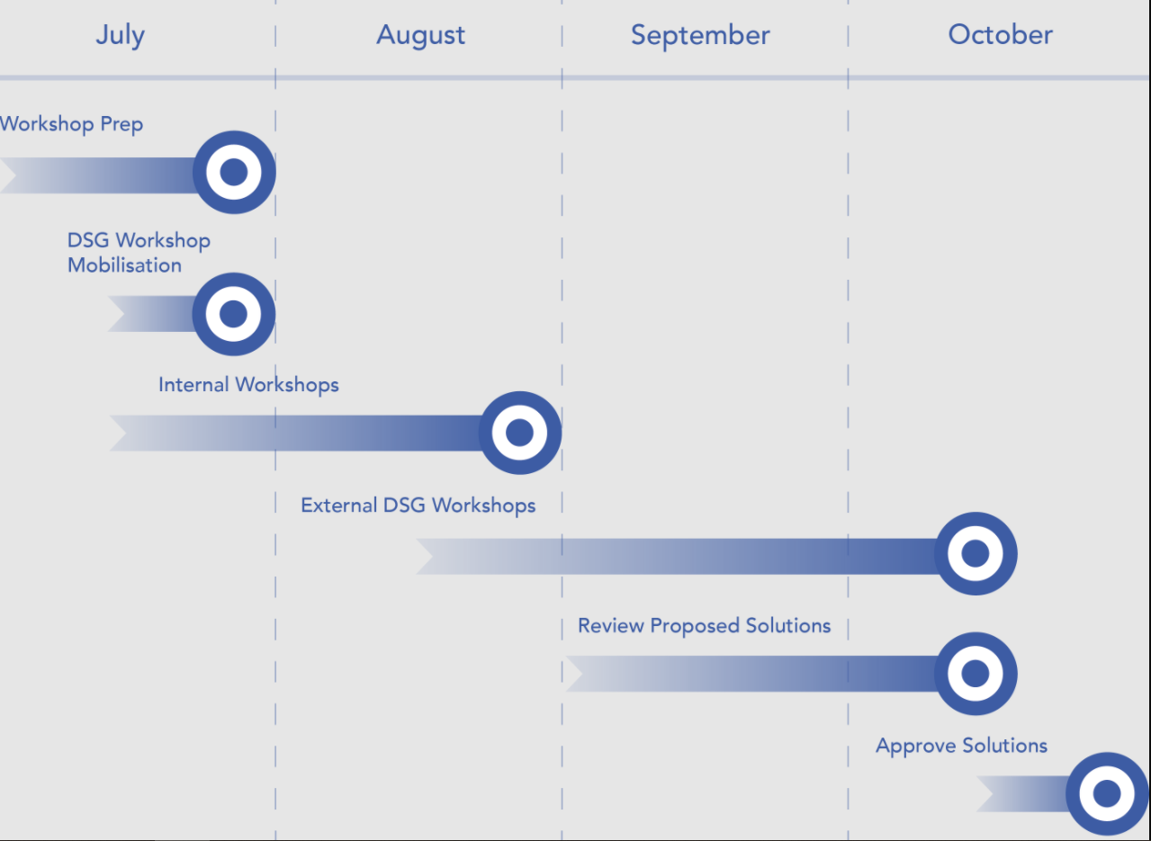
CMS Rebuild Timeline
Further workshops will be required to:
Understand level and complexity of impact to customers
Identification of any consequential impacts
Firm up requirements
The outputs of these workshops will then be used as inputs to the CMS DSG and once the solutions have been chosen these can then feed the Change Pack process
We will be targeting September / October with a preferred solution

