Slide 1
Annual General (DSC) Change Budget in BP22
ChMC recommendation required

Slide 2
Headlines
The suggested DSC (UNC/REC, value add) Change Budget for has a similar size and shape to BP21
Rather than being based on an existing change backlog (this time last year we knew more about the changes already in the pipeline and had a predictable delivery backdrop) we are instead basing this budget on potential delivery windows and historic costs to deliver change
All unspent funds returned at end of financial year with ChMC in control of scoping decisions throughout

Slide 3
Approach
xoserve-bp22-principles-and-approach-draft-single.pdf

Slide 4
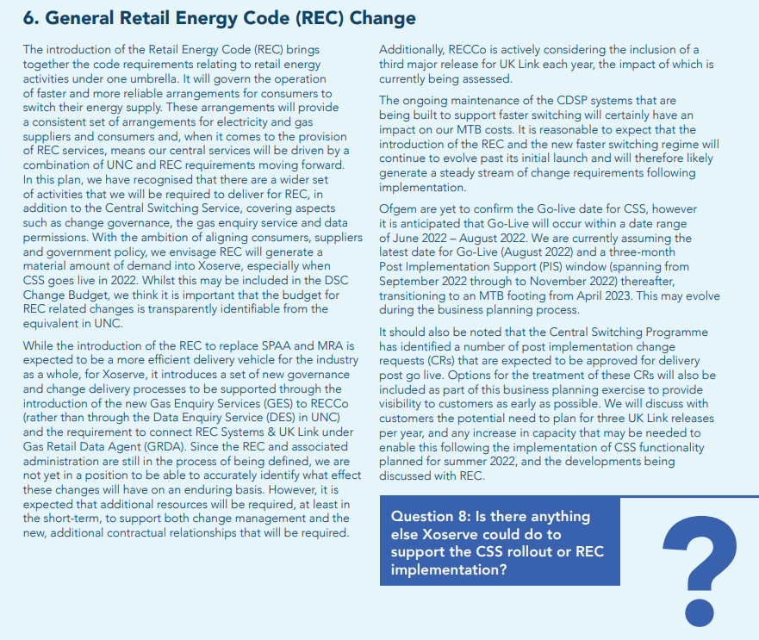

Slide 5
REC Impacts on Change Delivery and Development
As well as being CDSP under DSC, Xoserve is appointed under REC as Gas Retail Data Agent (GRDA) and Gas Enquiry Service (GES)
Changes will arise from REC like they do from other codes (UNC) and these changes will impact DSC IT systems / process (e.g. UK Link). These changes will need DSC funding in BP22 and beyond
A budget will be required to sit alongside the ‘Annual UNC Budget’ (DSC Change) to fund REC change
Known
Assumption
Impact
REC combines related gas and electricity changes together under one code
There will be a requirement to deliver change in February as well as June / November, to align with other fuel change delivery releases
Future change budgets will need to be appropriately sized to fund a 3rd major release
Delivery
Xoserve’s current business plan doesn’t include any costs associated with ‘BAU’ (non CSSC programme) REC change.
UNC / DSC change will continue to be raised at historic pace, at the same time as a potentially busy period of REC change (post CSS implementation)
Xoserve / Correla change development / delivery resource capacity / capability will need to reflect this increased demand
Development

Slide 6
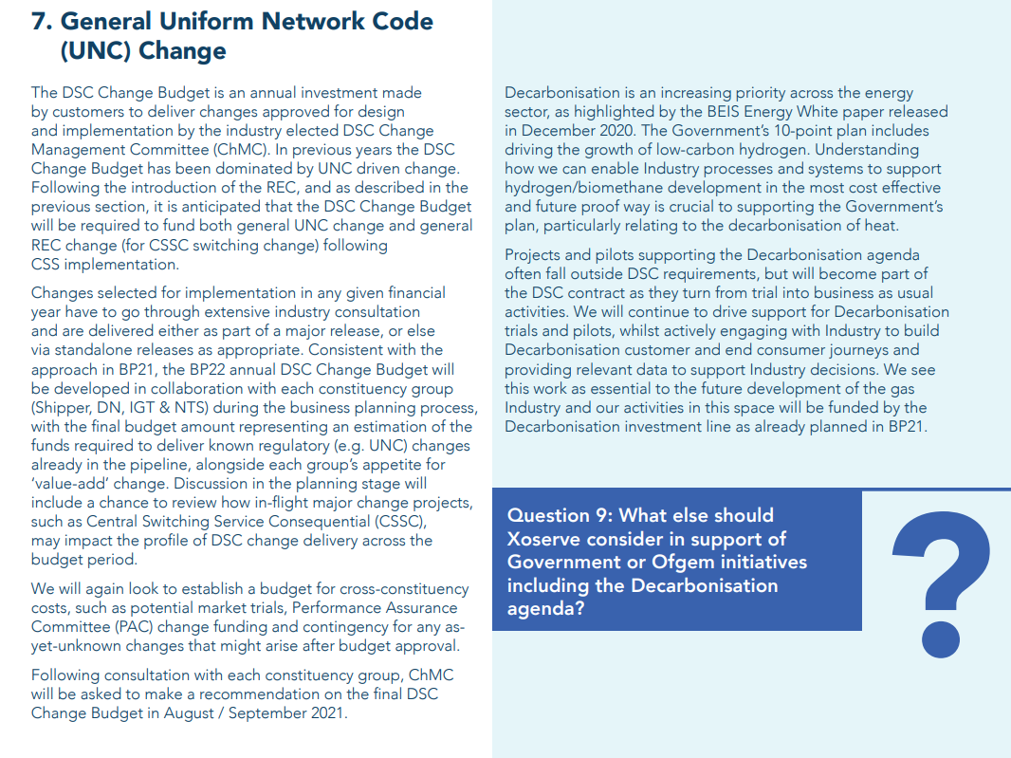

Slide 7
Potential Releases & Impacts to Change Budget BP22
 | 2022 |  |  |  |  |  |  |  |  |  |  |  | 2023 |  |  |  |  |  |  |  |  |  |  |  | 2023
 | Jan | Feb | Mar | Apr | May | Jun | Jul | Aug | Sep | Oct | Nov | Dec | Jan | Feb | Mar | Apr | May | Jun | Jul | Aug | Sep | Oct | Nov | Dec | Jan | Feb | Mar | Apr
Minor
Major
CSSC
MiR 12
MiR 13
MiR 14
MiR 15
MiR 16
MiR 17
MiR 18
N22
Develop
Design
Build/Test
PIS
F23
Develop
Design
Build/Test
PIS
J23
Develop
Design
Build/Test
PIS
N23
Develop
Design
Build/Test
PIS
Key
BP22 Delivery Budget Impact
Planning
Transition
Go Live Range
PIS
BP22 Development Budget Impact
BP22 No Impact

Slide 8
Suggested Major Release Delivery Budget
The image below uses the average post-Nexus costs listed in Change Completion Reports (CCRs) for major releases
Where project delivery crosses financial years, only the elements that will be approved (via EQR / BER) have been included.
EQR value based on c10% of total release costs
The costs don’t include development (capture) costs
£2.4m
Historic Costs to calculate average
N22
£0.73m
F23
£0.81m
J23
£0.81m
N23
£0.08m
N22
Develop
Design
Build/Test
PIS
F23
Develop
Design
Build/Test
PIS
J23
Develop
Design
Build/Test
PIS
N23
Develop
Design
Build/Test
PIS

Slide 9
Suggested REC Change Development Budget
Additional resources will be required to develop REC changes alongside more traditional change sources (e.g. UNC)
It is appropriate to seek investment (rather than to increase MTB) to cover this work for at least 1 year post CSS implementation so that demand can be assessed
Some change development costs will apply throughout the financial year, with resources being utilised to interact with REC governance, impact assess incoming change and work with DSC customers to develop solutions (capture)
£0.25m
N22
Develop
Design
Build/Test
PIS
F23
Develop
Design
Build/Test
PIS
J23
Develop
Design
Build/Test
PIS
N23
Develop
Design
Build/Test
PIS

Slide 10
Suggested % Share of Budget
It is proposed that the budget is funded based on the % splits applied in BP21 (which also have a similar profile to what was spent by each constituency in BP20)
It is proposed that contingency may not be required as we are using delivery bandwidth, rather than bottom-up change approach to set total budget - however constituencies may wish to add specific contingency amounts, which would not impact any other constituency weighting
All uncommitted funds are returned at the end of the financial year

