Slide 1
Interactive Unidentified Gas Data Charts
For Information

Slide 2
Interactive UIG Data Charts
We’ve launched two new interactive charts showing Unidentified Gas (UIG) data. The charts are accessed directly from the Xoserve website and allow users to ‘drill down’ to display data for a specific date range. The charts are:
UIG Percentage by Gas Day – shows daily national UIG percentage levels for the first (D+1) and last (D+5) run of allocation (updated weekly).
UIG as a Percentage of Total Throughput – shows monthly UIG as a percentage of total throughput at allocation and after reconciliations processed to date (updated monthly).
Both charts are available via the ‘UIG Interactive Data’ area of the 'Unidentified Gas (UIG)' page or from the Xoserve homepage, click Services and using the Issue Management dropdown, select Unidentified Gas (UIG) (Orange Section titled “UIG Interactive Data”).
Any queries in relation to this please contact the UIG team via uigtaskforce@xoserve.com

Slide 3
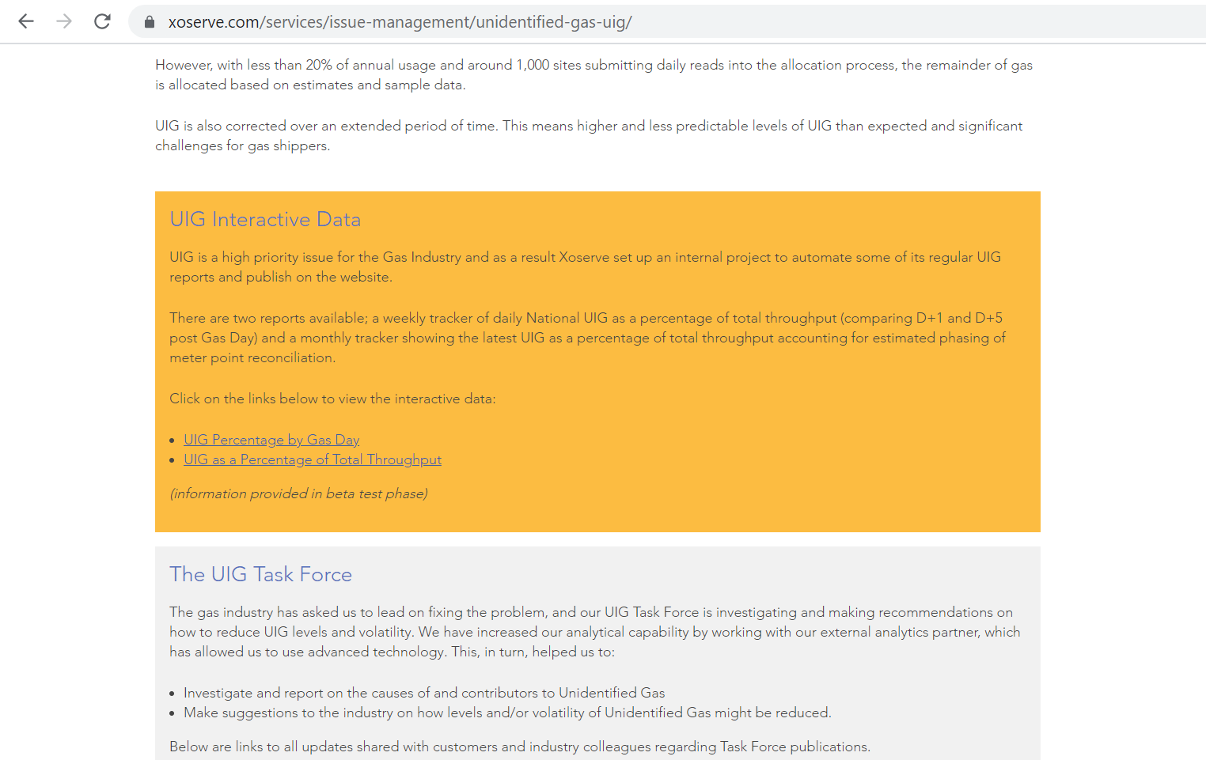
Website Location

Slide 4
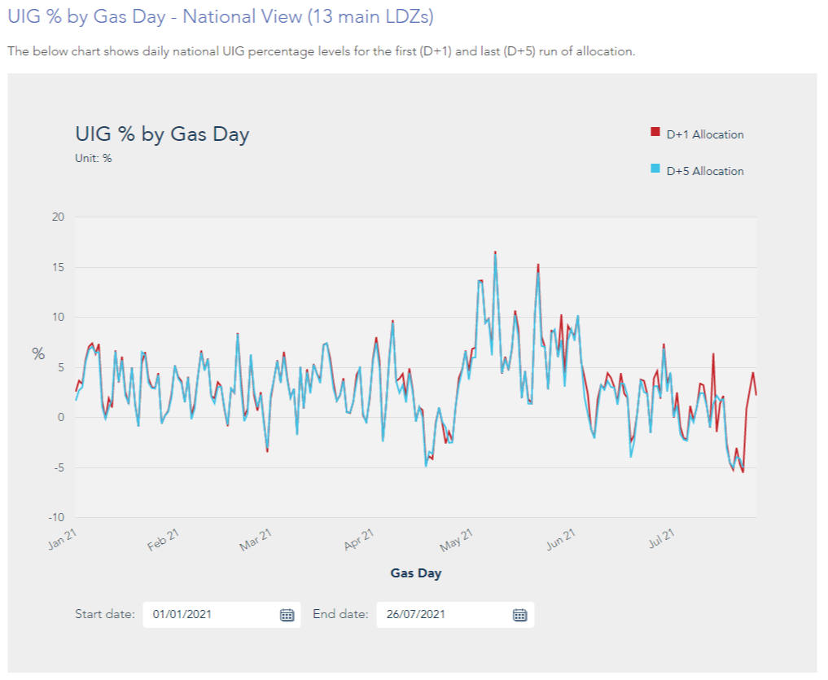
UIG Percentage by Gas Day

Slide 5
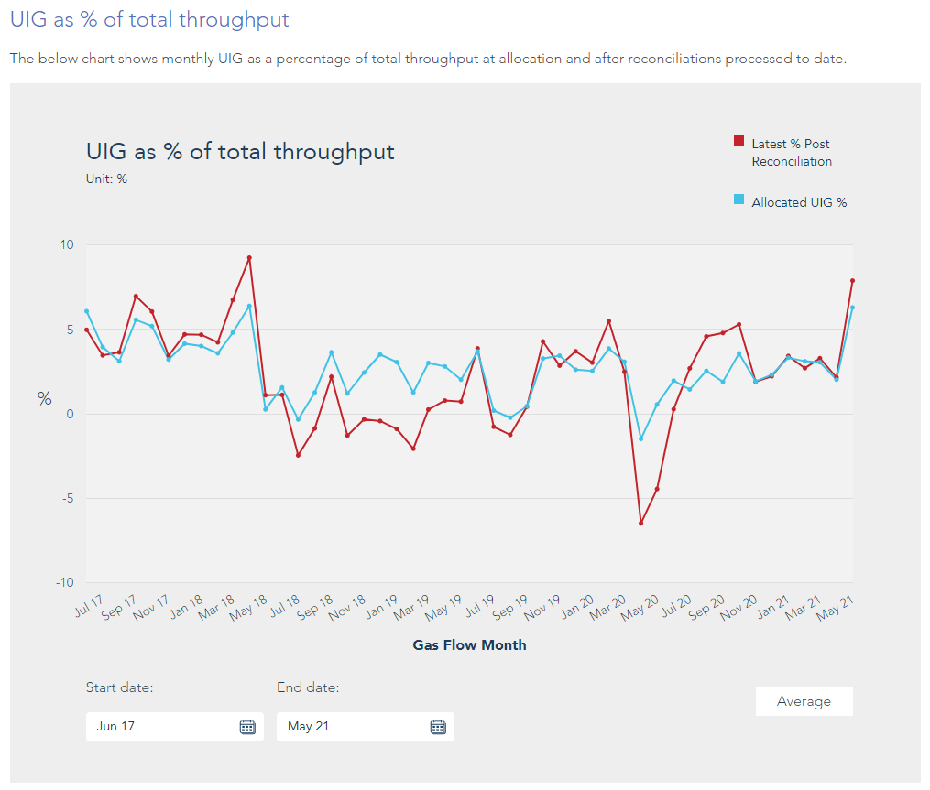
UIG as a Percentage of Total Throughput

