Slide 1
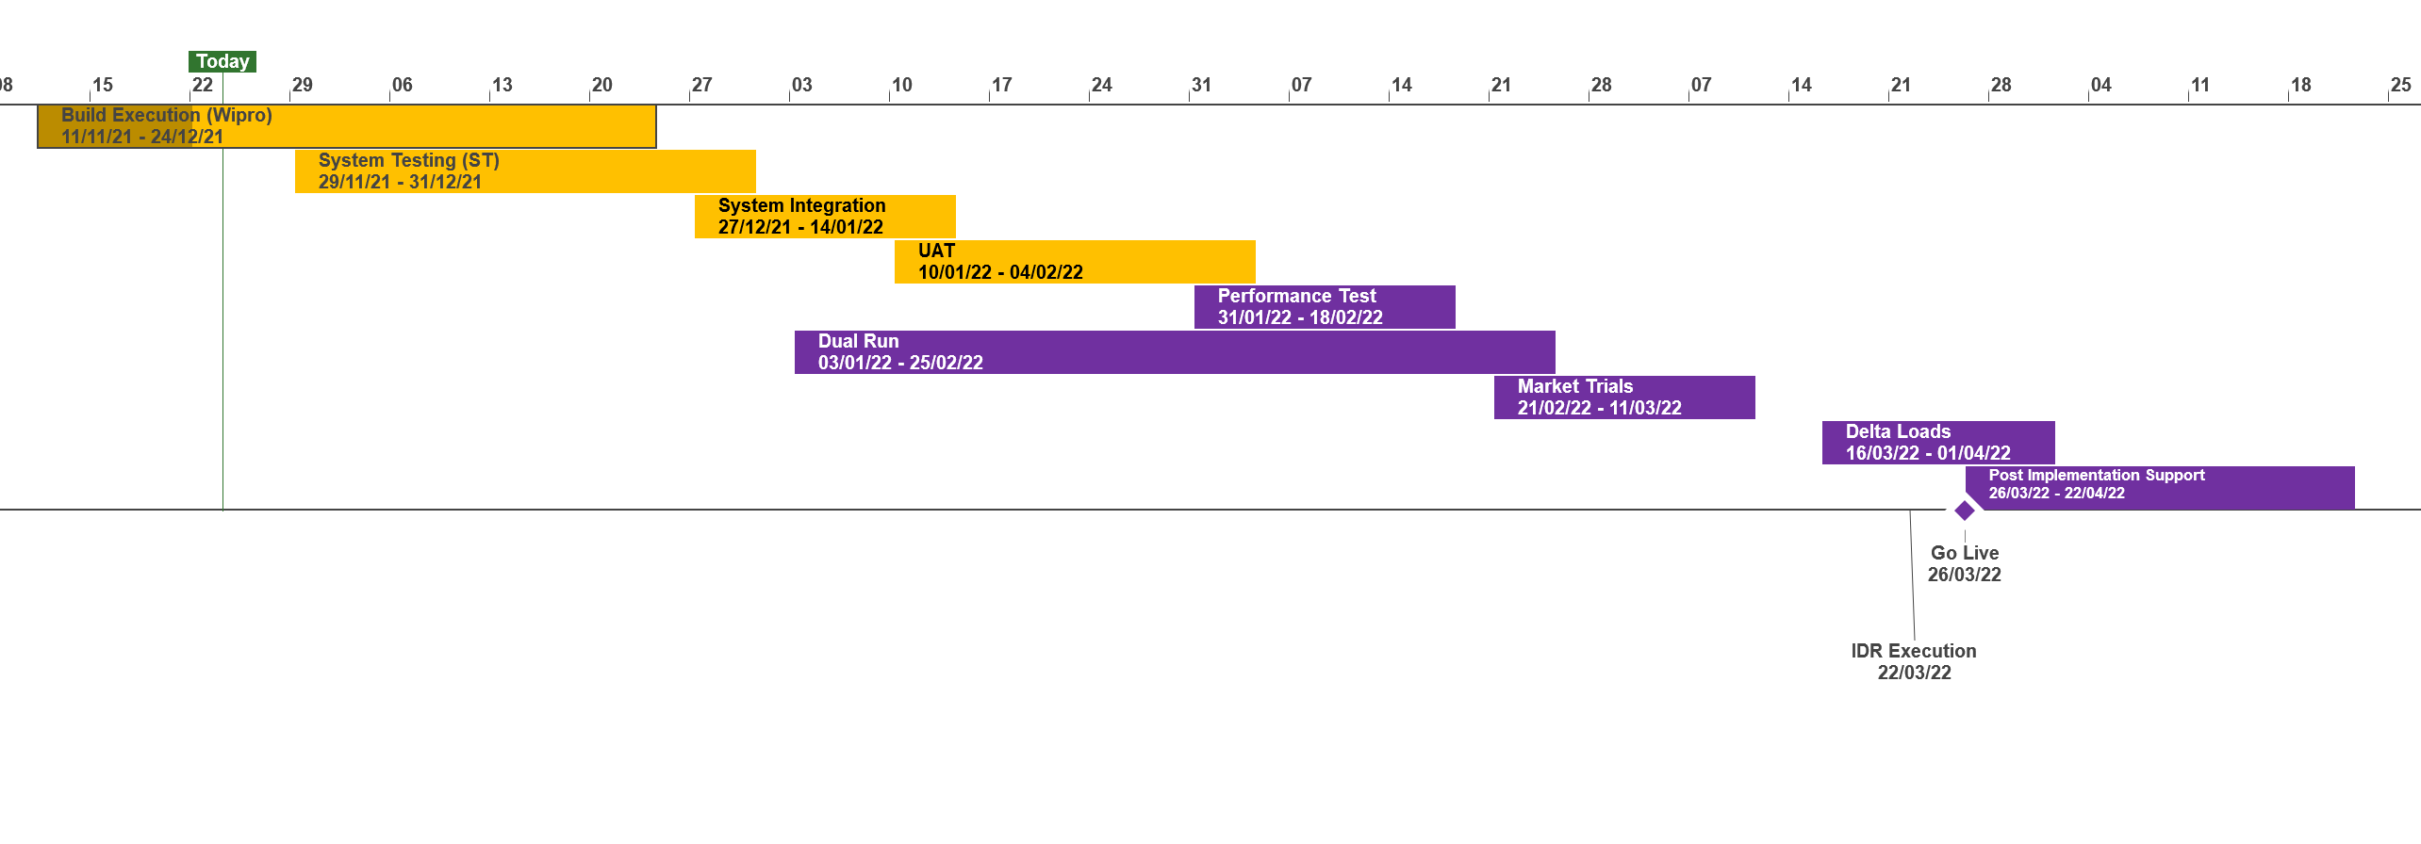
XRN5231 Flow Weighted Average CV
 | Overall Project RAG Status
 | Schedule | Risks and Issues | Cost
RAG Status
Status Justification
Schedule | Overall Status set to Amber due multiple phases progressing in parallel and the need to baseline the project phases post System Test. All funding now in place following approval of a revised BER at the November ChMC Start Up and Initiation Phases have completed Detailed Design completed and Design Change Pack approved at the November ChMC Revised BER approved at November ChMC to bring into scope Gemini consequential changes Build has commenced, System Testing due to commence as per plan Xoserve to engage with National Grid (NG) and DNs through December to stand up Engagement approach and meetings Dual Run and Market Trials approach to be published to stakeholders in December ahead of planned start in January 2022. Dates will be formally baselined following agreement of approach Notional Implementation date set for 26th March, to be confirmed
Risks and Issues | There is a risk that change congestion with UK Link move to Cloud, Gemini Regulation and Sustaining change during Q1 2022 that cutover & implementation dates may need to be prioritised There is a risk that until the transition & cutover approach is agreed between Xoserve, National Grid & DNs to confirm the length of Post Implementation Support and what support dependencies are required from National Grid as the existing service provider There is a risk that National Grid have served notice to terminate the current FWACV service on the 31st March 2022 and the project plan does not meet an implementation date of the new service from the 01st April 2022, resulting in the need to negotiate an extension of the service by National Grid
Cost | Forecast costs tracking to approved BER costs
Scope | XRN5231 Flow Weighted Average (CV) Gemini consequential change part A - PRCMS validation/processing Gemini consequential change part B - LDZ Stock Change and Embedded LDZ Unique Sites
Complete
On Track
At Risk
Overdue
Not Baselined
Slide updated on 23rd November

