Slide 1
Change Management Committee
8th December 2021

Slide 2
Section 2: DSC Change Budget & Horizon Planning

Slide 3
DSC Change Budget 21/22 YTD

Slide 4
Budget v Committed Spend BP21/22
Finance Tracker (linked) has been simplified in line with discussion in November’s ChMC
No variance from last month, so graph not included

Slide 5
Change Pipeline

Slide 6
Change Development & Delivery Pipeline (DSC Change / Minor Release Budget)
* Pre-capture may contain changes that won’t require delivery / funding

Slide 7
2021-2022 DSC Change / MiR Pipeline
Key:
Approval on track
Approved
Approval at risk
Key:
On Track
Potential Activity
Complete
Potential risk to plan
Plan At Risk

Slide 8
Section 3: Capture

Slide 9
New Change Proposals – Initial Review
For Approval
XRN5450 Demand tool to support Urgent Modification 0788 - Minimising the market impacts of ‘Supplier Undertaking’ operation
XRN5453 GSOS 2, 3 & 13 Payment Automation
For Information
XRN5452 - Amendments to v20 of the Service Description Table For information
XRNTBC – UNC Modification (reference TBC) - Contingency Gas Procurement Arrangements when a Supplier acts under a Deed of Undertaking

Slide 10
XRN5450 Demand tool to support Urgent Modification 0788 - Minimising the market impacts of ‘Supplier Undertaking’ operation
Customer Class | Voting Party?
Shipper
Distribution Network Operators (DNOs)
National Grid Transmission | X
IGT’s
Change Description
Modification 0788 - Minimising the market impacts of ‘Supplier Undertaking’ operation was implemented on 01 November 2021. This provides the ability for Suppliers who are operating under a DoU following the Termination of the Shipper User, to make arrangements with another Shipper User to source additional supplies of gas and make trade nominations to the Terminated Shipper User account to balance that portfolio and mitigate increased costs, until a new ‘Registered User’ is appointed. XRN5443 was raised to accommodate the Modification 0788 process. Under XRN5443, as per Modification 0788, the CDSP will send the new Shipper relevant TSMPs information and the new Shipper is responsible for confirming the demand for the TSMPs they have agreed to supply gas for. It has been acknowledged between National Grid and the CDSP that there could be a scenario where a new Shipper looking to supply gas for the TSMPs doesn’t have the ability to work out the estimate demand or simply wants the CDSP to provide this estimate. To address this scenario, this Change Proposal has been raised to create and make available where required, a demand tool which in the event of a Shipper termination, the tool would allow the CDSP to calculate estimate demand at Supplier level enabling the Supplier to enter an arrangement with a new Shipper to offset the demand, via a trade, with the Terminated Shipper.
DSC Service Area: | TBC
Link to Change Proposal | Link to CP
Change Type | Regulatory
Priority Score | High
Sponsor Representative | National Grid

Slide 11
XRN5453 GSOS 2, 3 & 13 Payment Automation
Customer Class | Voting Party?
Shipper | X
Distribution Network Operators (DNOs) | X
National Grid Transmission
IGT’s
Change Description
To automate the GSOP 2, 3 & 13 payments currently made via the Adhoc Request to Bill (RTB) process will require the following changes: • New Invoice Type • Utilise existing Charge Types • New Template in line with current FSG process • New AMT Interfaces • New PO Interfaces • Update Supporting Information We would look to Xoserve to provide solution options which could facilitate the timely payment of the GSOP’s listed within this Change Proposal and would expect that the following options be investigated as a minimum. 1. A solution which could automate the current RTB process. 2. A solution which would utilise similar functionality to the current Failure to Supply Gas process. 3. A solution which could facilitate a daily submission.
DSC Service Area: | TBC
Link to Change Proposal | Link to CP
Change Type | Non Regulatory
Priority Score | Medium
Sponsor Representative | SGN

Slide 12
XRN5452 Amendments to v20 of the Service Description Table
Customer Class | Voting Party?
Shipper | N/A
Distribution Network Operators (DNOs) | N/A
National Grid Transmission | N/A
IGT’s | N/A
For Information – This will be presented at November CoMC for approval
Change Description
This change is to seek approval for the inclusion of a new service lines to the DSC Service Description Table and to propose an amendment to an existing service line. Proposed New Service Line Proposed Service Line amendment Existing Line :-
DS-NCS SA2-01 | The provision of a webpage available on the specific Shipper dashboard via DDP to allow Shippers to self serve and access the pre-COVID AQ held within the UK Link System for a specific Meter Point Reference Number
This line has been drafted to support XRN5431 Temporary community access to pre-COVID AQ values for Shippers
DSC Service Area: | N/A
Link to Change Proposal | Link to CP
Change Type | Documentation
Priority Score | High
Service Line | Proposed amendment
DS-NCS SA9-01 | The provision of reporting / information services to the UNCC Performance Assurance Committee to the value of £50,000 per annum, increasing to £75,000 £125,000 with effect from 01 April 2020. for Financial year 2021/22
Sponsor Representative | Xoserve

Slide 13
XRNTBC - UNC Modification (reference TBC) - Contingency Gas Procurement Arrangements when a Supplier acts under a Deed of Undertaking
Verbal update to be presented by Ellie Rogers

Slide 14
Change Proposals – Post Solution Review for Approval
XRN5236 Reporting Valid Confirmed Theft of Gas into Central Systems (Modification 0734)

Slide 15
XRN5236 Reporting Valid Confirmed Theft of Gas into Central Systems (Modification 0734)
Solution Review Consultation Summary
Change Pack Ref | HLSO Cost | Funding | Preferred Option | Voting | Proposed Delivery | Link to CP | Representation Summary
 |  |  |  |  |  |  | Approve | Defer | Reject
2934.1 - RT - PO | 135K – 175K | 100% Shipper | Option 1- Interim solution only | Shipper | By April 22 | CP Page |  |  | 1
Org | Status | Comments
EDF | Reject | We support MOD 0734S and the enduring solution which seeks to introduce a robust process whereby the volume of the confirmed theft is reported into central systems. We feel that the solution should allow the shippers to bulk accept Theft claims via CMS, and have a preview option of the bulk list so that the shipper is able to see any stand out volume and reject that one and then accept the rest. We feel this would allow efficiency in the solution. In terms of the interim solution, we cannot see a strong benefit case to implement something which will be subsequently replaced within months by the enduring solution. We would like to understand more details in terms of the benefits it would bring to industry. Our understanding is that MOD 0734S is yet to be approved in January 2022, which raises a question whether the solution should be discussed for approval. In addition, it is not clear what is driving the early implementation of the interim solution. Our understanding is that the proposed implementation date April 2022 was originally based on the new TRAS process being in place by this time. The new TRAS process will no longer be in place by this time as it has been delayed. Moreover, if the “as is” process is followed correctly then identified gas theft will be entered into settlements. MOD 0734S makes this simpler and to ensure compliance but there is nothing preventing compliance if current processes are followed. Therefore, we believe that this change should be delivered as part of the CMS rebuild programme as a more cost-efficient way to deliver the change.

Slide 16
section 4. Design & Delivery

Slide 17
XRN4992 - Modification 0687 - Creation of new charge to recover Last Resort Supply Payments

Slide 18
Background - XRN4992 - Modification 0687 - Creation of new charge to recover Last Resort Supply Payments
Solution Option 1 (enduring) was approved to progress into development at February 2020 ChMC meeting for proposed November 2020 release
Detailed Design Change Pack was sent out for consultation on the enduring solution (Option 1)
At the eChMC meeting in May 2020 the Committee pulled the change from November 2020 release due to the Modification still awaiting an Ofgem decision.
There was also an interim solution (Option 4), which ChMC were considering to implement if delivery of the enduring solution (Option 1) couldn’t align with a 01 April implementation date.
Please note, at this point, we are asking ChMC to consider voting on the interim solution (Option 4) only to aim for implementation by 01 April 2022.
If approved and implemented, we will subsequently bring the enduring solution (Option 1) back to ChMC to consider when it can be scheduled for delivery (UK Link Major Release required).
Consultation Summary
Change Pack | Detailed Design | Representations | Voting
April 2020 | 2566.10 - MT - JR | 3 Approvals | Shipper & DNO

Slide 19
ChMC Decision Required
The industry are expecting Ofgem to make a decision on Modification 0687 imminently (expected prior to December ChMC).
If approved, in order to implement the Modification by 01 April 2022 (advised as the required implementation date), DSC Change Managers need to approve the CDSP starting work to deliver the interim solution (Option 4).
Based on this, we are seeking ChMC approval to proceed into detail design / delivery for the interim solution (Option 4). Please see below the summary details:
Revised HLSO including Option 4 only attached for reference:
*Please note this is the high-level indicative cost based on the HLSO previously presented in October 2019. If approved into detailed design / delivery, as per the usual process an updated cost will be shared.
Overall Impact | Release Type | High Level Cost Estimate* | Impacted / Voting Parties | Funding Parties
Small | Any | 25,000 to 50,000 GBP* | Shippers and DNOs | 100% Shippers

Slide 20
Standalone Change Documents for Approval (BER, CCR, EQR)
CCR for XRN5431 Temporary community access to pre-COVID AQ values for Shippers
  Voting Shippers
CCR for XRN5318 / 5319 Assessing MPID Reassignment – Supplier/All Party Types
  Voting Shipper, DNO, IGT & NTS
CCR for XRN5183 Access to Daily Biomethane Injections
  Voting DNO
CCR for XRN5371 Minor Release Drop 10
  Voting Shipper, DNO, IGT & NTS
CCR for XRN5122 Gemini System Enhancements - Delivery
  Voting NTS
EQR for UK Link Dec 21 – Apr 22 Detailed Design
  Voting Shipper, DNO, IGT & NTS

Slide 21
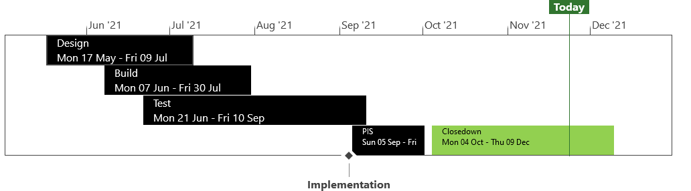
XRN5371 - Minor Release Drop 10 - Status Update
 | Overall Project RAG Status
 | Schedule |  | Risks and Issues | Cost
RAG Status
Status Justification
Schedule | Closedown progressing to plan Decision in December ChMC: Approval of Change Completion Report
Risks and Issues | None applicable
Cost | Completed within approved spend
Scope | XRN5309 - FSG Automation of FSR Process XRN5188 - MAP ID Data Upload to UK Link XRN5246 - Confirmation File Performance improvements
Complete
On Track
At Risk
Overdue
Not Baselined
Slide updated on 23rd November 2021

Slide 22
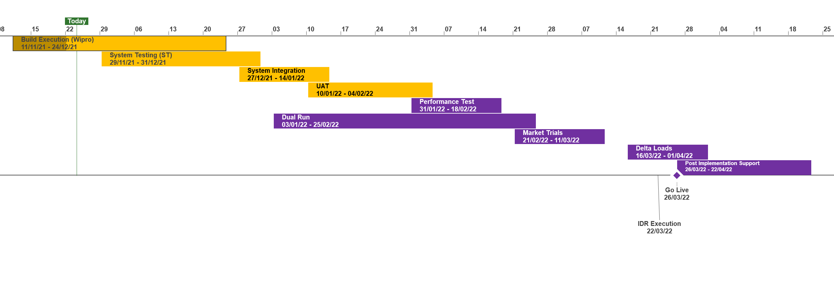
XRN5231 Flow Weighted Average CV
 | Overall Project RAG Status
 | Schedule | Risks and Issues | Cost
RAG Status
Status Justification
Schedule | Overall Status set to Amber due multiple phases progressing in parallel and the need to baseline the project phases post System Test. All funding now in place following approval of a revised BER at the November ChMC Start Up and Initiation Phases have completed Detailed Design completed and Design Change Pack approved at the November ChMC Revised BER approved at November ChMC to bring into scope Gemini consequential changes Build has commenced, System Testing due to commence as per plan Xoserve to engage with National Grid (NG) and DNs through December to stand up Engagement approach and meetings Dual Run and Market Trials approach to be published to stakeholders in December ahead of planned start in January 2022. Dates will be formally baselined following agreement of approach Notional Implementation date set for 26th March, to be confirmed
Risks and Issues | There is a risk that change congestion with UK Link move to Cloud, Gemini Regulation and Sustaining change during Q1 2022 that cutover & implementation dates may need to be prioritised There is a risk that until the transition & cutover approach is agreed between Xoserve, National Grid & DNs to confirm the length of Post Implementation Support and what support dependencies are required from National Grid as the existing service provider There is a risk that National Grid have served notice to terminate the current FWACV service on the 31st March 2022 and the project plan does not meet an implementation date of the new service from the 01st April 2022, resulting in the need to negotiate an extension of the service by National Grid
Cost | Forecast costs tracking to approved BER costs
Scope | XRN5231 Flow Weighted Average (CV) Gemini consequential change part A - PRCMS validation/processing Gemini consequential change part B - LDZ Stock Change and Embedded LDZ Unique Sites
Complete
On Track
At Risk
Overdue
Not Baselined
Slide updated on 23rd November

Slide 23
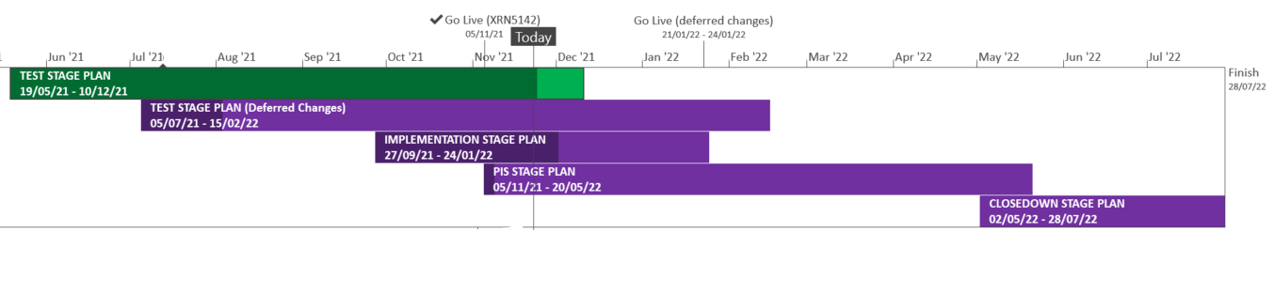
XRN5289 – November 21 Major Release - Status Update
 | Overall Project RAG Status
 | Schedule | Risks and Issues |  | Cost
RAG Status
Status Justification
Schedule | XRN5142: Implementation and data cleanse completed successfully First usage is in progress; due to complete 03/12/21 Final usage to be completed 31/01/22 Deferred Changes: Re-plan is in progress Preparation for go-live is in progress for 22/01/22 Revised dates for implementation approach will be shared in January ChMC Revised data cleanse plan will be shared via email XRN4992a: Impact assessment taking place to ascertain if delivery can be aligned to 22/01/22 Decision in December ChMC: None
Risks and Issues | In re-plan
Cost | Forecast to complete delivery against approved BER
Scope | In Scope – XRN4941 - MOD0692 - Auto updates to meter read frequency Icope - XRN5007 - Enhancement to reconciliation process where prevailing volume is zero​ In Scope - XRN5072 - Application and derivation of TTZ indicator and calculation of volume and energy – all classes​ In Scope - XRN5142 - New allowable values for DCC Service Flag in DXI File from DCC​ In Scope - XRN5180 - Inner tolerance validation for replacement reads and read insertions​ In Scope – XRN4780C – Inclusion of Meter Asset Provider Identity (MAP Id) in the UK Link system (CSS Consequential Change) Descoped - XRN5091 - Deferral of creation of Class change reads at transfer of ownership​ Descoped - XRN5186 MOD0701 – Aligning capacity booking under the UNC and arrangements set out in relevant NExAs​ Descoped - XRN5187 MOD0696 – Addressing inequalities between capacity booking under the UNC and arrangements set out in the relevant NExAs
Complete
On Track
At Risk
Overdue
Not Baselined
Slide updated on 24th November 2021

Slide 24
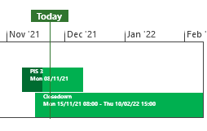
XRN5253 June 21 Major Release - Status Update
 | Overall Project RAG Status
 | Schedule | Risks and Issues | Cost
RAG Status
Status Justification
Schedule | Project on track Post implementation support (PIS) period 2 successfully concluded on 28/10/21 Period 3 commenced to plan on 08/11/21 and is on track to complete on 10/12/21 Decision in December ChMC None
Risks and Issues | None Applicable
Cost | Forecast costs on track to complete within approved BER
Scope | In Scope (XRN5093) - MOD0711 – Update of AUG Table to reflect new EUC bands Descoped (XRN4992) - MOD0687 – Creation of new charge to recover last resort supply payments – Descoped at Extraordinary ChMC on 26th October 2020 Descoped (XRN4941) - MOD0692 - Auto updates to meter read frequency – Descoped at ChMC on 11th November 2020
Complete
On Track
At Risk
Overdue
Not Baselined
Slide updated on 23rd November 2021

Slide 25
NG TRANSMISSION CHANGE HORIZON PLAN
0 - 2 YEARS NOV 2021 - NOV 2023
November 2021

Slide 26
NG TRANSMISSION CHANGE HORIZON PLAN 0-2 YEARS NOV 2021 – NOV 2023
Programmes & Projects 2021-2023 |  |  |  | 2021 |  | 2022 |  |  |  |  |  |  |  |  |  |  |  | 2023
 |  |  |  | Nov | Dec | Jan | Feb | Mar | Apr | May | Jun | July | Aug | Sept | Oct | Nov | Dec | Jan
MAJOR RELEASES | Regulatory / Customer Requested Change | PM Matthew Rider | XRN5393 – Gemini Spring 22 Release
 |  |  | MOD0728B – UK Link & Gemini Delivered as part of CP5341
 | UK Link Consequential Changes | PM Hannah Reddy | Flow Weighted Average CV FWACV
 | Gemini Change Programme Sustain | PM Manisha Bhardwaj | Single Sign on Experience
 |  |  | API Enhancements
 |  |  | Site Minder Upgrade
Analysis & Design – Oct 21 – Dec 21
Testing – Dec 21 to Mar 22
Pre-implementation/IDR
Mar 22 to Apr 22
Change Deployment
Apr 22
PIS – From Apr 22 to Jun 22
PIS UKL - Sept to Nov 21
PIS Gemini - Sept to Dec 21
Content: External Test Phase Jul - Dec 21
KEY RISK & % = Certainty of Scope
 | Approved on Track
 | Approved
 | Approval at Risk
 | Change Completion Report
 | External User Activity
Design to PIS - Nov 21 to Mar 22 – Indicative timeline
Design to PIS – Sept 21 to May 22 – Indicative timeline
KEY – Project Status
On Track
Complete
Potential Risk to Plan
Plan at Risk
Design to PIS – Jan 22 to Apr 22 – Indicative timeline
Design to PIS – Dec 21 to Feb 22 – Indicative timeline

Slide 27

CSSC Programme Dashboard
December 2021

Slide 28
Move to Cloud
Placeholder

Slide 29
Programme Update
Programme Health – RAG |  |  | Return to Green Plan
Overall Programme Status | Previous | Current | The programme remains at a Green status and all Programme activities remain on track with all key internal and eternal milestones being met
Programme Plan | Previous | Current
Risk Profile | Previous | Current
Resources | Previous | Current
Executive Summary |  |  |  | Upcoming Activities & Milestones (Next Month)
Key Programme Updates: Transition: A preliminary Go Live date of the 18th July has been released by Ofgem. The Programme has also confirmed a ‘firebreak’ period of six weeks which will be added to transition phase 2 timelines. This means that the current transition timelines remain ‘as is’ and do not ‘lift and shift’ with the change in Go Live date from the June date that has been used for transition/cutover planning. Industry has been consulted on both the Go Live date and the firebreak. Xoserve have supported both aspects in principle but have called out impacts, for which we have proposed mitigations and are pending Ofgem approval/discussion. Internal & External Testing: UEPT has completed, E2E is nearing it’s final stages of Programme testing. A CR has been approved at Programme delivery group to allow the continuation of testing on the UIT environment for new participants and low priority support. The SI confirmed that this continuation presently is contained to one participant and would require support from two DNO’s only. Data Migration: REL Cycle 5 was delivered on track to Landmark last week. Landmark have confirmed receipt. Landmark are now in the process of providing the REL analysis reports on the back of REL cycle 4. Portfolios will be prepared and issued to customers for investigation into sites where a REL is failing to be identified. SOLR: The CR is now out for Industry consultation and is due to be tabled for recommendation for approval at the Ofgem Design Forum on the 6th December. |  |  |  | Transition: Completion of transition testing stage 1 and commencement of stage 2. Testing: Completion of E2E testing until end of phase. Continue to review programme CR’s and defect fixes to Programme release plan DES: CR has been raised by Xoserve to clarify the NFR around how quickly CSS data will be displayed in DES. This CR is being tabled on the 6th December at Ofgem Forum with recommendation for approval.

Slide 30
Section 6: Any Other Business
January Paper Submission

Slide 31
APPENDIX

Slide 32
Outages
Outages
Change Request Number | Impacted System | Outage Duration |  |  |  |  | Committee Notified Date
 |  | Start Date | Start Time | End Date | End Time | Brief Description
XRN 5339 | EFT | 27/02/2022 | TBC | 27/02/2022 | TBC | This change will be to cutover from the existing EFT PROD to the newly built and upgraded EFT PROD, to keep the application in support. This extended outage will be on a Sunday and utilise the maintenance window for EFT to cause less impact to the industry. During the extended outage any files that would be processed by EFT during this window will remain safely in their respective Folders, once EFT is back online, all file transfers will be synced and issued. Please be aware that the EFT cutover Contingency Dates will be carried out on the following weekend, 6th March. | 13/10/2021
XRN 5339 | EFT | 13/03/2022 | TBC | 13/032022 | TBC | As part the Enhanced File Transfer (EFT) project we will conduct Disaster Recovery (DR) testing. The EFT DR test will prove and confirm the procedures, resilience and capability of the newly upgrade EFT. As EFT is a multiple site application we will fail over to one site then failback to service normal and test the other site the following week. Please be aware that the EFT DR Contingency Dates will be carried out on the following weekend. Any files that would be processed by EFT during this window will remain safely in their respective Folders, once EFT is back online, all file transfers will be synced and issued. | 13/10/2021
XRN 5339 | EFT | 20/03/2022 | TBC | 20/03/2022 | TBC | As part the Enhanced File Transfer (EFT) project we will conduct Disaster Recovery (DR) testing. The EFT DR test will prove and confirm the procedures, resilience and capability of the newly upgrade EFT. As EFT is a multiple site application we will have failed over, then failed back one site on the previous week, to complete the DR testing this weekend we will DR test the remaining site. Please be aware that the EFT DR Contingency Dates will be carried out on the following weekend. Any files that would be processed by EFT during this window will remain safely in their respective Folders, once EFT is back online, all file transfers will be synced and issued. | 13/10/2021

Slide 33
CSSC Programme Dashboard
December 2021

Slide 34
Programme Update
Programme Health – RAG |  |  | Return to Green Plan
Overall Programme Status | Previous | Current | The programme remains at a Green status and all Programme activities remain on track with all key internal and eternal milestones being met
Programme Plan | Previous | Current
Risk Profile | Previous | Current
Resources | Previous | Current
Executive Summary |  |  |  | Upcoming Activities & Milestones (Next Month)
Key Programme Updates: Transition: A preliminary Go Live date of the 18th July has been released by Ofgem. The Programme has also confirmed a ‘firebreak’ period of six weeks which will be added to transition phase 2 timelines. This means that the current transition timelines remain ‘as is’ and do not ‘lift and shift’ with the change in Go Live date from the June date that has been used for transition/cutover planning. Industry has been consulted on both the Go Live date and the firebreak. Xoserve have supported both aspects in principle but have called out impacts, for which we have proposed mitigations and are pending Ofgem approval/discussion. Internal & External Testing: UEPT has completed, E2E is nearing it’s final stages of Programme testing. A CR has been approved at Programme delivery group to allow the continuation of testing on the UIT environment for new participants and low priority support. The SI confirmed that this continuation presently is contained to one participant and would require support from two DNO’s only. Data Migration: REL Cycle 5 was delivered on track to Landmark last week. Landmark have confirmed receipt. Landmark are now in the process of providing the REL analysis reports on the back of REL cycle 4. Portfolios will be prepared and issued to customers for investigation into sites where a REL is failing to be identified. SOLR: The CR is now out for Industry consultation and is due to be tabled for recommendation for approval at the Ofgem Design Forum on the 6th December. |  |  |  | Transition: Completion of transition testing stage 1 and commencement of stage 2. Testing: Completion of E2E testing until end of phase. Continue to review programme CR’s and defect fixes to Programme release plan DES: CR has been raised by Xoserve to clarify the NFR around how quickly CSS data will be displayed in DES. This CR is being tabled on the 6th December at Ofgem Forum with recommendation for approval.

Slide 35
Green Workstream Updates
RAG Previous MONTH | RAG Current MONTH | WORK STREAM | SUMMARY
 |  | DES & Secondary API | UEPT/E2E support continues. Defects raised via external testing phases have been fixed and release within the Programme releases.
 |  | Testing | UEPT has completed. E2E is in the final stages of this testing phase. CR approved to continue low level support testing but at the moment this is related to one party only and requires only DNO support.
 |  | Service Management | Continued operational readiness support. Internal workshops being held with relevant business teams to continue to work through scenarios.
 |  | Batch | All internal activities are on track and being managed across workstreams as well as working with other Programmes where activities require monitoring and regression tests.
 |  | Gemini | There are currently no Shippers registered to test the new ACT file. Information has been provided to Shippers but as yet there is still no uptake for anybody to test this file. We have one Shipper who has been granted access to the testing but they are not testing the ACT file or Exit Zone change scenario.
 |  | Reporting | Internal CR is being progressed to incorporate known changes to current reporting suites in readiness for Programme Go Live. Continued review with business teams to identify any further reporting requirement change.
 |  | UK Link | We are working on a revised retrofit delivery plan for post Jan 2022. We continue to work on the approval and implementation of internal CR’s within the Programme release timelines

Slide 36
Green Workstream Updates
RAG Previous MONTH | RAG Current MONTH | WORK STREAM | SUMMARY
 |  | REC | REC version 3 consultation is complete.
 |  | Data | REL Cycle 5 has been delivered to Landmark in advance of the delivery milestone. Landmark are working on providing the REL cycle 4 analysis reports. Once analysed we will issue to the wider industry for industry cleanse. Continue to work with transition workstream for planning for cutover and transition.
 |  | Environments | All activities continuing to track to plan for all upcoming activities. Environment readiness for Transition is in progress. Environment requirements will continue to be assessed in line with the Cloud Programme for combined activities.
 |  | MAP C (XRN-4780C) | Detailed delivery updates are being provided as part of November 21
 |  | SoLR (XRN-5144) | The CR is now out for Industry consultation and is due to be tabled for recommendation for approval at the Ofgem Design Forum on the 6th December.

Slide 37
Key Programme Risks (1/2)
RTC | RAG | Workstream | Description | Mitigation Strategy | Latest Update | Resolution Date
64171 |  | Transition and Cutover | There is a risk that the SoLR process might kick off during the transition period because of a supplier going out of business at that time leading to Landmark needing to cater to additional volumes and also the potential for additional requirements for PUIs to undertake to ensure Transition timelines are maintained | Raise the risk with Ofgem and SI to understand what non-functional considerations have been applied to enable Landmark to manage the increased volumes Raise with the SI to include a transition test scenario if relevant to mitigate this possibility | There is a potential that SoLR related implications during Transition may be considered for Transition Testing. Currently expected to be discussed in September. Dates have been aligned accordingly | 30/12/21
64513 |  | Data | There is a risk that data cleansing requirements may not be met because Xoserve are not responsible for the data in UK Link, and can't compel shippers / GTs / iGTs to correct their data leading to incorrect data at the point of go live. | Communicate requirements through DSG and track progress | MDD data cleansing is with Customer Advocates to process. Additionally, further work is ongoing on REL reports | 30/12/22

Slide 38
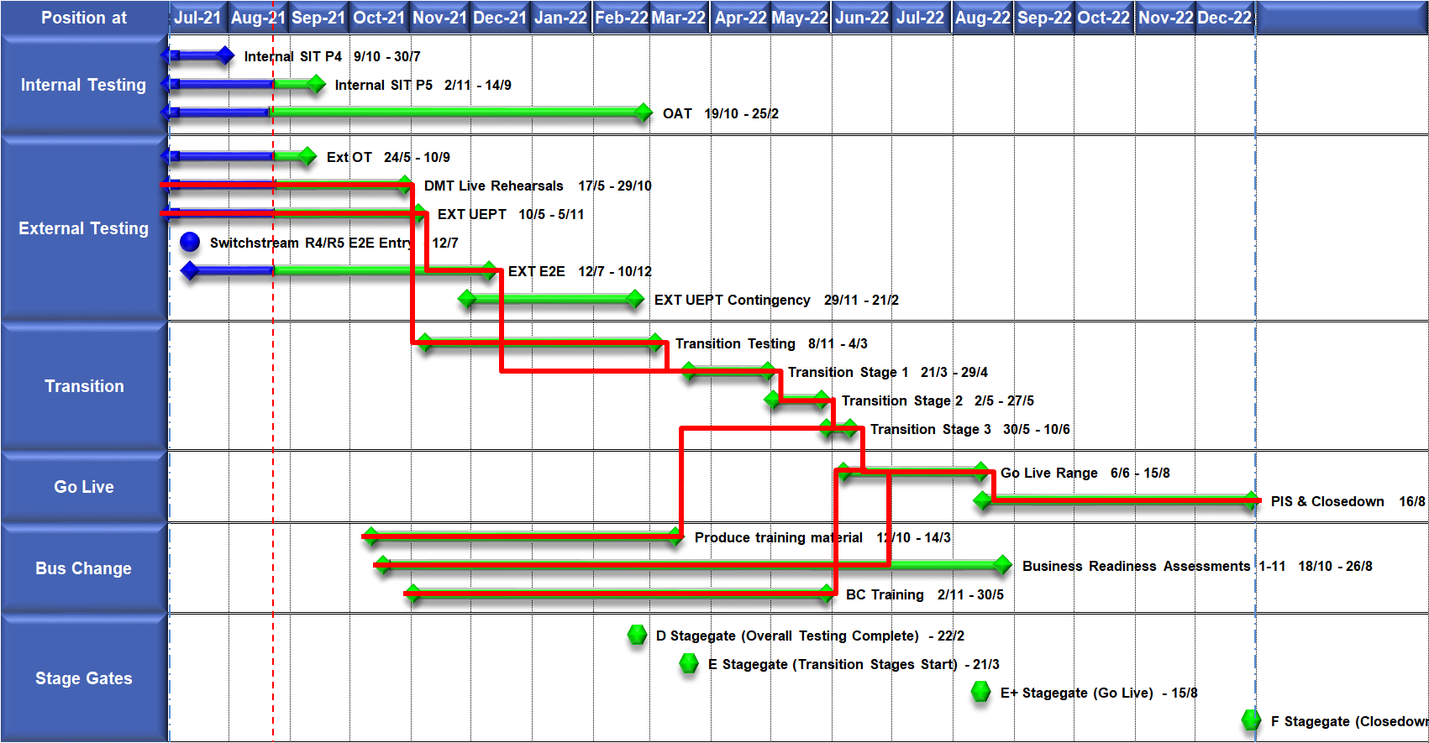
High Level Plan

Slide 39
Switching Programme CR Position – CRs impacting Xoserve
CR Name | CR Ref | High Level Cost IA Cost | Date Raised | Status
Programme Plan Re-Baseline | CR-D002 | £0.00 | 07/11/2019 | Approved - Complete
Updates to the CSS Physical Interface Design (PhID). | CR-D008 | £17,250.00 | 22/01/2020 | Approved - Internal CR Created
CSS_Exception_Handling_Strategy_v0.2 | CR-D014 | £0.00 | 26/02/2020 | Approved - Internal CR Created
Provide_CSS_RegistrationID_to_PUI_and_LPs | CR-D016 | £12,643.00 | 07/08/2020 | Approved - Internal CR Created
Licence Exempt Network Customer Identifier – ABACUS Data Model update | CR-E51 | £0.00 | 29/10/2019 | Approved - Complete
Amendments to the DMS artefact suite | CR-D019 | £6,500.00 | 16/03/2020 | Approved - Internal CR Created
Migration of Terminated Gas RMPS | CR-D022 | £0.00 | 10/06/2020 | Approved - Internal CR Created
Amendments to the NC-0079 for REL (Retail Energy Location) Data Migration and Reconciliation | CR-D024 | £20,000.00 | 06/07/2020 | Approved - Internal CR Created
DMS - PHID Alignment Parties | CR-D026 | £0.00 | 06/07/2020 | Approved - Internal CR Created
Request For a New or Upgraded DMT Environment | CR-D027 | £256,009.00 | 07/08/2020 | Approved - Internal CR Created
Enable TLS connection pooling for all directly connected parties to CSS] | CR-D028 | £2,500.00 | 13/07/2020 | Approved - Internal CR Created
Message Header Format for PKI Certificate Identification] | CR-D029 | £2,500.00 | 13/07/2020 | Approved - Internal CR Created
SIT Functional Test Re Plan Enabling Parallel Testing | CR-D030 | £56,000.00 | 20/07/2020 | Approved - Internal CR Created
DM_Validation Catalogue_Shipper_Effective_Date_Change_ | CR-D032 | £0.00 | 03/08/2020 | Approved - Internal CR Created
Compression During Data Migration | CR-D034 | £500.00 | 09/09/2020 | Approved - Internal CR Created
Uplift to the CSS Interface Specifications | CR-D038 | £70,000.00 | 07/10/2020 | Approved - Internal CR Created
Uplift to Business Data Validation Rules | CR-D039 | £20,000.00 | 25/09/2020 | Approved - Internal CR Created
Programme Plan Re-Baseline | CR-D042 | £14,913,000.00 | 28/09/2020 | Approved - Internal CR Created
Changes to Support Energy Company Data | CR-D059 | £37,500.00 | 03/08/2021 | Awaiting Decision
Operational Choreography Detection 0.5 | CR-D060 | £308,205.00 | 25/01/2021 | Awaiting Decision
Operational Choreography Rectification 0.3 | CR-D061 | £0.00 | 25/01/2021 | Awaiting Decision
Amendment of Data Migration Solution to Protect Programme Timescales - Removal of Transition Stage 1 Delta files | CR-D062 | £83,490.00 | 25/02/2021 | Approved - Internal CR Created
Change to Management of In-Flight Switches Approach | CR-D071 | £0.00 | 15/03/2021 | Approved - Internal CR Created
Increase Cadence of Data cuts | CR-D080 | £24,600.00 | 10/05/2021 | Approved - Internal CR Created
Amendment to Assumptions as a result of analysis undertaken during CP1 v0.4] | CR-D083 | £0.00 | 24/05/2021 | Approved - Complete
TT Remediation & Paper-Based Testing Workshop | CR-D095 | £34,000.00 | 23/08/2021 | Pending PIA
Continuation of support for UEPT | CR-D098 | £308,000.00 | 03/08/2021 | Awaiting Decision
Documentation only updates to NCT-0134 DMT Live Rehearsal Test Plan and NCD-0012 Data Migration Solution Design Catalogue | CR-D103 | £0.00 | 17/08/2021 | Pending PIA
Elaborations for Service Management Requirements DB4 | CR-D104 | £0.00 | 17/08/2021 | Pending SI Response

Slide 40
Switching Programme CR Position – CRs not impacting Xoserve ((Cost Implication)
CR Name | CR Ref | Date Raised | Status
Non_Mandatory_MPAS_Metered_Indicator_v0.4 | CR-D001 | 27/01/2020 | Complete - No Xoserve Impact
REC Manager Procurement Timelines | CR-D003 | 02/12/2019 | Complete - No Xoserve Impact
MPAS Related MPAN Disconnection | CR-D004 |  | Withdrawn
Introduction of Validation Message to Logical Mode | CR-D005 | 25/11/2019 | Withdrawn
Modification of Related MPAN Cleanse Checkpoint Milestones | CR-D006 | 27/11/2019 | Complete - No Xoserve Impact
ABACUS Corrections and Re-alignments | CR-D007 | 04/12/2019 | Complete - No Xoserve Impact
ECOES REL API Webmethod | CR-D009 | 17/12/2019 | Complete - No Xoserve Impact
CSSIA Uplift to Implement IG Recommendations | CR-D010 | 17/12/2019 | Complete - No Xoserve Impact
Update 3 E2Es to align to CSSIA | CR-D011 | 10/06/2020 | Complete - No Xoserve Impact
CSS_Physical_Interface_Design_Updates_mpxn_v0.2 | CR-D012 | 30/01/2020 | Complete - No Xoserve Impact
Messaging_Requirements_Revisions_REC_Code_Manager_and_CSS_v0.1 Clean | CR-D013 | 28/01/2020 | Complete - No Xoserve Impact
Amendment_of_Xoserve_Consequential_Change_Milestone_Delivery_Dates_v0.2[DRAFT] | CR-D015 | 26/02/2020 | Withdrawn
CSS_Handling_of_MPAS_Business_Dates_v0.2[DRAFT] | CR-D017 | 20/07/2020 | Complete - No Xoserve Impact
Confirmation_Responses_to_Outbound_Synchronisations_v0.2[DRAFT] | CR-D018 | 02/03/2020 | Withdrawn
Regulatory Workstream – Programme Milestones Refresh | CR-D020 | 16/03/2020 | Withdrawn
Remove MPAS Interface | CR-D021 | 29/04/2020 | Withdrawn
DSP_Specific_ SIT_ Functional_Exit_Criteria | CR-D023 | 29/05/2020 | Complete - No Xoserve Impact
Changes to support enhanced Solar arrangements | CR-D025 |  | Withdrawn
CSS Role-based access control (RBAC) | CR-D031 | 24/07/2020 | Withdrawn
A Quality Analysis Activity of the Data being used for the DMT Non-Functional Test Phase​​ | CR-D033 |  | Withdrawn
CSS Change from UTC to Local Time | CR-D035 | 22/09/2020 | Complete - No Xoserve Impact
Xoserve CR for DES AI Removal | CR-D036 | 24/09/2020 | Complete - No Xoserve Impact
Provide_CSS_RegistrationID_to_LPs | CR-D037 | 06/10/2020 | Complete - No Xoserve Impact
UEPT Tranche Regulatory Change | CR-D040 | N/A | Complete - No Xoserve Impact
NCT-0073 Functional Script Master Changes | CR-D041 | 25/09/2020 | Complete - No Xoserve Impact
Update to the End to End Testing Plan | CR-D043 | 05/10/2020 | Complete - No Xoserve Impact
Request For a New DMT Environment for DMT Live Rehearsal | CR-D044 | 23/10/2020 | Complete - No Xoserve Impact
NC-0079 Adding Post Load Integrity Check Document | CR-D045 | 09/11/2020 | Complete - No Xoserve Impact
Uplift to the Code of Connection | CR-0046 | 09/11/2020 | Complete - No Xoserve Impact
Correctional Changes to MAD Log v2.0 & POAP v2.0 | CR-D047 | 13/11/2020 | Complete - No Xoserve Impact
Changes to Data Milestones in MAD Log v2.0 & POAP v2.0 | CR-D048 | 09/11/2020 | Complete - No Xoserve Impact
Consequential Changes to Testing Milestones in MAD Log | CR-D049 | 13/11/2020 | Withdrawn
CSS Environments for Faster Switching Enduring Service | CR-D050 |  | Withdrawn
Changes to Data Validation Rules | CR-D051 | 30/11/2020 | Complete - No Xoserve Impact

Slide 41
Switching Programme CR Position – CRs not impacting Xoserve (Cost Implication)
CR Name | CR Ref | Date Raised | Status
Additional and Further Correctional Changes to MAD Log v2.0 | CR-D052 | 05/12/2020 | Complete - No Xoserve Impact
Additional Onward Dependencies for MAD Log | CR-D053 | 18/12/2020 | Complete - No Xoserve Impact
Changing from GetOrganised to Landmark SFTP for SI receiving files | CR-D054 | 18/12/2020 | Complete - No Xoserve Impact
Amendments to the Data Cleansing Catalogue | CR-D055 | 18/12/2020 | Complete - No Xoserve Impact
MAD Log Changes for UIT Environment Verification | CR-D057 | 25/01/2021 | Complete - No Xoserve Impact
Discontinuance of Xoserve Consequential Change Market Trials | CR-D058 | 25/01/2021 | Complete - No Xoserve Impact
Uplift to SMS CoCo | CR-D063 | 29/01/2021 | Complete - No Xoserve Impact
Changes to SIT Functional Test Scenarios | CR-D064 | 29/01/2021 | Complete - No Xoserve Impact
Uplift to the Code of Connection | CR-D065 | 29/01/2021 | Complete - No Xoserve Impact
In-Flight Reg ID Dissemination | CR-D066 |  | Withdrawn
Uplift to the CSS Business Data Validation Rules Doc | CR-D067 | 19/03/2021 | Complete - No Xoserve Impact
Uplift to the CSS Interface Specification | CR-D068 | 15/03/2021 | Complete - No Xoserve Impact
REL Dissemination to iDNO and DNO | CR-D069 | 15/03/2021 | Complete - No Xoserve Impact
Removal of UEPT Stage 1 Data Allocation and Verification for Tranche 3 and 4 Participants and delivery acceleration of Stage 2 Data Allocation | CR-D070 | 05/03/2021 | Complete - No Xoserve Impact
Re-align Switching Programme Response SLAs with Xoserve response SLAs | CR-D072 | 07/05/2021 | Complete - No Xoserve Impact
Changes to MAD Log v2.2 to rectify incorrect milestone descriptions | CR-D074 | 29/03/2021 | Complete - No Xoserve Impact
Update Service Management Baseline Requirement | CR-D076 | 20/04/2021 | Complete - No Xoserve Impact
Amend the Transition Testing Milestones TR210 & TR220 for PUI Production Data Cuts v0.4 | CR-D078 | 14/05/2021 | Complete - No Xoserve Impact
Removal of SMS005 from UEPT Test Scenarios v0.2 | CR-D081 | 14/05/2021 | Complete - No Xoserve Impact
Engagement for Early E2E Testing v0.2 | CR-D082 | 14/05/2021 | Withdrawn
Change to Transition Stage 3 File-Based Migration Sequencing v0.2 | CR-D084 | 26/05/2021 | Complete - No Xoserve Impact
Request for an additional Data Reconciliation Activity at the end of DMT Live Rehearsal Cycle 2 v0.2 | CR-D086 | 01/06/2021 | Withdrawn
Update to UIT E2E Plan and Artefacts to incorporate the additional scope identified on the outcome of REL Gap Analysis v0.7 | CR-D087 | 17/06/2021 | Complete - No Xoserve Impact
Elevation of L2-TR070 (Transition Stage 1 Start) to a L1 milestone | CR-D088 | 04/06/2021 | Complete - No Xoserve Impact
NC-0107 Master Handover Pack Purpose Change | CR-D089 | 04/06/2021 | Complete - No Xoserve Impact
REC Code Manager Market Intelligence Reporting | CR-D090 | 11/06/2021 | Complete - No Xoserve Impact
Removal of Transition Test Artefacts | CR-D091 | 24/06/2021 | Complete - No Xoserve Impact

Slide 42
Switching Programme CR Position – CRs not impacting Xoserve (Cost Implication)
CR Name | CR Ref | Date Raised | Status
Feasibility study on potential to update Domestic Premises Indicator (DPI) electricity flags to reflect license status during transtion stages, 1, 2 & 3 | CR-D093 | 28/06/2021 | Complete - No Xoserve Impact
Changes to Operational Testing | CR-D094 | 28/06/2021 | Complete - No Xoserve Impact
Changes to milestone date for L3-TE720 | CR-D096 | 29/07/2021 | Complete - No Xoserve Impact
Further consquential changes to DB4 and related artefacts following CR-D071 v0.2 | CR-D100 | 06/08/2021 | Complete - No Xoserve Impact
CSS Stage 1 ECOES Interface Specification Uplift to v2.0 | CR-D102 | 17/08/2021 | Complete - No Xoserve Impact
Addition of assumption on MAD Log in relation to earliest possible Go-Live date | CR-D103 | 17/08/2021 | Complete - No Xoserve Impact
Elaborations for Service Management Requirements DB4 | CR-D104 | 17/08/2021 | Complete - No Xoserve Impact
Update of the Code of Connection Document to reflect the Enduring PKI Process Updates | CR-D106 | 22/09/2021 | Complete - No Xoserve Impact
Addition of assumption on MAD Log in relation to earliest possible Go-Live date | CR-D107 | 15/09/2021 | Complete - No Xoserve Impact
Change to Data Migration and Transition artefacts following the completion of CR-D093 | CR-D108 | 15/09/2021 | Complete - No Xoserve Impact
Change to EES requirements to bring REL search and retrieval into closer alignment with GES and assessment of programme | CR-D109 | 15/09/2021 | Complete - No Xoserve Impact
Changes and additions to PIWG and CWG governed MAD Log v2.4 milestones to address timing and clarity issues | CR-D110 | 22/09/2021 | Complete - No Xoserve Impact
Transition Stage 1 – CSS ad-hoc data removal solution development based on Source Data Provider in response to DI-1655 remedial solution] | CR-D111 | 14/10/2021 | Complete - No Xoserve Impact
End to End Test Exit Criteria refinement and clarification of the decision making process | CR-D112 | 01/10/2021 | Complete - No Xoserve Impact
Update to E2E Transition Inflight Switches Management Approach Document | CR-D116 | 27/10/2021 | Complete - No Xoserve Impact
Operational Change Window and Type | CR-D117 | 25/10/2021 | Complete - No Xoserve Impact
Change to effect a Gas Supplier of Last Resort (SoLR) | CR-D118 | 03/11/2021 | Complete - No Xoserve Impact
GES Data Refresh SLA | CR-D119 | 10/11/2021 | Complete - No Xoserve Impact
Updates to NCT-0188 REL Testing Gap Analysis Report | CR-D120 | 10/11/2021 | Complete - No Xoserve Impact

