Slide 1

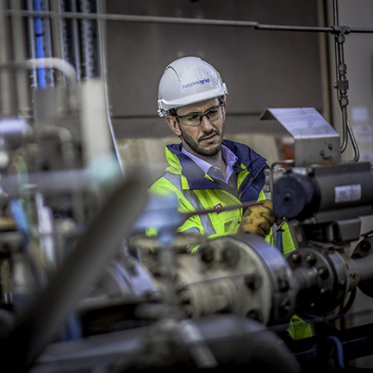

NTS Specification for Mercury
  Transmission Workgroup
  6th January 2022

Slide 2
Background
  Since the LNG storage sites closed, mercury content has not been a concern for NTS assets
  We have recently received enquiries from upstream operators about what level we would regard as acceptable
  Our understanding is that a limit of 10 μg/m³ is typically specified for heat exchangers in industrial and power plant which are often constructed of aluminium alloys
  We therefore included a guidance limit in the latest Gas Ten Year Statement of 10 μg/m³ although we do not at present specify a limit for mercury content in our connection agreements with NTS terminal operators
Notes:
A of up to 0.01μg.m-3 was factored in when liquefaction was taking place on the NTS due to gaseous Hg condensing out and potentially damaging aluminium based cryogenic heat exchangers (LNG Sites).

Slide 3
GS(M)R Requirements
GS(M)R does not contain a specific limit for mercury content in natural gas
Rather it is included within the following statement on impurities
“[the gas conveyed] shall not contain solid or liquid material which may interfere with the integrity or operation of pipes or any gas appliance (within the meaning of regulation 2(1) of the 1994 Regulations) which a consumer could reasonably be expected to operate”.

Slide 4
Proposed Next Steps
We are therefore interested to know whether mercury content in natural gas presents any risks to customers’ operations downstream of the NTS and, if so, at what concentration
We propose to issue a short on-line questionnaire to the industry later in the month to obtain feedback and inform our next steps on this topic
For any queries, please contact either Philip.Hobbins@nationalgrid.com or nicola.lond@nationalgrid.com

