Slide 1
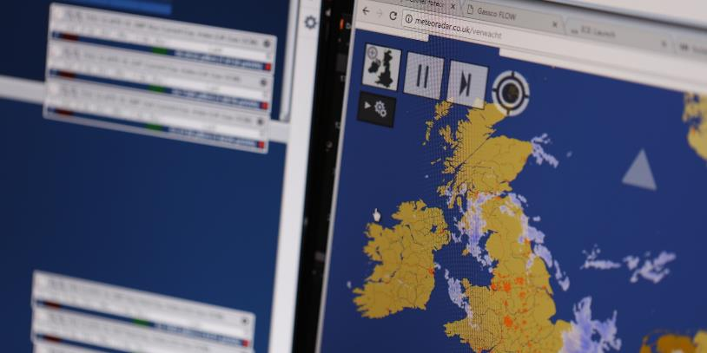
GS(M)R Review Transmission Workgroup 7th April 2022

Slide 2
Summary of NGG Response to HSE Consultation
We supported the proposed changes to the gas quality specification, subject to HSE’s final impact assessment demonstrating a net benefit
We expect a reduction in the lower limit for Wobbe Index to reduce the costs of bringing gas to market for some players and to encourage diversity and resilience of UK gas supplies
We do not expect material NGG implementation costs, although some compressor works may be needed depending on actual gas quality variability
We see merit in retaining Regulation 2(4) which underpins our gas quality management arrangements at NTS entry points
We support consistency in the treatment of pipelines connecting facilities to the NTS/GDN networks under GS(M)R
We think it best not to link network operation to operation of the emergency call handling service
Notes:
Consistency point = biomethane with other connecting pipelines, also an opportunity to clarify the status of interconnectors – on or off the network. Questioned the merit of including biomethane connecting pipelines specifically; what benefits would it bring and is it consistent with other connecting pipelines?
But agree to extend duties of cooperation with the NEC to biomethane producers and LNG terminals

Slide 3
Implementation Planning Update
We are currently seeking views from NTS entry terminal operators about whether a reduction to their lower Wobbe Index limit would be of interest
Where terminal operators indicate this change would be beneficial, further information on volumes and timescales will be sought, as suggested by the Workgroup
Amendments to the Wobbe Index lower limits between NGG and the Bacton interconnector operators may be a pre-requisite for reductions at other NTS terminals
Engagement with Interconnector, BBL and NW EU TSOs has begun to explore the continental change requirements that will be needed to facilitate this

