Slide 1
Change Pipeline

Slide 2
Change Development & Delivery Pipeline (DSC Change / Minor Release Budget)
* Pre-capture may contain changes that won’t require delivery / funding

Slide 3
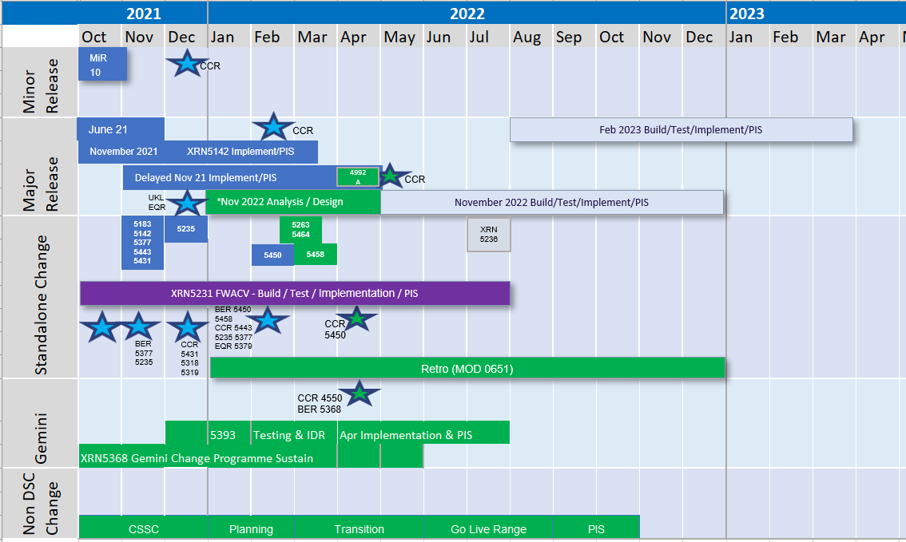
2021-2022 DSC Change / MiR Pipeline
Key:
Approval on track
Approved
Approval at risk
Key:
On Track
Potential Activity
Complete
Potential risk to plan
Plan At Risk
Planning

