Slide 1
DPM Update
April 2022
Contract Management Committee

Slide 2
DPM ‘For Information’ Changes
At Jan 22 CoMC:
We agreed the need to keep the DPM / DAM aligned in readiness for REC v3 Go Live
This will help with Transition for when we want to split the DPM / DAM
Ensure that the DPM / DAM is correct for CSS Go Live
We indicated that changes to the DPM that were as a result of projected changes to the DAM we would send these to CoMC as ‘For Information’
At Feb 22 CoMC:
We added additional rows to the DPM / aligned these to existing UNC data items
Elaborated the functionality introduced at CSS Implementation Date around release of REL data and CSS Registration information
Agreed that the PAFA data would continue to be managed under the DPM
At Mar 2022 CoMC:
We under took some minor changes to: Align DPM to CSSC Changes; amend Conditionality statements in DPM to align to DPM Conditionality Documents; some other minor housekeeping changes

Slide 3
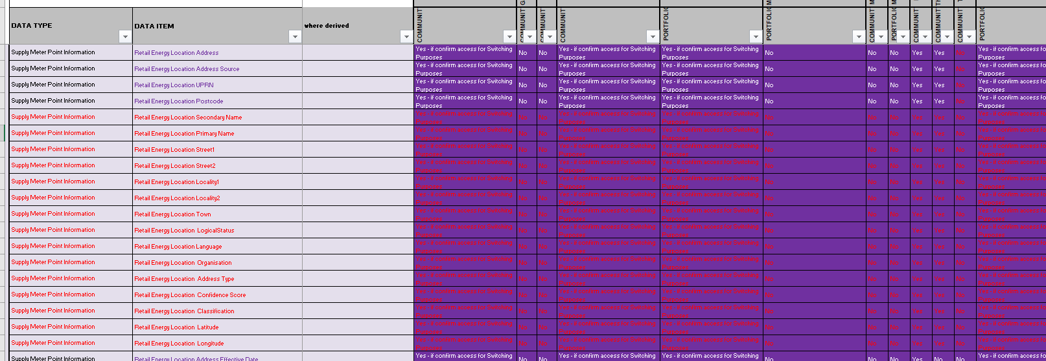
DPM ‘For Information’ Changes
RECCo requested that the REL Data Items are individually named – we had concatenated a number into ‘REL Address’ – these are now shown individually:

Slide 4
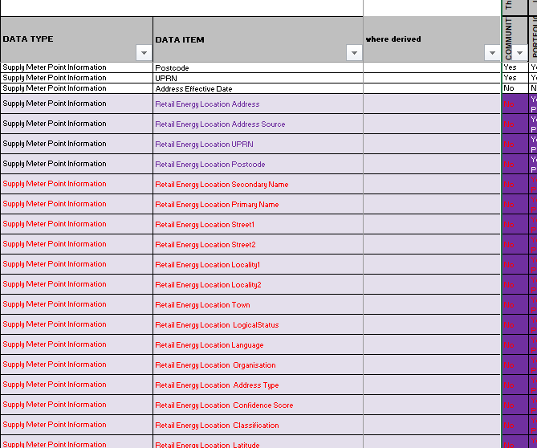
DPM ‘For Information’ Changes
Previously had granted “The parties given the power of investigation and consumer issue resolution” would receive REL data – but as this is not for Switching this has now been set to ‘No’…

Slide 5
DPM ‘For Information’ Changes
Provided no issues with the above – this will be published as v20

