Slide 1
DSC Service Lines Update
Change Management Committee
June 2022

Slide 2
DSC Service Lines
Mod 0804 Consultation closed out on 1st April 2022 – no detailed comments raised regarding the UNC drafting
Stable version of the SCR text against which to assess the DSC Service Lines
Change raised with Change Management Committee – 28th April 2022 – with a view to seeking approval at the May Contract Management Committee
Propose 10 New Service Lines due to CSS – NB: plus further Service Line related to 0728B CNCCD
Moving of 1 Service Line from Direct Service Code Services to Agency Services Non Code
Amendments to a large number of Service Lines to reflect new Code References / terminology change for CSS Supply Points
Amendments to ‘Agency Services GT and IGT - Non-Code’
Deletions of 5 Agency Services GT Non Code Service Lines, and 2 from ASIGTNC
New Service Lines will be required
Amendments to ‘Specific Services’
Deletion of some existing Service Lines

Slide 3
DSC Service Lines
It is planned that this change will be approved at the June CoMC

Slide 4
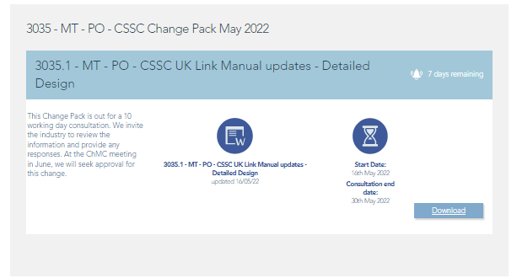
Why is this relevant to ChMC?
When we are making changes to the Service Description Table we raised a change, XRN5505, and this was presented to this Committee ‘for information’
This change is slightly different, we have also circulated three documents in the Change Pack on 16th May 2022 (3035.1-MT-PO- CSSC UKLM Updates) – two of which are relevant to the SDT documentation as the UKLM is cross referenced
UKLCD1 - Code Communications Reference
UKLBD2 UK Link IS Service Definition
These documents sought to consistently define:
the SLAs
the maximum design volumes for the new processes

Slide 5
Why is this relevant to ChMC?
An amendment to the version of the document issued in the 16th May change pack was communicated on 25th May…
This sought to clarify the SLA end time (in addition to the start time that we had already defined):

Slide 6
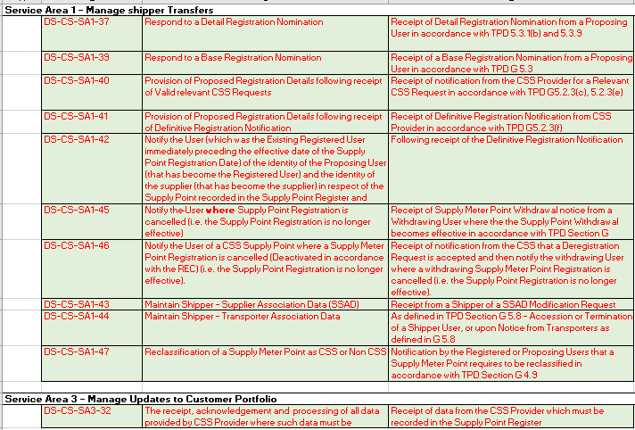
Direct Services Code Services
Following CSS DSC SLs are proposed:

Slide 7
Direct Services Code Services
Further Service Line added as a result of 0728B to reflect the CNCCD:
Following DSC Service Line is proposed to be moved to Agency Services Non Code:

Slide 8
Agency Services GT / IGT - Non-Code
A number of new obligations are placed on the CDSP as the GRDA in the REC, expect that we will require New Service Lines to reflect these
We think that this is the correct approach:
Non Code as it’s REC, not UNC
[Doing these activities to ultimately meet your obligation in the Licence]
[Consistent with where other REC Obligations reside]
Proposed Deletions from the Agency Services GT/IGT Non Code
RDP File removal
SPAA Schedule 23 / REC Transition Schedule DES Services

Slide 9
Agency Services GT/IGT - Non-Code
Proposed Service Lines:
Notification of Registerable Metering Point Data to CSS
RMP Creation / move into scope of CSS
MPL Address Change detail
RMP Status Notification – incl Transformation of MP Status / Isolation Status / Meter Status
Provision of [Regulatory Alliance] Data to CSS - (collated by the CDSP under the UNC as Shipper-Transporter Alliance Data G 5.8)
Provision of a Registration Block Notice or Withdrawal of a Registration Block Notice – following update by Transporter (G5.8 / V3.3.29(c) / S3.5.3)
Provision of [Commercial Alliance] Data to CSS - (collated by the CDSP under the UNC as Supplier-Shipper Alliance Data G 5.7)
Notification of Supplier Agent Appointment to CSS
MEM [and MAP] data to CSS
Reporting on GRDA Performance for REC Performance Assurance Board
Receipt of messages by GRDA from CSS

Slide 10
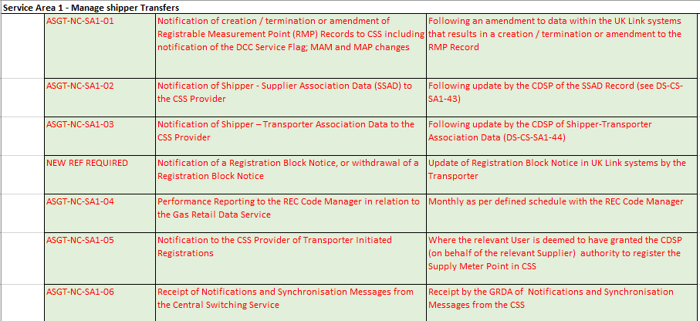
Agency Services GT/IGT - Non-Code
As above - Proposed Service Lines:

Slide 11
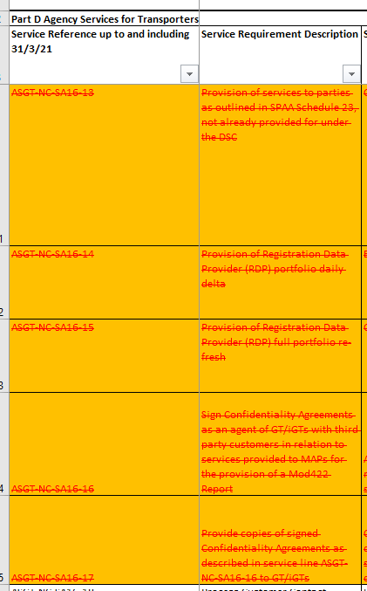
Agency Services GT/IGT - Non-Code
Service Lines proposed for deletion:
Reference to SPAA Schedule 23 can be removed – other ‘Information Services’ have retained Service Lines**
RDP File to DCC is being decommissioned
Xoserve was required to execute confidentiality agreements – as responsibility transfers to REC (RECCo) then this is not relevant to be retained**
** - An equivalent Agency Services IGT Non Code Service did not exist

Slide 12
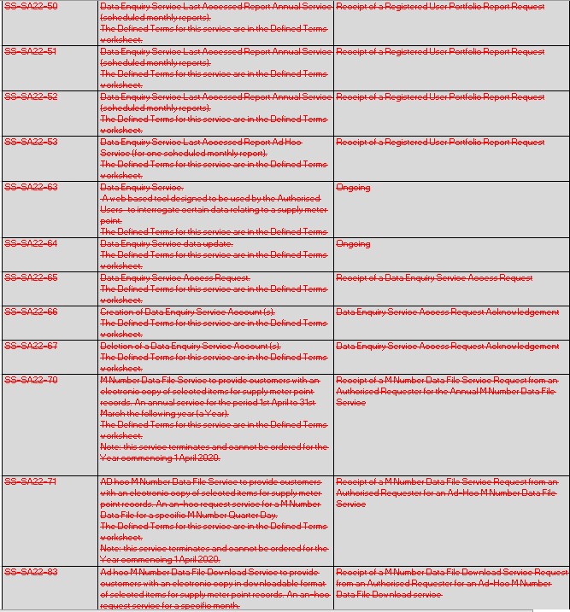
Specific Services
To reflect the movement of services into the Gas Enquiry Service the following lines are proposed to be deleted:
Please note that this includes the MNumber Data File Service.

Slide 13
Questions?

