Slide 1
14 June 2022
Performance Assurance and Code Reforms
Jon Dixon - RECCo

Slide 2
Introduction
The BEIS/Ofgem Code Reforms aim to make energy industry governance more responsive to strategic energy policy:
Ofgem to act as a strategic body, within parameters set by BEIS;
Ability of Ofgem to change industry codes directly where necessary;
Day to day decisions to rest with an empowered Code Manager, rather than Panel’s;
Industry parties to engage via stakeholder advisory forums.
Although the original rationale for reforms stem from the need for coordinated and/or expedited change, policy with respect to panels was extended to performance assurance:
“where an industry panel has an existing decision-making role in monitoring compliance, for example through a performance assurance regime, or in events of default, responsibility for such decisions would move to the code manager”.
April 2022 decision document is not explicit on performance assurance, focusing more on appeals against code manager decisions, but no indication that policy intent has changed.

Slide 3
Role of Performance Assurance Board (PAB) under REC
The RECCo Board has established the PAB and may from time to time, delegate additional powers, rights or responsibilities to the PAB.
The PAB is assigned functions and responsibilities either directly by the REC, with reference to the Performance Assurance Schedule or as required by the RECCo Board. These include:
contributing to the development of, and deciding upon REC Change Proposals that relate to performance assurance
assessing retail risks and issues relating to REC Parties and REC Service Providers
making Risk Management Determinations in accordance with the Performance Assurance Framework (PAF) and Performance Assurance Techniques (PATs)
determining appeals or disputes against outcomes of Qualification/Maintenance of Qualification
responsibility for specifying REC Party, Non-Party REC Service User and REC Service Provider security and data protection requirements under the REC.

Slide 4
PAB membership
REC Parties:
• Three member(s) nominated by Parties who are Gas Suppliers and/or Electricity Suppliers;
• One member nominated by Gas Transporters;
• One member nominated by Distribution Network Operators; and
• One member nominated by Meter Equipment Managers.
Other Voting Members:
• One member nominated by the BSC Performance Assurance Administrator;
• One member nominated by the UNC Performance Assurance Framework Administrator;
• One consumer representative, being either an employee or a nominee of Citizen’s Advice or Citizen’s Advice Scotland; and
• Three independent performance management experts who shall be appointed by RECCo for this purpose.
Plus: non-voting chair, secretariat, subject matter experts as required (standing invitation for Ofgem).

Slide 5
The Role of the Code Manager
The Code Manager will monitor performance of:
market participants (REC Parties and non-party users of REC services); and,
service providers.
They use dynamic risk assessments and analysis to help drive improvements to existing code process and potentially to identify wider market improvements – which could be integrated into the REC via a Change Proposal.
supporting the running of the PAB;
performing market monitoring and REC Party compliance audits;
administering the REC Party entry and exit process on behalf of the PAB;
undertaking performance assurance over the REC Service Providers.
PAF Core Components
Performance
Assurance
Methodology
(
PAM
)
Retail Risk Register
Performance
Assurance
Techniques (PATs)
Performance
Assurance Report
Catalogue (PARC)

Slide 6
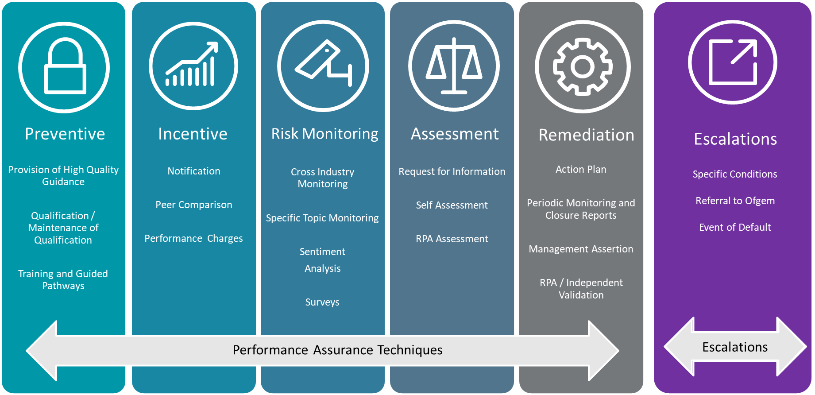
Performance Assurance Techniques
In response to high, or increasing, risk scores the PAB can use Performance Assurance Techniques.
Each month the Code Manager will review performance data to decide which techniques to apply. This is referred to as the risk management determination process.
The Code Manager can apply one of 17 Performance Techniques, and 3 escalations, as set out below.

Slide 7
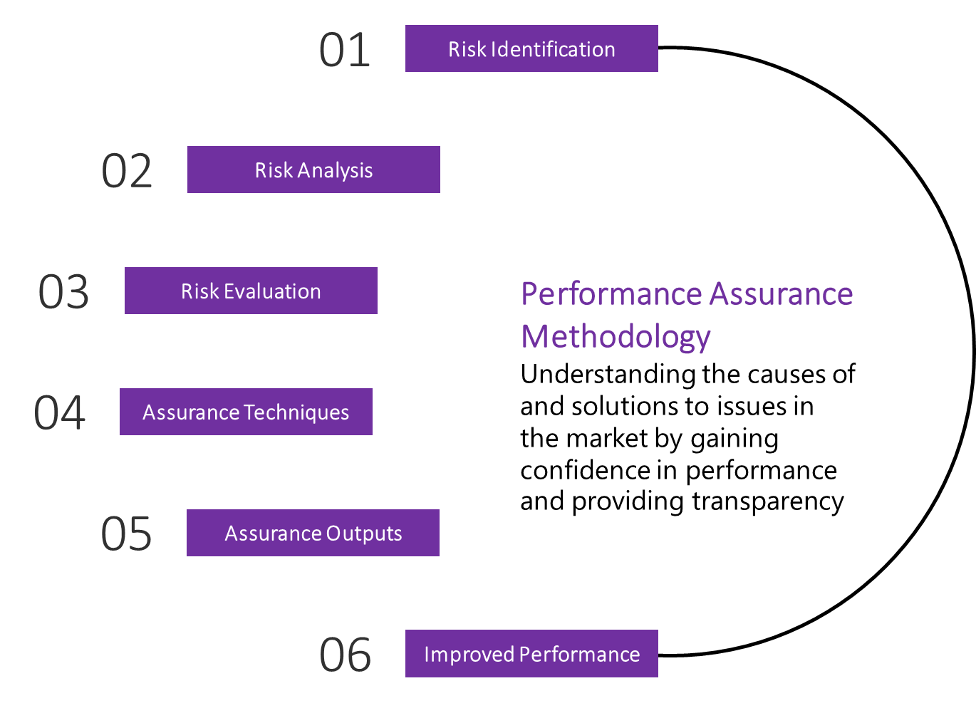
Performance Assurance Framework
Risk-based and data-driven approach, allied with market intelligence to determine appropriate response:
Measurement of the risks in the Risk
Register
Individual Party
Whole market
Performance
performance
Information from
Contextual
Performance
Risk Management
information on
Assurance
Determination
individual
Techniques
Parties
Techniques Applied

Slide 8
Near-term: closer collaboration
While the Code Reform may result in further code consolidation, this will be several years away (and very unlikely to result in full consolidation) – the industry needs better integration now;
Cross-code collaboration is continually improving, and generally does not require code changes to allow it;
BSC PAB and UNC PAFA members of and advise REC PAB (may extend to SEC if a PAF is established under that code);
Risk should be tackled at source – which may involve a process governed elsewhere in the supply chain/best placed to manage it, e.g.:
could risks associated with meter reading/installation (conversion factor, etc) be further mitigated through PATs applied to MEMs rather than shippers?
looking at possibility of backing-off supplier Deeds of Undertaking within REC.
Risk Registers could be consolidated/aligned (but retaining separate responsibilities):
improve visibility and access for parties;
reduce duplication of reporting;
increase verification of data and cooperation between PA bodies.
Better data sharing:
RECCo working with CDSP to fulfil intent of UNC Mod734 (theft reporting);
Match supplier meter read performance (for billing purposes) against submissions into settlement;
Considering an MoU to facilitate general data sharing for codified performance assurance purposes (avoid duplicate reporting);
Possibility of ‘whole of system’ dashboards
Single coordinated market entry process fulfilling all code/ licence requirements – and ability to effectively ‘pause’ at Ofgem mandatory review thresholds:

Slide 9
Longer term: scope of Performance Assurance
Engineering Standards:
The Codes Reform proposes to appoint one or more Code Managers to oversee engineering standards. Not obvious what this may mean for gas, as document referred largely to electricity Distribution Code, Grid Code and SQSS while excluding IGEM from scope. However, it is possible that some elements may move from traditional GT oversight to that of a Code Manager.
Information Systems:
The four central system delivery functions previously identified in consultation will be captured within the scope of the Code Reforms:
gas industry arrangements undertaken by Xoserve - (UNC);
balancing and settlement arrangements undertaken by Elexon - (BSC);
service delivery for smart metering undertaken by DCC – (SEC) and;
data transfer services undertaken by electralink – (DTSA).
Scope expected to extend to:
Central Switching Services – (REC), and,
MHHS Data Integration Platform - (BSC).
Implications:
it is not yet certain (though seems logical) that the oversight of the engineering standards and IS protocols will remain with the same Code Manager that oversees the relevant market rules and commercial arrangements;
any performance assurance function will need sufficient expertise (and leverage) to assure these specialised functions.

Slide 10
Conclusions
The timetable for proposed Code Reforms is unclear, will likely be prolonged and subject to competing parliamentary priorities:
to the extent the direction of travel is clear, some of the proposals can be embraced under existing governance – we can get on with it;
Original concern over Panel decision-making was vested interest over (and therefore potential to stymie) change – this has been extended to performance assurance - however we expect that there will continue to be a role for bodies such as the REC PAB and UNC PAC:
regulation is unlikely to prescribe how Code Managers should reach decisions;
a proxy measurement of stakeholder support remains likely to be needed, if only as filter for appeals;
clear Terms of Reference will continue to be needed on role of any groups, including extent of decision-making or ability to recommend as an ‘advisory forum’, and where powers stem from (i.e. may be explicitly from licensed Code Manager rather than code), ensuring clear accountabilities;
constitution of groups may need to demonstrate balance – greater use of non-party experts and other stake-holder representatives, alongside parties (not a ‘Panel’ by another name);
Service Providers will be brought within scope of performance assurance (if they are not already) - through oversight of matters such as SLAs, change delivery, etc;
Code Managers will need (amongst other things):
clear objectives (not least, to assess whether more appropriate to instigate change rather than enforce BAU, if not linked to strategic direction, etc);
appropriate access to data;
sufficient resource and expertise to discharge requirements of their particular code(s);
effective performance assurance techniques;
adequate support from code parties and the regulator.

