Slide 1
General Change Budget BP23

Slide 2
Guiding Principles
General Change (formerly called ‘UNC Change’) is an investment budget that iteratively funds UNC, REC and DSC Changes, once approved for delivery in ChMC
Investment funds are only utilised from design phase onwards (via approval of EQRs) and also cover build/test/implement/PIS phases (via approval of BER) for major release or standalone change delivery
Regulation-driven change (UNC, REC) is prioritised as per DSC Change Management procedures 46768906.01 (gasgovernance.co.uk)
Unutilised funds rebated at end of financial year

Slide 3
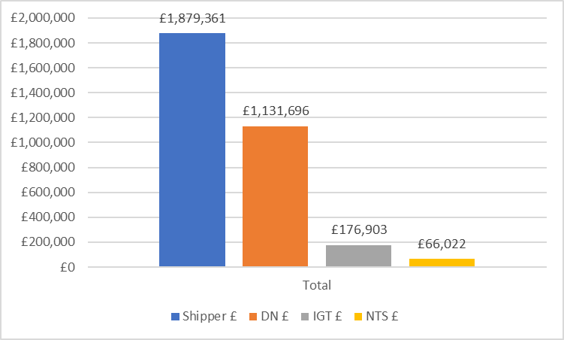
Proposed Budget
Proposed total budget is the same size as in BP22
Calculation based on major release bandwidth, historic trends / costs and a provision for REC change development above and beyond ‘BAU’ levels of regulatory change post CSSC implementation

Slide 4
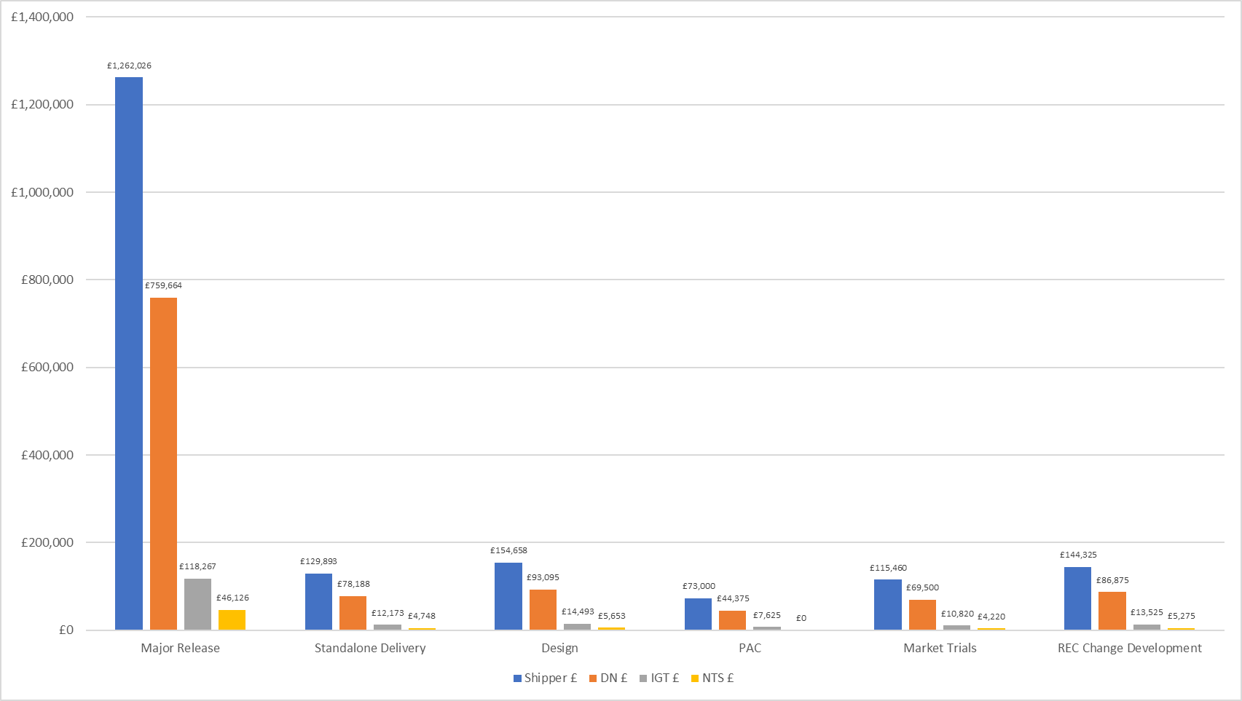
Breakdown
Same as previous years, except with the introduction of ring-fenced ‘Design’ pot for transparency and to support ‘factory model’ of design activity
Cost splits the same as in BP20 and BP21:
PAC funding split |  | 58.4% | 35.5% | 6.1% | 0%
All other categories funding split |  | 57.7% | 34.8% | 5.4% | 2%

Slide 5
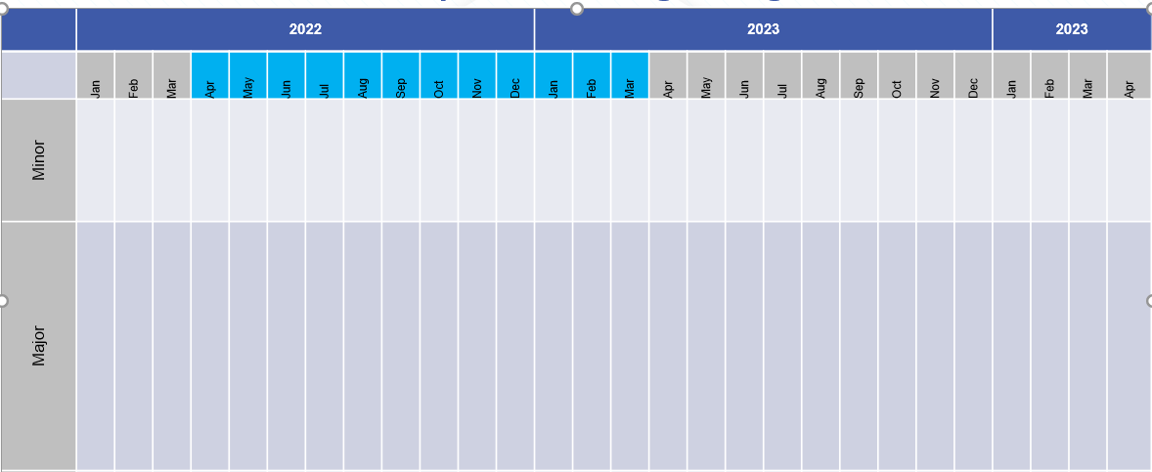
Release bandwidth & impacts to budget BP23
2023
2024
2025
2023
2024
2025
Standalone*
MiR 12
XRN
XRN
XRN
XRN
XRN
Costs for release or individual changes are considered committed upon approval of EQR/BER
Major release costs based on average cost of previous releases (£0.8m)
F23
Build/Test / Imp
PIS
Build/Test
PIS
J23
Build/Test /Imp
PIS
Major Release
F23
Build/Test
PIS
N23
Build/Test/Imp
PIS
J23
Build/Test
PIS
F24
Build/Test/Imp
PIS
Build/Test
N23
PIS
J24
Build/Test/Imp
PIS
Design
N24
Build/Test /Imp
PIS
Develop
Key
Activity
BP23 Delivery Budget Impact
Design
Design
Design
Development
Develop
No £ Impact to BP23
BP22 Delivery Budget Impact
* Standalone for illustration only

Slide 6
Design approach
We have optimised the CDSP design process, so it’s a more efficient process for customers that leads to smarter release planning outcomes

Slide 7
Timeline for next steps
BP23 Principles and approach doc published for customer consultation
2nd draft presented to ChMC incorporating feedback from customers
Discussion with constituency groups
New budget goes live
BP consultation iterative draft process
Jun-22
Jul-22
Aug-22
Sep-22
Jan-23
Apr-23
BP approval
Initial draft of General Change Budget presented to ChMC for feedback / discussion
Final draft presented to ChMC for recommendation into BP23
Key
Wider BP events
GC Budget Specific events

Slide 8
General Change Budget BP22 YTD (July 2022)

Slide 9
Budget v Committed Spend BP22
The Change Budget can be found here

