Slide 1
General Change Budget BP22 YTD

Slide 2
Forecasted Year End Spend (BP22)
The graph below illustrates the current forecast for financial year-end utilisation of the General Change investment budget (BP22) – this is subject to change should ChMC approve further change delivery
Committed spend has increased since last month by £0.8m - £0.1m adjusted following approvals in Aug-ChMC and £0.7m for illustrative / forecasting purposes (embedded spreadsheet provides XRN-level detail)

Slide 3
General Change Budget BP23

Slide 4
Guiding Principles
General Change (formerly called ‘UNC Change’) is an investment budget that iteratively funds UNC, REC and DSC Changes, once approved for delivery in ChMC
Investment funds are only utilised from design phase onwards (via approval of EQRs) and also cover build/test/implement/PIS phases (via approval of BER) for major release or standalone change delivery
Regulation-driven change (UNC, REC) is prioritised as per DSC Change Management procedures 46768906.01 (gasgovernance.co.uk)
Unutilised funds rebated at end of financial year

Slide 5
How does this relate to previous investments?
The purpose and size of the investment has remained relatively static over the last three BPs as the graph below shows. The proposed budget in BP23 is £3.5m
Previous BPs included investment associated with Decarbonisation and Minor Release. From BP22 Decarbonisation was communicated as its own investment and Minor Release moved into Operate. Only elements that have been consistently applied across the period depicted in the graph below have been included for comparison)

Slide 6
Breakdown per element / constituency
The shape of the investment has evolved. As with BP22, there is a continued need to ring-fence funds to cover the following items:
Cost splits the same as in BP20 and BP21:
PAC funding split |  | 58.4% | 35.5% | 6.1% | 0%
All other categories funding split |  | 57.7% | 34.8% | 5.4% | 2%

Slide 7
Plan v investment
The graph below depicts how maximum utilisation of the budget could be committed through the course of the BP:

Slide 8
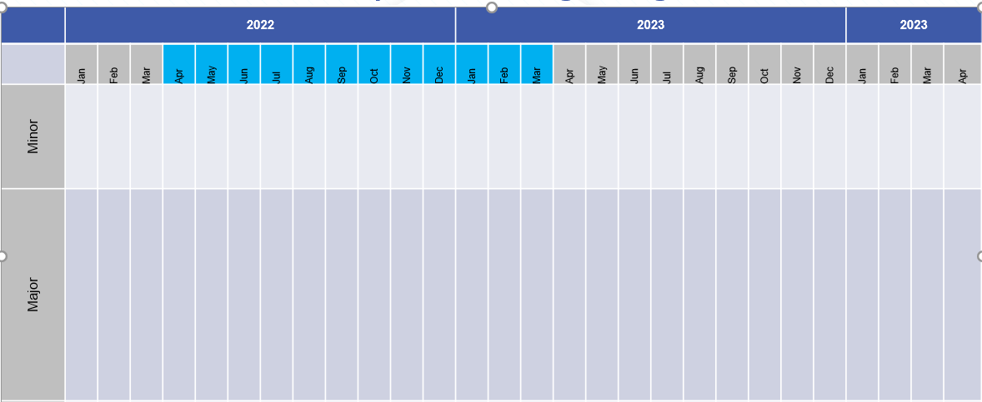
Release bandwidth & impacts to budget BP23
2023
2024
2025
2023
2024
2025
Standalone*
MiR 12
XRN
XRN
XRN
XRN
XRN
Costs for release or individual changes are considered committed upon approval of EQR/BER
Major release costs based on average cost of previous releases (£0.8m)
F23
Build/Test / Imp
PIS
Build/Test
PIS
J23
Build/Test /Imp
PIS
Major Release
F23
Build/Test
PIS
N23
Build/Test/Imp
PIS
J23
Build/Test
PIS
F24
Build/Test/Imp
PIS
Build/Test
N23
PIS
J24
Build/Test/Imp
PIS
Design
N24
Build/Test /Imp
PIS
Develop
Key
Activity
BP23 Delivery Budget Impact
Design
Design
Design
Development
Develop
No £ Impact to BP23
BP22 Delivery Budget Impact
* Standalone for illustration only

Slide 9
Timeline for next steps
BP23 Principles and approach doc published for customer consultation
2nd draft presented to ChMC incorporating feedback from customers
Discussion with constituency groups
New budget goes live
BP consultation iterative draft process
Jun-22
Jul-22
Aug-22
Sep-22
Jan-23
Apr-23
BP approval
Initial draft of General Change Budget presented to ChMC for feedback / discussion
Final draft presented to ChMC for recommendation into BP23
Key
Wider BP events
GC Budget Specific events

